Slide 1
The School District of Okeechobee County - Legislative Priorities
Special Facilities
Extended School Day
Accountability

Slide 2
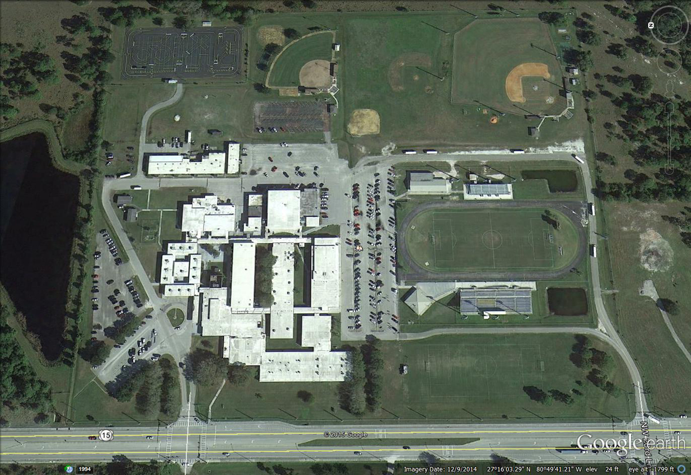
Special Facilities

Slide 3
Special Facilities Construction Account
Section 1013.64(2), F.S.
Specific Legislative Appropriation
Project Must be Critical Need & In Survey
Dedicate 1.5 Mills for Three Years
Application Deadline: August 1

Slide 4
Issues and Concerns
Technology
Electrical
Elevation / Drainage / Flooding
Exterior Mold
On-site Full Time Maintenance Staff
Plumbing
Security Improvement
Telephone System Upgrade
Fire Detection Upgrades
Asphalt Needs
Life Expectancy of Roof < 5 years
Handicapped Accessible
Lighting
Capacity Issues in Lecture Hall and Cafeteria

Slide 5
Value of 1.5 Mill
 |  | 2014
 |  | Per Capita | 2014
 | School | Value of 1.5 Mill | Total Value
# | District | Levy | of 1.5 Mill Levy
1 | Monroe | $ 446.14 | $ 33,033,873
2 | Walton | $ 335.15 | $ 20,039,846
3 | Collier | $ 302.18 | $ 101,767,878
4 | Franklin | $ 221.56 | $ 2,613,054
5 | Martin | $ 191.45 | $ 28,445,885
6 | Sarasota | $ 181.93 | $ 70,431,390
7 | Palm Beach | $ 165.40 | $ 224,980,944
8 | Indian River | $ 152.16 | $ 21,447,918
9 | Lee | $ 147.51 | $ 96,395,787
10 | St. Johns | $ 145.44 | $ 30,171,271
11 | Nassau | $ 139.37 | $ 10,497,811
12 | Miami-Dade | $ 134.77 | $ 352,257,383
13 | Bay | $ 133.94 | $ 22,874,233
14 | Sumter | $ 132.78 | $ 14,755,182
15 | Gulf | $ 130.38 | $ 2,156,945
16 | Broward | $ 127.53 | $ 230,058,129
17 | Charlotte | $ 126.79 | $ 20,852,950
18 | Manatee | $ 123.55 | $ 41,950,473
19 | Okaloosa | $ 121.53 | $ 23,172,457
20 | Orange | $ 117.76 | $ 144,608,480
21 | Flagler | $ 112.34 | $ 11,134,892
22 | Pinellas | $ 104.79 | $ 97,794,540
23 | Osceola | $ 99.63 | $ 29,447,146
24 | Seminole | $ 97.33 | $ 42,540,689
25 | Duval | $ 92.74 | $ 82,546,398
26 | St. Lucie | $ 91.60 | $ 25,906,172
27 | Citrus | $ 91.09 | $ 12,825,665
28 | Taylor | $ 86.54 | $ 1,984,553
29 | Hillsborough | $ 86.20 | $ 112,219,333
30 | Volusia | $ 86.00 | $ 43,332,771
31 | Brevard | $ 84.83 | $ 46,859,776
32 | Hamilton | $ 83.89 | $ 1,203,886
33 | Lake | $ 83.81 | $ 25,958,128
34 | Leon | $ 81.62 | $ 22,959,326
35 | Hardee | $ 81.48 | $ 2,257,971
 |  | 2014
 |  | Per Capita | 2014
 | School | Value of 1.5 Mill | Total Value
# | District | Levy | of 1.5 Mill Levy
36 | Santa Rosa | $ 81.23 | $ 12,979,695
37 | Escambia | $ 78.21 | $ 23,768,565
38 | Alachua | $ 77.05 | $ 19,319,241
39 | Putnam | $ 76.23 | $ 5,528,233
40 | Hendry | $ 73.85 | $ 2,798,654
41 | Clay | $ 72.75 | $ 14,361,493
42 | Highlands | $ 72.70 | $ 7,256,880
43 | Marion | $ 70.64 | $ 23,837,291
44 | Pasco | $ 70.48 | $ 33,783,258
45 | Hernando | $ 70.08 | $ 12,261,407
46 | Glades | $ 69.40 | $ 891,983
47 | Polk | $ 67.49 | $ 42,061,014
48 | Jefferson | $ 65.06 | $ 949,717
49 | DeSoto | $ 64.70 | $ 2,227,256
50 | Levy | $ 64.31 | $ 2,602,649
51 | Okeechobee | $ 61.99 | $ 2,468,914
52 | Gilchrist | $ 58.41 | $ 984,452
53 | Columbia | $ 57.43 | $ 3,895,237
54 | Wakulla | $ 55.99 | $ 1,751,724
55 | Suwannee | $ 54.72 | $ 2,416,837
56 | Washington | $ 53.94 | $ 1,346,168
57 | Madison | $ 53.51 | $ 1,032,893
58 | Bradford | $ 50.51 | $ 1,380,110
59 | Baker | $ 48.56 | $ 1,310,703
60 | Jackson | $ 47.77 | $ 2,399,408
61 | Dixie | $ 46.85 | $ 766,232
62 | Gadsden | $ 46.02 | $ 2,213,437
63 | Lafayette | $ 45.82 | $ 398,442
64 | Calhoun | $ 44.68 | $ 652,014
65 | Liberty | $ 40.23 | $ 348,712
66 | Holmes | $ 35.72 | $ 715,193
67 | Union | $ 24.54 | $ 383,930
 | Statewide | $ 116.91 | $ 2,280,574,876

Slide 6
Special Facilities
Continue to recognize the impact of the Special Facilities Program to small and rural districts
Amend Florida Statute 1013.64(2)(a)8 to require a payback of 1.0 mill per year for three years
Advocate for replacement of Okeechobee High School during the 2017 Legislative Session

Slide 7
Extended School Day
Reduce the number of schools to 100
Fully fund the provision
Allow local flexibility in the scheduling of additional hours of instruction
Oppose any automatic second year provisions

Slide 8
Extended School Day
Free/Reduced Lunch
Minority Rate

Slide 9
The Perfect Storm – Florida’s Current Accountability System
New Florida Standards Assessment
New Cut Scores
New School Grading Formula

Slide 10
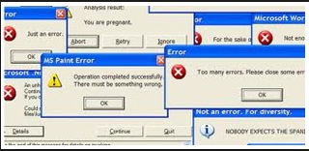
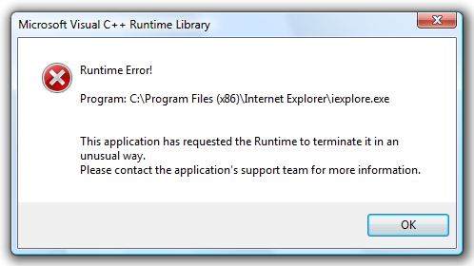
FSA Assessment
Administered for the first time in 2014-15
Significant administration problems
Testing Conditions
Cyber Attacks
Calculator Issues
Accommodation Concerns
Invalidations
Validity Study

Slide 11
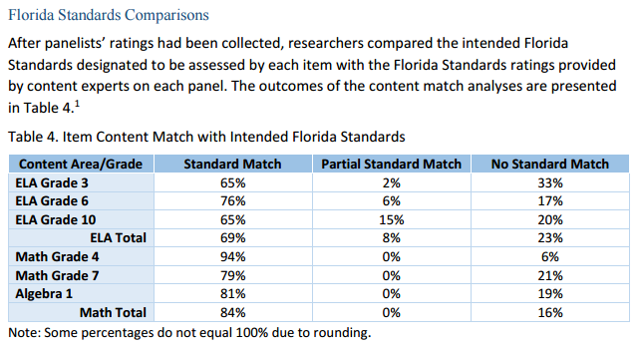
Validity Study

Slide 12
Validity Study
Are Florida’s Students Similar to Utah’s?

Slide 13
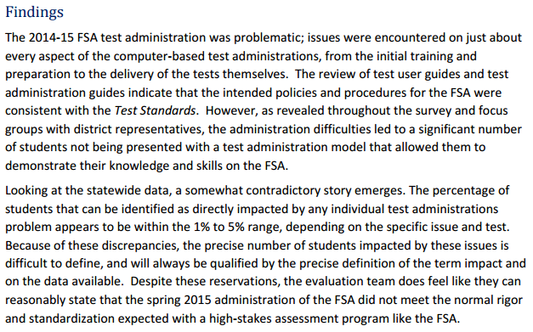
Validity Study

Slide 14
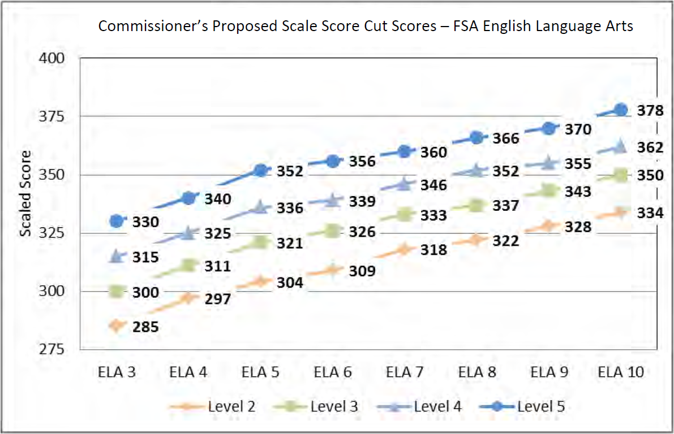
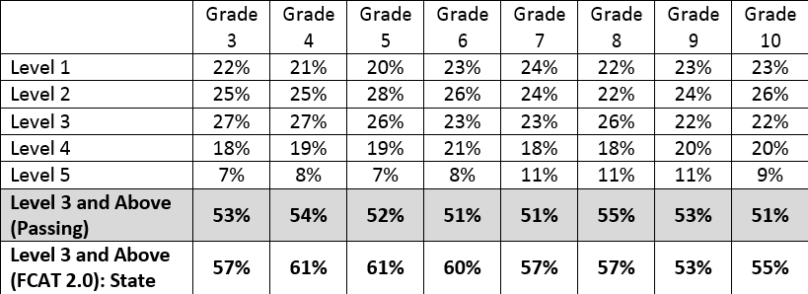
Proposed Cut Scores for FSA ELA

Slide 15
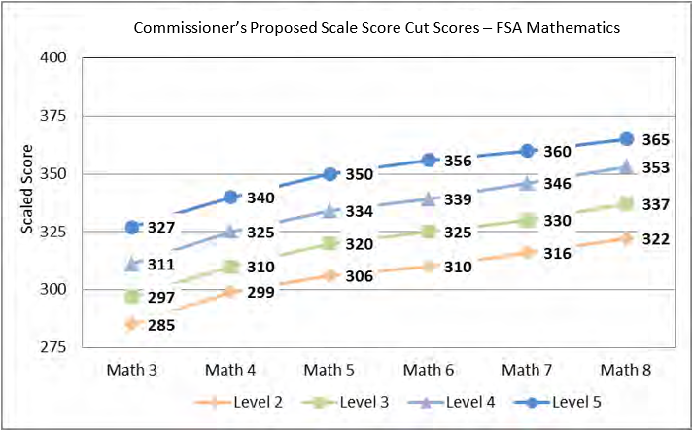
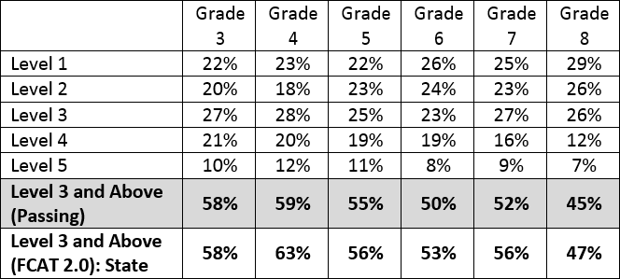
Proposed Cut Scores for FSA Math

Slide 16
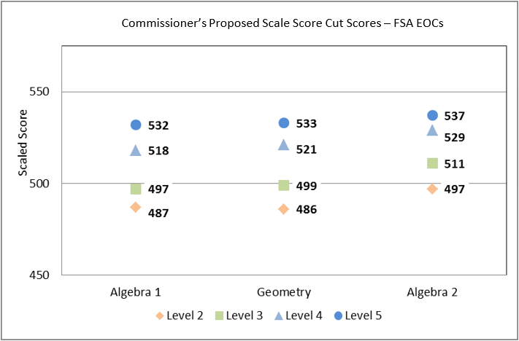
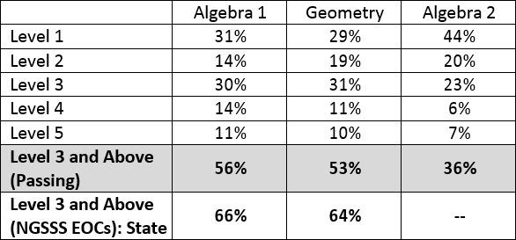
Proposed Cut Scores for FSA End of Course Exams

Slide 17
Cut Score Impacts
Grade Level | Fewer Students Scoring Proficient
3 | 8,611
4 | 13,834
5 | 17,708
6 | 17,318
7 | 11,502
8 | 3,956
9 | -
10 | 7,617
Grade Level | Fewer Students Scoring Proficient
3 | -
4 | 7,972
5 | 1,989
6 | 5,726
7 | 7,149
8 | 2,465
Algebra 1 | 20,175
Geometry | 19,459
Grade Level | Designated Non-Proficient
Algebra 2 | 101,130

Slide 18
Overall Impact of Cut Scores
In the event that the recommended cut scores are implemented, 145,480 fewer students will be proficient in English/Language Arts and/or Mathematics exams.
Not Counting Algebra II

Slide 19
Elementary School Grading Formula
English/Language Arts | Mathematics | Science
Achievement (0% to 100%) | Achievement (0% to 100%) | Achievement (0% to 100%)
Learning Gains (0% to 100%) | Learning Gains (0% to 100%)
Learning Gains of the Low 25% (0% to 100%) | Learning Gains of the Low 25% (0% to 100%)

Slide 20
2013-14 School Grades: Proficiency vs. Learning Gains
School | Percent of Proficiency Points Earned | Percent of Learning Gains Points Earned
Central Elementary | 45% | 73%
Everglades Elementary | 46% | 69%
North Elementary | 58% | 70%
Seminole Elementary | 46% | 69%
South Elementary | 39% | 68%
Osceola Middle | 40% | 63%
Yearling Middle | 40% | 64%
Okeechobee High | 57% | 59%

Slide 21
Groups Suggesting a Deeper Conversation
Florida Association of District School Superintendents
Florida Association of School Administrators
Florida School Boards Association
Multiple Local School Boards
Florida PTA
Florida Education Association
NAACP
League of United Latin American Citizens
Fund Education Now
Parents Across America - Florida
Florida Opt Out

Slide 22
Accountability
Suspend school grades for 2014-15 or issue an “I” or ”Incomplete” to all schools and districts due to inability to calculate learning gains and the results of the validity study
Mandate a “Phase in” of cut scores
Amend F.S. 1008.34 to ensure inclusion of learning gains or prohibit the issuance of grades
Recognize, through accountability calculations, the impact of socio-economic status on proficiency levels

