Slide 1
Florida Assessments for Instruction in Reading, Aligned to the
Language Arts Florida Standards (FAIR-FS)
Grades 3-12

Slide 2
Session Topics
Administration of FAIR-FS 3-12
Example of Administration
Scoring and Reports
Notes:
Presenter: “ Our goal is that by the end of the session, you will have increased knowledge of these areas: “
Present slide.

Slide 3
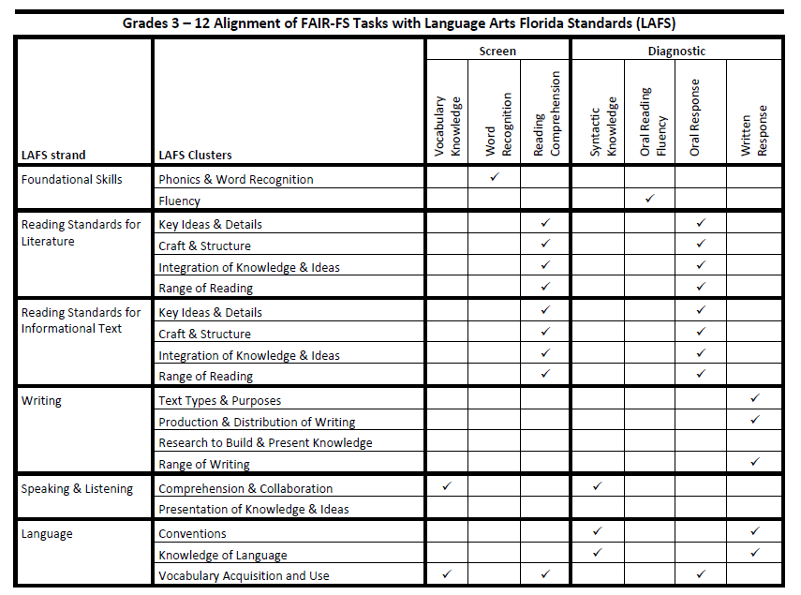
Notes:
Presenter:
“This chart demonstrates how the task items are aligned to the Florida standards.”

Slide 4
What’s New?
FAIR 2009 | FAIR-FS
Tasks
Reading Comprehension Maze Word Analysis | Word Recognition (WRT) Vocabulary Knowledge (VKT)* Syntactic Knowledge (SKT)* Reading Comprehension (RC)
RC Passage Placement
Starts with grade level passage | Ability in WRT & VKT determines initial passage
Probability of Success
Calculated based on RC & prior FCAT | Based on current RC, WRT, & VKT scores; Predicts to nationally-normed reading comprehension
Additional tools (optional)
Ongoing progress monitoring Discussion templates | Open Response Diagnostics Ongoing progress monitoring still available
4
Notes:
Present slide.

Slide 5

FAIR-FS Grades 3 – 12
(10th grade level of competency)
Administration
Notes:
Presenter:
“This section describes the new features of FAIR-FS, the system specifications, and the screening and diagnostic assessment.”

Slide 6
3-12 WAM System Specifications
Recommended Bandwidth Specifications
  External Connection to Internet
    100 kbps per student or faster
  Internal School Network
    1000 kbps per student or faster
Notes:
Presenter: “These system specifications pertain to what’s required for administering the FAIR-FS.”
Present slide.

Slide 7
3-12 WAM System Specifications
Desktop, Laptop, Netbook & Thin Client / Virtual Desktop Infrastructure
  Operating System
    Windows – XP, 7, or newer
    MAC OS – 10.7 or newer
    Linux – Linux: Ubuntu 11.10, Fedora 16 or newer
    Memory – 1gb RAM or greater
    Connectivity - Computers must be able to connect to the Internet via wired or wireless networks.
    Screen Size – 9.5 inch screen or larger
    Screen Resolution - 1024 x 768 resolution or higher
Notes:
Present slide.

Slide 8
3-12 WAM System Specifications
Desktop, Laptop, Netbook & Thin Client / Virtual Desktop Infrastructure
  Input Device Requirements
    Keyboard, Mouse
  Headphone/Earphone Requirements
    One set of headphones per computer
Notes:
Present slide.
Additional Information:
The input device must allow students to enter letters, numbers, and symbols and shift, tab, return, delete, and backspace. To meet security guidelines, each Bluetooth/wireless keyboard and/or mouse must be configured to pair with only a single computer during assessment administration.
Other assistive technologies may be needed for students requiring accommodations.
There is no requirement for microphones.

Slide 9
3-12 WAM System Specifications
Browser Specifications
  Internet Explorer (IE)
    Version 9, 10
  Chrome
    Version 32
  Firefox
    Version 26
  Safari
    Version 5.1.7
  Flash Player
    Version 10.3
Notes:
Present slide.

Slide 10
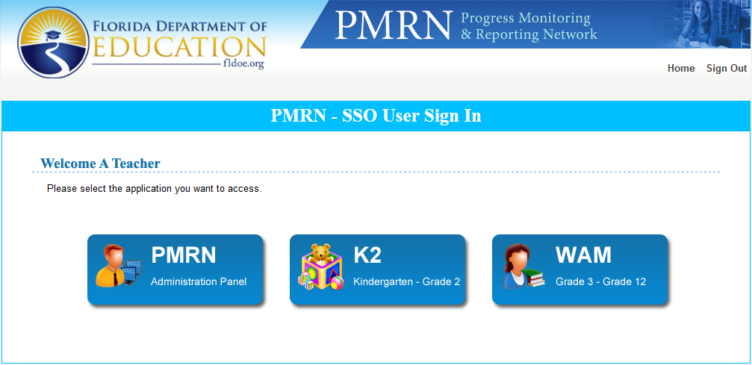
Preparing for Administration
To Access the 3-12 WAM
  Sign In via SSO Portal
  Click WAM button
Notes:
Present slide.
Presenter:
The 3-12 WAM may be accessed by:
School Level 1, 2, 3, and 4 Users
Reading and Resource Level Users
Assessment Team Members
To access the 3-12 WAM, Users must:
Sign In to the PMRN via the SSO Portal
Click the WAM button to access the 3-12 WAM SSO Manager page
For the purpose of the WAM, WAM Managers are Users that are able to generate the daily WAM Key

Slide 11
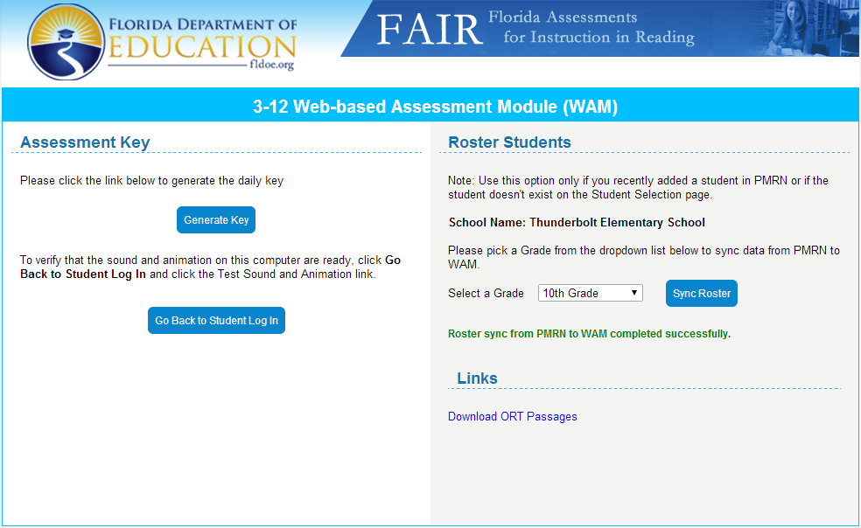
Preparing for Administration
3-12 WAM SSO Manager Page
Daily WAM Key Retrieval
  Click Generate Key button
Sync Rosters
Links
Notes:
Present slide.
Present:
SSO Users will visit the 3-12 WAM SSO Manager page via the WAM button.
Students will visit the 3-12 WAM Sign In page via the URL:
https://wam.fldoe.org
Functions that are available via the 3-12 SSO WAM Manager Page include:
The ability to generate the daily WAM Key for teachers and students using the 3-12 WAM
The ability to sync class rosters from the PMRN to the WAM to allow for the addition of students recently added to the PMRN
Links available to download and print 3-12 FAIR-FS assessment materials

Slide 12
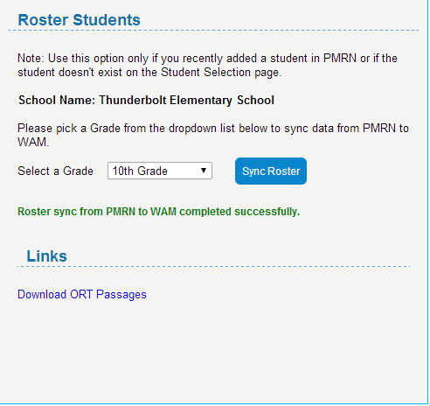
Preparing for Administration
Syncing Rosters Function
  Syncs class roster information from PMRN to WAM
WAM Manager Page
  Roster Students section
  Select grade level via drop-down menu
  Click Sync Roster
Notes:
Present slide.
Present:
PMRN Managers now have the ability to sync roster data from the PMRN to the WAM. This will allow for quicker assessment availability of students that have recently been added to a class in the PMRN for the PMRN Manager’s school.
Note: Users are to use this option only if a student was recently added to a class in the PMRN or if the student is in a class in the PMRN but doesn’t exist on the Student Selection page.
To sync rosters, the PMRN Manager will:
Select the grade level to which the roster should be synced via the grade selection drop-down menu
Click the Sync Roster button
A confirmation message will appear under that confirms the roster sync from the PMRN to the WAM has been successfully completed

Slide 13
Modification for Hearing Impairment
The WRT Task is not appropriate for students who are hearing impaired
  Standard Task Flow (WRT → VKT → RCT → SKT → ORT)
  Modified Task Flow (VKT → RCT → SKT → ORT)
Within the Exceptional Education file provided by the district, the student must have a primary ESE status of Deaf or Hard of Hearing (H) or Dual Sensory Impaired (O).
Notes:
Present slide.
Presenter:
The Modifying Task Flow function in the PMRN is available for School Level Users to exempt students who are deaf or hard of hearing from the first task in the 3-12 WAM, the Word Recognition Task (WRT).
The WRT is a task that requires the ability to listen to words read by the computer via headphones. Students then must select the correct pronunciation of the word. The mechanics of the task would not allow a student that is deaf or hard of hearing to be able to successfully complete the items. As a result, the MTF function allows School Level 1, 2, or 3 Users to select students that have been classified in their student demographic information by Surveys 8, 2, and 3 as deaf or hard of hearing to be exempt from the WRT task. Instead, students that have been designed using the MTF function will begin with the Vocabulary Knowledge Task (VKT) for each exposure.
Reading Coaches and IEP team members should use their best judgment when determining whom not to assess. Additionally, students identified by the school district with low incidence exceptionality classifications (i.e., intellectual disability, autism, visual impairment including blindness) may also take the paper/pencil version of the assessment.

Slide 14
Modifying the Task Flow
To Modify Task Flow
  School Level 1, 2, 3 Users
  Sign In to the PMRN
  Click the Students tab
  Click the Students Identified for Modified Task Flow button
  Click the check box to the left of the student’s name who is to be administered the modified task flow
  Click Submit
Notes:
Present slide.
Presenter:
To modify the task flow of students using the MTF function, School Level 1, 2, and 3 Users are to:
Sign In to the PMRN
Click the Students tab
Click the Students Identified for Modified Task Flow button
Click the check box next to the student whose task flow is to be modified
Click Submit
Note: This process must be completed only once a year for a student. School Level Users only need to complete this process for students that are new to the school, are located in the MTF function list, and meet the requirements for task exclusion.

Slide 15
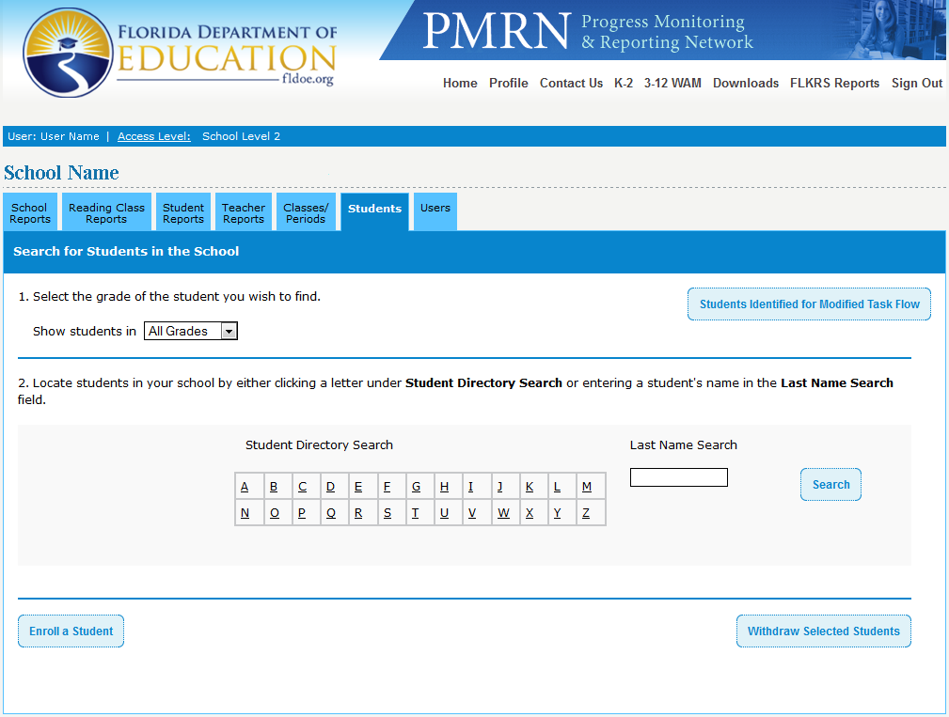
Modifying the Task Flow
Notes:
Present slide.

Slide 16
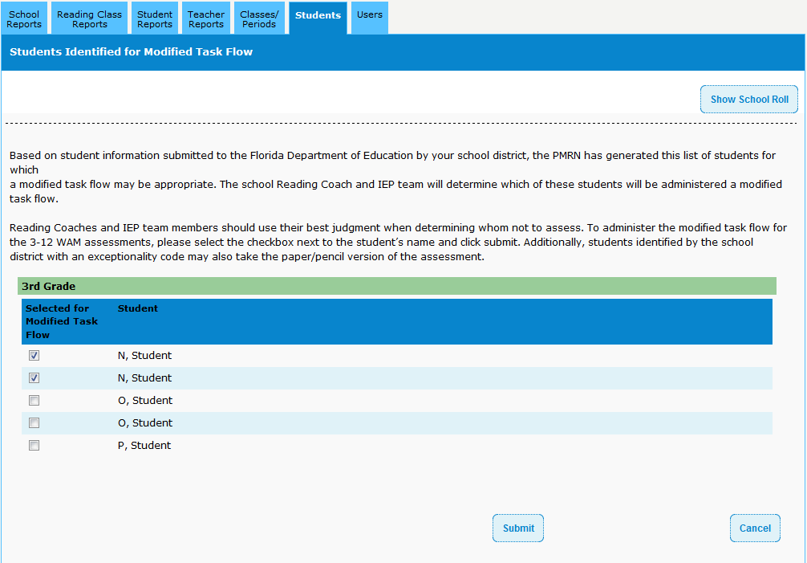
Modifying the Task Flow
Notes:
Present slide.

Slide 17
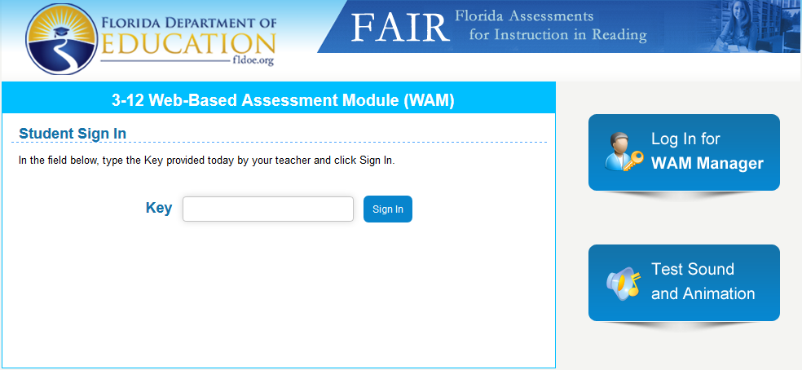
Student Access: 3-12 WAM
https://wam.fldoe.org
Test Sound and Animation
Student WAM Access
  Enter WAM Key
  Click Sign In
Notes:
Present slide.
Presenter:
Students will access the 3-12 WAM via the WAM Sign In page at the following URL:
https://wam.fldoe.org
Students will enter the daily WAM Key given to them by their teacher or WAM Manager.
Students will click the Sign In button.

Slide 18
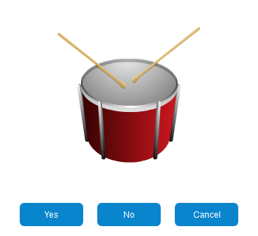
Student Access: 3-12 WAM
Test Sound and Animation Page
  Via 3-12 WAM Sign In page
Do you hear the drum?
  Yes
    Click the Yes button
  No
    Click the No button
    Make sure that your computer has the latest version of Flash installed
    Try Again after latest Flash has been installed
Notes:
Present slide.
Presenter:
The Sound and Animation Check page, located via the 3-12 WAM Sign In page, makes sure that the computer being used has the most up-to-date Flash version installed.
Users will look at listen to the image of a drum.
If the User hears and sees the drum being played, he or she will click the Yes button and will be returned to the WAM Sign In page.
If the User does not hear and see the drum being played, he or she will click the No button and will need to make sure that the latest version of Flash has been installed on the computer. Once the latest version of Flash has been installed, the User will click the Try Again button. If the sound and animation is still unsuccessful, it is recommended that the User see his or her school’s IT or computer specialist.

Slide 19
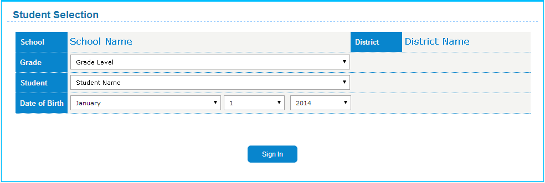
Student Access: 3-12 WAM
Student Selection Page
The student will
  Confirm school name
  Select Grade Level via drop-down
  Select Name via drop-down
  Select Date of Birth via drop-down
  Click Sign In
Notes:
Present slide.
Presenter:
The Student will
Confirm his or her school’s name
Select his or her grade level via the Grade drop-down menu
Select his or her name via the Student drop-down menu
Select his or her date of birth via the Date of Birth drop-down menu
Click the Sign In button
Once the student has verified his or her identity, he or she will be able to begin the assessment tasks.

Slide 20
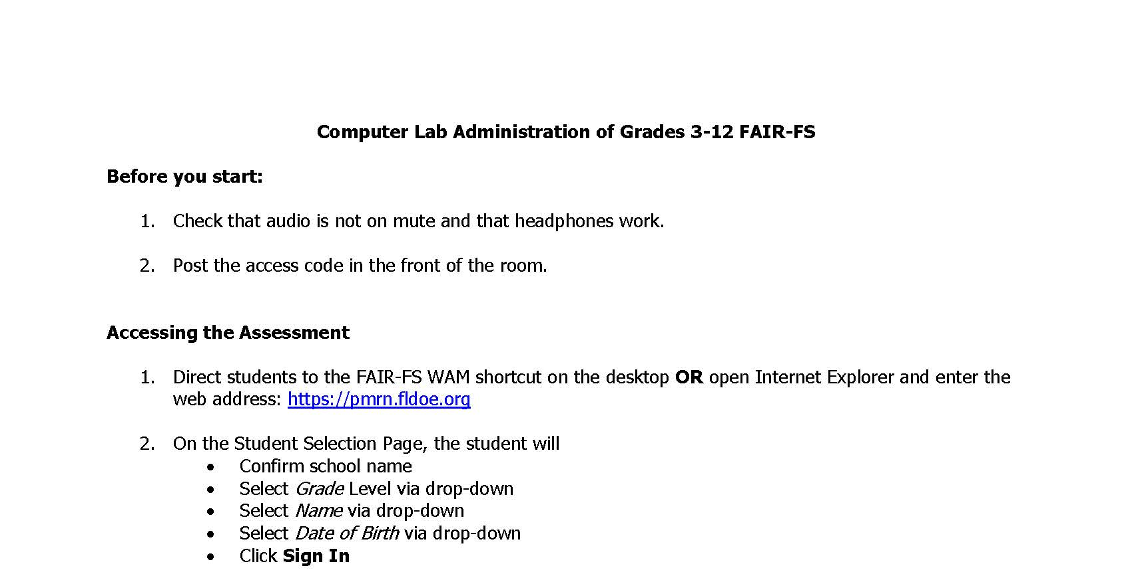
Computer Lab Quick Guide

Slide 21
Flow of Tasks
Word Recognition
(about 2 min.)
STOP
STOP
NO
NO
Compute Probability of Literacy Success
(PLS)
PLS
<.85?
Take optional tasks?
Vocabulary Knowledge
(about 3 min.)
YES
YES
Syntactic Knowledge
(about 5 min.)
Oral Reading Fluency
Reading Comprehension
(about 15 min.)
Oral Response
Paper/Pencil Administration
Written Response
Computer Administration
Notes:
Presenter:
“A federal grant from the Institute of Education Sciences funded a study to explore the components of reading comprehension at each grade level. The FCRR team found that the most important predictors fall into 2 categories: Alphabetics (Letter Sounds/Phonological Awareness in very early development and Word Reading/Spelling in early literacy development) and Oral Language (Vocabulary and Following Directions). New tasks and items were developed to fit each area.
This flow chart shows the order in which students flow through each task. Time estimates on the chart represent the “average” time to complete each task. Since the test is adaptive, times will vary depending on each student’s responses.
A score based on the first 2 screening tasks determines which reading comprehension passage with questions is most suitable for each student.
After completing the 3 screening tasks, a “probability of literacy success” score is calculated. This score indicates the probability (likelihood/chance) that a student will pass the English/Language Arts end of year test. Those students whose likelihood of passing is below .85 will take the Syntactic Knowledge task in order to obtain additional information regarding that skill set. If the teacher wishes to get even more information about a given student’s performance, the open response tasks (oral reading fluency, oral response, & written response) may be administered. These optional tasks are completely up to the teacher’s discretion.”

Slide 22
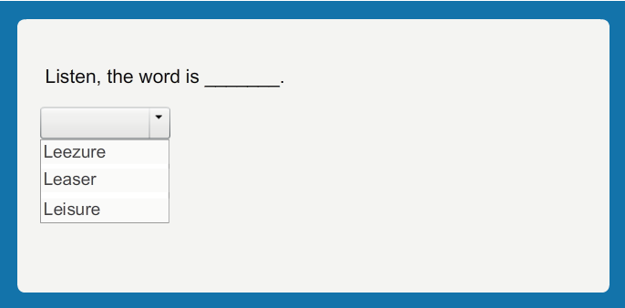

Word Recognition Task
Screen #1
Word Recognition Task
The student hears a word pronounced by the computer.
The student selects the word pronounced by the computer.
Notes:
Presenter:
“The Word Recognition Task (WRT) assesses a student’s abilities related to decoding and word recognition.
Approximately 70% of students who demonstrate low comprehension struggle with word recognition.”
(i.e., decoding; Catts, Hogan, & Adlof, 2005).

Slide 23
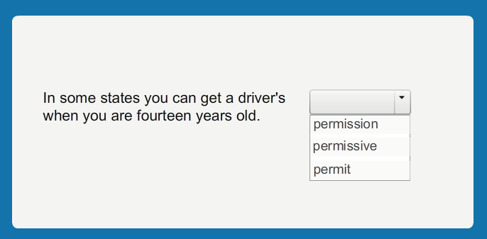
Vocabulary Knowledge
Screen #2
Vocabulary Knowledge
The student reads the sentence on the screen.
The student completes the sentence with 1 of 3 morphologically related words.
Notes:
Presenter:
“Approximately 50% of students who demonstrate low comprehension struggle with oral language skills (e.g., vocabulary; Catts, Hogan, & Adlof, 2005). In this vocabulary-like task, students complete a sentence with one of three morphologically related words. The advantage of this type of vocabulary task is that it measures students’ recognition of morphological patterns in words, which can generalize to recognition of new words instead of measuring only isolated vocabulary words. This task can more directly inform broader instruction on the metalinguistic aspects of vocabulary essential to building vocabulary depth as opposed to memorization of a large corpus of isolated words, in an attempt to increase vocabulary breadth.”
Present slide.
Additional Information:
Oral language refers to skills such as morphological & vocabulary knowledge, listening comprehension, and syntax.

Slide 24
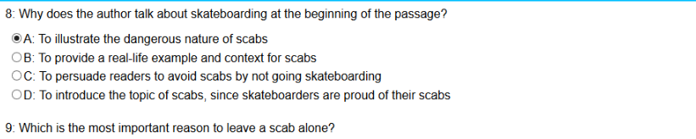
Reading Comprehension
Screen #3
Reading Comprehension
The student reads the passage, then clicks to show the questions. Questions & passage can be viewed simultaneously.
The student selects the correct response to the question.
Notes:
Presenter:
“After taking the WR and VK, the student’s score is used to identify a passage targeted to that student’s ability level.
When this score is combined with scores on the other screening measures, a more accurate prediction of performance on the end of year assessment can be made for each student. The student silently reads the passage and answers 7 – 9 multiple choice questions.
Students will be able to view the passage and questions on the same screen (there is a scroll bar for the passage and a scroll bar for the questions so that the entire passage and all questions are available on the same screen).”
Additional Information:
The student silently reads the passage and answers 7 – 9 multiple choice questions that are written to three strands of the Language Arts Florida Standards: Reading Informational Text, Reading Literary Text, and Language Strands. This task is conceptually related to the types of questions that will be asked on the end-of-year assessment.

Slide 25
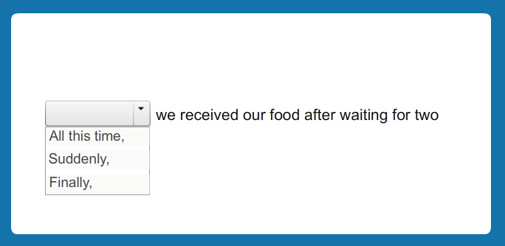
Diagnostic: Syntactic Knowledge
(Students with PLS <.85 will complete this task, optional if >.85 )
The student hears the sentence read by the computer.
The student selects the word that best completes the sentence.
Notes:
Presenter:
The Syntactic Knowledge measure, when added to a diagnostic profile with the WRT and VKT, rounds out a complete profile of the important components of reading comprehension for adolescent students. This task addresses issues of text cohesion (e.g., connectives, pronoun reference, and subject/verb agreement).
Present Slide.
Additional Information:
Previous research indicates that this type of sentence-level inferencing (Foorman, Arndt, & Crawford, 2011) and use of connective words affects text cohesion (Graesser, McNamara, & Kulikowich, 2011) and predict students’ abilities to comprehend text.

Slide 26
Flow of Tasks
Word Recognition
(about 2 min.)
STOP
STOP
NO
NO
Compute Probability of Literacy Success
(PLS)
PLS
<.85?
Take optional tasks?
Vocabulary Knowledge
(about 3 min.)
YES
YES
Syntactic Knowledge
(about 5 min.)
Oral Reading Fluency
Reading Comprehension
(about 15 min.)
Oral Response
Paper/Pencil Administration
Written Response
Computer Administration
Notes:
Presenter:
“A federal grant from the Institute of Education Sciences funded a study to explore the components of reading comprehension at each grade level. The FCRR team found that the most important predictors fall into 2 categories: Alphabetics (Letter Sounds/Phonological Awareness in very early development and Word Reading/Spelling in early literacy development) and Oral Language (Vocabulary and Following Directions). New tasks and items were developed to fit each area.
This flow chart shows the order in which students flow through each task. Time estimates on the chart represent the “average” time to complete each task. Since the test is adaptive, times will vary depending on each student’s responses.
A score based on the first 2 screening tasks determines which reading comprehension passage with questions is most suitable for each student.
After completing the 3 screening tasks, a “probability of literacy success” score is calculated. This score indicates the probability (likelihood/chance) that a student will pass the English/Language Arts end of year test. Those students whose likelihood of passing is below .85 will take the Syntactic Knowledge task in order to obtain additional information regarding that skill set. If the teacher wishes to get even more information about a given student’s performance, the open response tasks (oral reading fluency, oral response, & written response) may be administered. These optional tasks are completely up to the teacher’s discretion.”

Slide 27
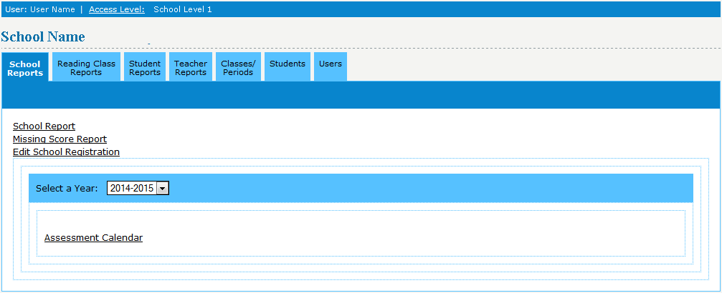
Accessing Missing Score Report
What is the Missing Score Report?
School Level Users
  Sign In
  Click the School Reports tab
  Click on Missing Score Report
Notes:
Present slide.
Presenter:
The Missing Score Report will provide the User with a list of students missing one or more scores for the current assessment period at the selected school.
The Missing Score Report will now be able to be accessed by School, Reading, and Resource Level Users.
School Level Users will be able to see all classes of students within the school.
Reading and Resource Level Users will only be able to view the missing score summaries for their classes and students assigned to them.
To view the Missing Score Report, School Level Users should:
Sign In to the PMRN
Click the School Reports tab
Click the Missing Score Report link

Slide 28
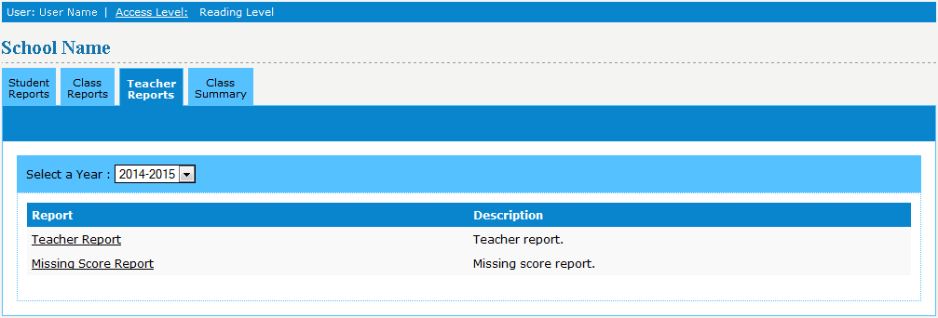
Accessing Missing Score Report
Reading and Resource Level Users
  Sign In
  Click the Teacher Reports tab
  Click on Missing Score Report
Notes:
Present slide.
Presenter:
To view the Missing Score Report in the PMRN, Reading and Resource Level Users should:
Sign In to the PMRN
Click the Teacher Reports tab
Click the Missing Score Report link

Slide 29
Flow of Tasks
Word Recognition
(about 2 min.)
STOP
STOP
NO
NO
Compute Probability of Literacy Success
(PLS)
PLS
<.85?
Take optional tasks?
Vocabulary Knowledge
(about 3 min.)
YES
YES
Syntactic Knowledge
(about 5 min.)
Oral Reading Fluency
Reading Comprehension
(about 15 min.)
Oral Response
Paper/Pencil Administration
Written Response
Computer Administration
Notes:
Presenter:
If the teacher wishes to get even more information about a given student’s performance, the open response tasks (oral reading fluency, oral response, & written response) may be administered. These optional tasks are completely up to the teacher’s discretion.
Click fly-in.

Slide 30
ORT
[Optional] Open Response Tasks (ORT)
Prerequisite: Syntactic Knowledge Task
Open response items allow teacher to analyze an individual’s approach to answering questions
Tasks are mostly teacher-administered and teacher-scored
Scores are not entered in the PMRN
Notes:
Presenter:
“If you want to gather more information on your student you have the choice to administer the Open Response Tasks.”
Present slide.

Slide 31
ORT
14 – 16 passages for each grade
Some Literary, some Informational
Text complexity (quantitative &
qualitative) fits the LAFS grade bands
Teacher chooses and prints passage
Each passage has 3 oral response questions and 1 written response question
Oral Reading Fluency
Oral Response
Written Response
Notes:
Present slide.
Additional Information:
Open Response Tasks: A set of passages with open response-type questions are available to teachers who would like to analyze an individual’s approach to answering questions. By analyzing students’ extended responses and misconceptions, educators may use this information to target day-to-day instruction for individual students.
The teacher is free to choose any passage from the bank. We recommend looking at the list of standards that the questions address (insert hyperlink to list) and choosing a passage based on the standards you are interested in for each student.

Slide 32
Downloading ORT Protocols
Links
  Printable 3-12 FAIR-FS assessment materials
WAM Manager Page
  Links section
  Click links for assessment materials
  Print assessment materials
Notes:
Present slide.
Present:
The PMRN SSO Manager page contains links for PMRN Managers to download and print 3-12 FAIR-FS assessment materials.
To download and print the 3-12 FAIR-FS materials, the PMRN Manager should select the links for the printable FAIR-FS materials under the Links section.
Note: Printable FAIR-FS materials are also available on the PMRN via the Downloads header link.

Slide 33
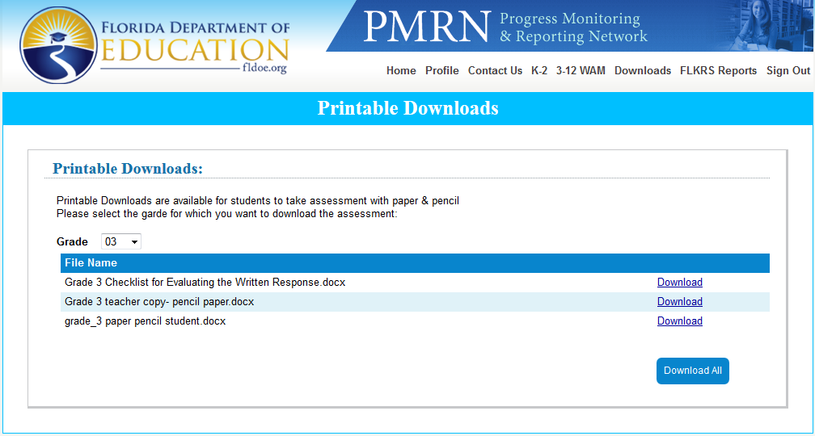
Downloading ORT Protocols
3-12 FAIR-FS Grade-Specific Assessment Materials
PMRN
  Downloads header link
Select Grade Level via drop-down menu
Click Download link for each item
Notes:
Present slide.
Presenter:
Additional downloadable and printable grade specific FAIR-FS assessment materials are located under the Downloads header link via the PMRN.
To access these materials, a User must:
Sign In to the PMRN
Click the Downloads header link in the top-right area of the page
Select the appropriate Grade Level via the drop-down menu
Click the appropriate Download link

Slide 34
ORT: Oral Reading Fluency (ORF)
Oral Reading Fluency
Directly aligned to Reading
Foundational Skills Standards
Student reads passage aloud while the teacher:
  Marks miscues and
  Scores Oral Reading Fluency
    Rate (total words read correctly in 1 minute)
    Accuracy (WRC/total words read)
    Expression (rating on the NAEP rubric)
Notes:
Present slide.
Additional Information:
The target ORF rate for each grade level is provided in a table in the administration manual. Fluency-building interventions are recommended for students with scores in the frustrational range. Decoding interventions are recommended for students who score below 95% accuracy.
The NAEP rubric score for expression is included on the teacher administration materials for each passage and was added to provide more descriptive information to teachers about a student’s reading fluency.
When targeting oral reading fluency for intervention, growth can be measured by ORF rate. However, change in the NAEP expression rating is only likely to occur over a long period of time (i.e., a school year or more).

Slide 35
ORT: Administering ORF
3-sec. hesitation – provide the word
5-sec. attempt – provide the word
Draw bracket ( ] ) at 60 seconds
Discontinue rule
  10 errors in the first line
  Administer an easier passage
Errors | NOT Errors
Mispronunciations (including leaving off –s, -ed, and –ing; reading “talk” for talked) | Insertions of words (reading “big, bad dog” instead of “bad dog”)
Omissions (leaving out a word) | Self-corrections (mark SC above the slash)
Substitutions (reading “beg” for “big”) | Repetitions (re-reading a word or phrase)
Reversals (reading “Tom said” instead of “said Tom”) *This counts as 2 errors; one point for each word. | Loss of place (e.g., skipping a line) Redirect the student to correct place and keep the stopwatch running.
Hesitations longer than 3 seconds *Provide the word, mark as incorrect, and move on. | Misarticulation or dialect * f → th fumb → thumb * da → the * w → r wabbit → rabbit
Proper nouns (any capitalized word) *If the student hesitates for 5 seconds or mispronounces the proper noun, provide the word and count as an error the first time only. | Multiple misreads of the proper noun Do Not count as errors
Oral Reading Fluency
Notes:
Present slide.
Additional Information:
(Detailed instructions can be found in the Administration Manual. A lookup table link for ORF can be found at www.fcrr.org/lookup)
If the student pauses for 3 seconds, provide the word and mark as an error
If the student attempts to decode a word, provide the correct word after 5 seconds
Place a bracket ] around the last word at 60 seconds
Discontinue administration of the passage if there are 10 errors in the first line
If discontinue rule is met, administer a passage from a lower grade level

Slide 36
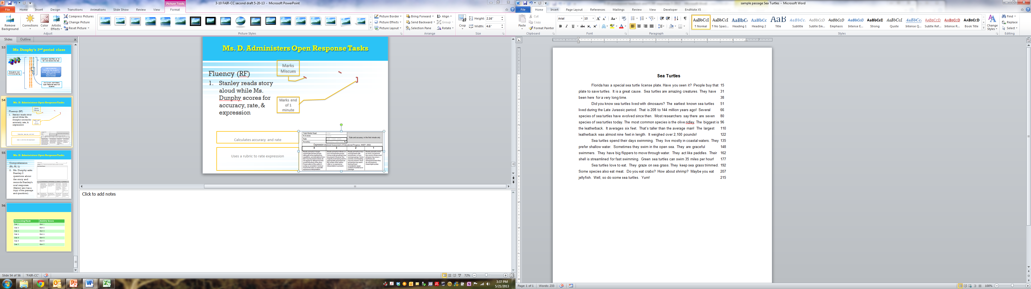
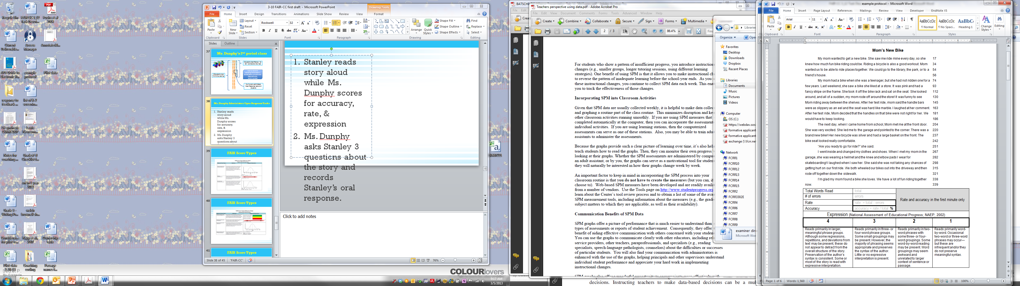
1. Record number of words read at 1 minute (at bracket)
Oral Reading Fluency
2. Record number of errors at 1 minute (count slashes)
3. Subtract errors from total to get rate
79
3
76
4. Divide rate by total and multiply by 100 to get accuracy
96
5. Choose a rating for expression based on the rubric
Notes:
Presenter:
“Here is a screen shot of a protocol of one of the diagnostic passages.
The teacher’s copy (upper left hand corner) has the number of words at the end of each line.”

Slide 37
Why measure ORF?
Oral Reading Fluency
Why measure oral reading fluency past grade 5?
  Some students do not read fluently by grade 8 or even beyond
Oral reading expression is an additional (qualitative) indicator of a student’s reading comprehension.
  Improves concurrently with ORF rate
Notes:
Presenter:
“Research indicates that measurement of oral reading fluency rate is a useful predictor of reading comprehension for most students until grade 6.
Present slide.
Additional Information:
The LAFS includes oral reading fluency as measured by accuracy, rate, and expression in the Reading Foundational Skills strand as standard #4 in grades K through 5. Some students may continue to strive to be fluent readers until grade 8 or even into high school.
When students read with appropriate expression, it is often evident that they are comprehending what they are reading, making expression a helpful indicator. However, it is not a target for instruction. It improves when fluency-building interventions are targeted to improving ORF rate.

Slide 38
ORT: Administering and Scoring Oral Response Comprehension Questions
Directly aligned to RI, RL, and
L strands of the LAFS
The teacher reads each question to the student (while the student follows along)
There is space for the teacher to record the student’s oral response
A 4-point rubric and sample answers for each category are provided
Oral Response
Notes:
Present slide.
Additional Information:
The oral responses will provide descriptive information regarding 3 strands of the LAFS: Reading Informational text, Reading Literary text, and Language.
The comprehension questions are designed to give teachers first hand experience with how the student is approaching reading comprehension questions. This will allow the teacher to adjust instruction to meet individual students’ needs. The rubric provides indicators of a student’s development in responding to questions like this.

Slide 39
Using the Oral Response Rubric
Oral Response
 | Exceeds Expectations | Meets Expectations | Emerging | Not Evident
Criteria | Response cites three clear supporting details to precisely explain why the mom wanted a bike, with no unnecessary information. | Response cites two relevant details to adequately explain why the mom wanted a bike. | Response cites a detail to explain why the mom wanted a bike. Answer is not completely developed and may include unnecessary information. | Uses irrelevant or distorted details to explain why the mom wanted a bike. Answers demonstrate minimal understanding of the text.
Sample Answers | Mom wanted a bike because it would be fun, it allowed her to spend time riding with her child, and it provided a good workout. | Mom wanted a bike because it was fun and it was a good workout for her and her child. | Mom wanted a bike because it was fun and comfortable to ride. | Mom wanted a bike because she had one when she was little.
Notes:
Presenter:
“This example rubric shows the information that will be used to evaluate the student’s oral response. Each rubric is tailored to the specific passage and the specific question.”
Additional Information:
Please note that the “not evident” category covers a broad variety of responses. Any of the following scenarios could be included in the “not evident” category:
Student’s response is incorrect
Student has no response
Student’s response is about an unrelated topic
Student seems to not understand the question
Student seems to not understand the topic
Student’s response is fixated on one aspect of the question, passage, or un-related background topic
Student’s mastery of the English language limits the student’s abilities to respond expressively

Slide 40
ORT: Administering the Written Response
Written Response
The student will respond in writing to 1 question related to the passage s/he just read (typed response)
Question will target one of the following types of writing:
  Opinion/argumentative
  Informative/explanatory
  Narrative
Student will log back into the web application & instructions will be provided
Make sure the student also has:
  Hard copy of the passage
  Scrap paper & pencil for planning purposes
  Headphones
Notes:
Present slide.
Additional Information:
The written response will provide descriptive information regarding these strands of the LAFS: Reading Informational text or Reading Literary text, Writing, and Language.
Teachers may want to choose the passage in advance based on the type of written response they want to evaluate for a particular student (argument/informative/narrative).
All instructions will be provided through the web application for planning and for writing. Have the student wear the headphones while planning AND writing so that the student hears warnings about how much time is left and to reduce distracting noise in the room.
You may want to keep the student’s planning sheet to help inform your instruction regarding planning strategies.

Slide 41
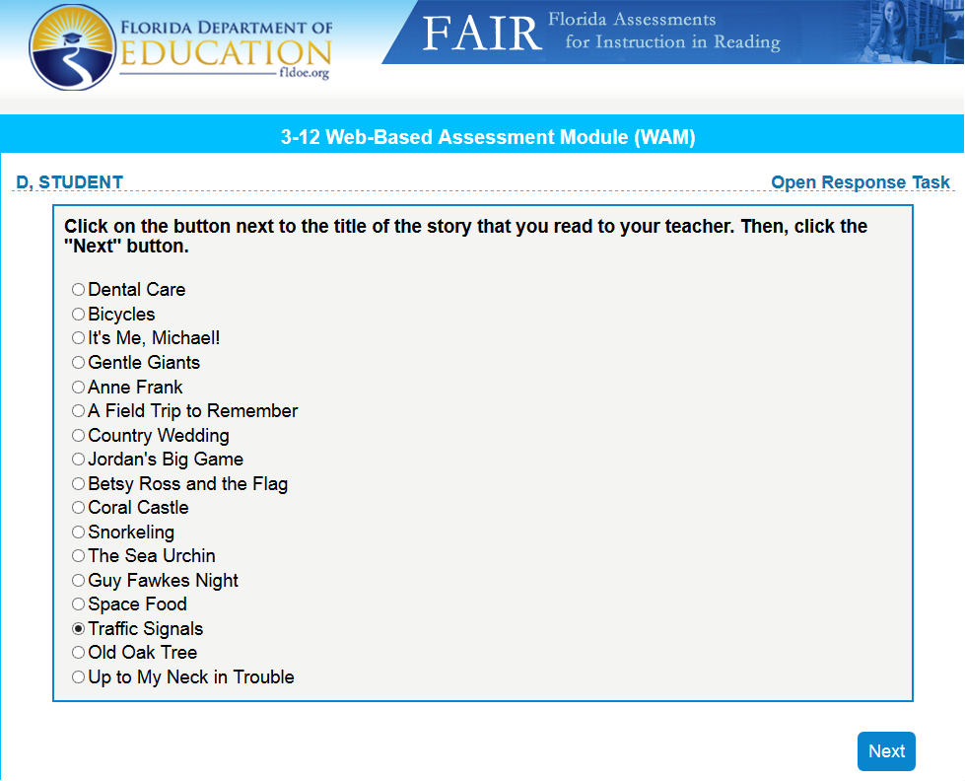
ORT: Administering the Written Response

Slide 42
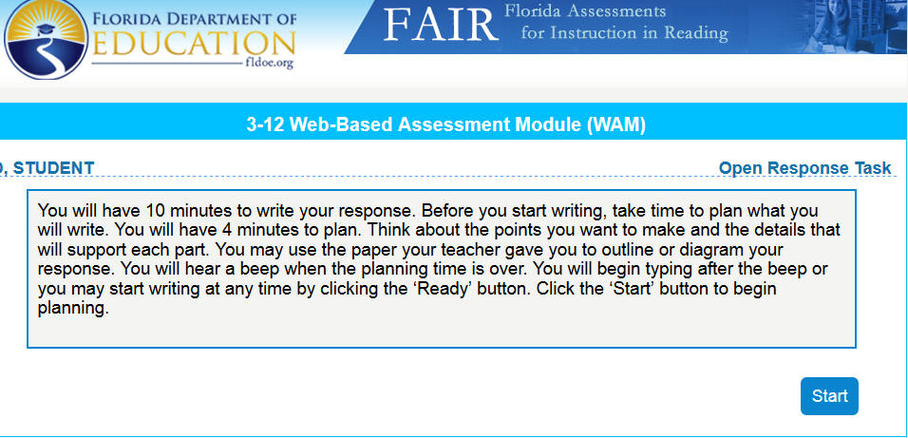
ORT: Administering the Written Response

Slide 43
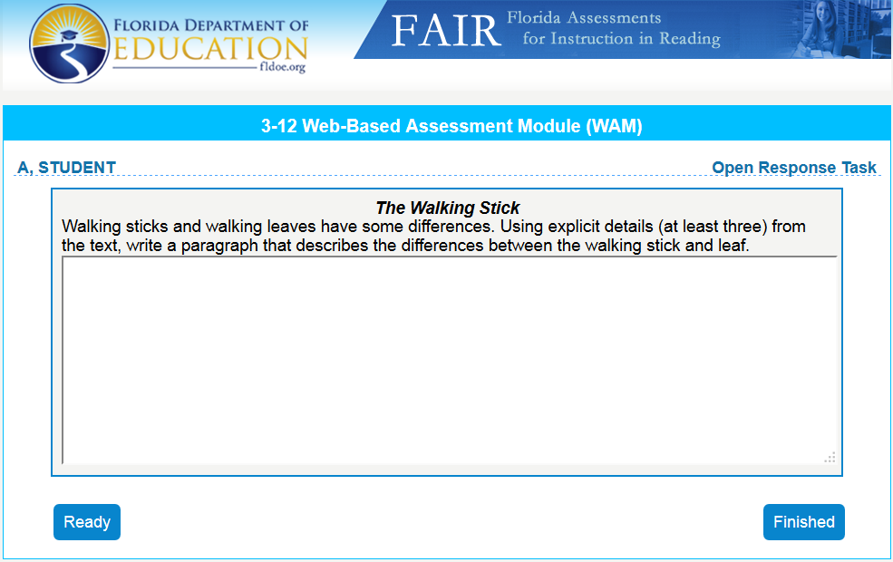
ORT: Administering the Written Response

Slide 44
Why keyboarding?
Written Response
Increasing workplace demand for written
composition exclusively on the computer
Instruction in Word Processing identified as critical element to effective adolescent writing instruction (Graham & Perin, 2007)
LAFS delineates digital publishing starting in Kindergarten
Notes:
Present slide.
Additional Information:
NAEP writing assessment was on computer in 2011 for grades 8 & 12 and will be on computer for grade 4 at the next assessment

Slide 45
Rationale for Time Limit
Written Response
Research indicates that:
  most students just begin writing without planning, even when prompted
  a brief written response (i.e., 3 minutes or 5 minutes) provides a sufficient sample of student’s writing for screening purposes
FAIR-FS allows up to 4 minutes to plan and
10 minutes to write the response
Notes:
Present slide.
Additional Information:
*Cited from McCutchen 2006 Handbook of Writing Research, edited by MacArthur, Graham, & Fitzgerald
**McMaster & Espin 2007

Slide 46
Scoring the Written Response
Comprehension Question
Written Response
Teachers will be able to print out 2 documents from the written response to score:
  The sample at 5 minutes for writing fluency
    Total number of words written (TWW) will be counted and provided by the computer
    Number of correct writing sequences minus incorrect writing sequences (CIWS) needs to be hand scored
  The complete sample that is collected at 10 minutes
    Scored utilizing the FAIR-FS checklist for the written response
Notes:
Present slide.
Additional Information:
The first document that the teacher may print, score, and keep on file for the student is a snapshot of the student’s composition after 5 minutes of writing. The computer captures this after 5 minutes of writing time has elapsed. This capture occurs without interruption to the student. The purpose of this sample is to obtain a writing fluency measure. This measure of writing fluency is a critical addition to the holistic evaluation of the writing because it is objective and it can be compared to other students.

Slide 47
Scoring Written Fluency
Written Response
Written fluency is associated with performance on high stakes assessments, especially for middle school students
Correct Minus Incorrect Writing Sequences (CIWS) – process used to determine written fluency
  A ‘writing sequence’ is the link between 2 words or a word and punctuation mark.
  The sequence is considered to be correct when spelling, grammar, syntax, capitalization, and punctuation are used correctly on either side of the link.
Notes:
Present slide.

Slide 48
Scoring CIWS
Written Response
All links between writing units are scored as correct (^) or incorrect (^{x})
^I ^would^ want^ to^ have ^a^ corn^ snake^ because ^the ^{x}aunthor^{x} gives^ me^ a ^good^ reason^ to^ have^ one^. ^One ^of^ the^{x} reason^{x} are^{x} that^ corn^ snakes^ eat ^mice^ or^ rats^{x} ^{x}and^ that^ when^ they^ shed
Notes:
Presenter:
“This is an example of how to score CIWS. See the manual for complete instructions.”
Additional Information:
This makes more sense with an example. What do you see marked with incorrect writing sequences? Why is it marked that way?
Misspelling (an incorrect sequence on both sides of the word)
Incorrect form (an incorrect sequence on both sides of the word)
Subject verb disagreement – think of it like choosing the wrong word (an incorrect sequence on both sides of the word)
Missing end punctuation (mark 2 incorrect sequences, 1 for the link between the word and the missing punctuation and the link between the missing punctuation and the capital letter to begin the next sentence)
NOTE: The computer will capture whatever the student has written at the end of 5 minutes. As such, the student may not have a complete sentence at the end or the capture may even have occurred mid-word. For this reason, the last word sequence should not be marked. In the above example nothing is marked after the word “shed”.
See admin manual for a full list of rules and special examples.
ACTIVITY – score the practice example and discuss your scoring with a partner

Slide 49
Scoring the Full Response
Written Response
Using grade level checklist, evaluate 10 minute written response
Checklists are based on grade level standards
  Writing Strand (standards 1 – 4)
  Language Strand (standards 1 & 2)
Checklists target specific concepts and skills
Notes:
Presenter:
“Grade level checklists based on the writing and language standards are provided in the manual. These checklists can be used to assess the written response.”
Present slide.
Additional Information:
Written responses don’t have 1 correct response. The potential set of correct responses is vast. Use of the fluency metrics (Total Words Written and Correct Minus Incorrect Writing Sequences - CIWS) allows a huge variety of responses to be measured on the same scale so that comparisons can be made between 2 or more students or between a student’s writing early in the year with that student’s writing at the middle of the year. The CIWS metrics are most useful for those comparisons, however, they do not give information about a student’s ability to organize ideas, ability to select relevant evidence, or choose a style for writing. Therefore, we are providing a checklist to supplement the CIWS which considers these other elements.
Judgments of clarity of writing, organization, and other components remain highly subjective. Interrater reliability (agreement between raters) will be calculated in the field test. Generally, interrater reliability for this type of tool is lower than ideal. This tool is strictly for your use in the classroom to choose areas you would like to see strengthened for particular students. Therefore, scores are not reported.

Slide 50
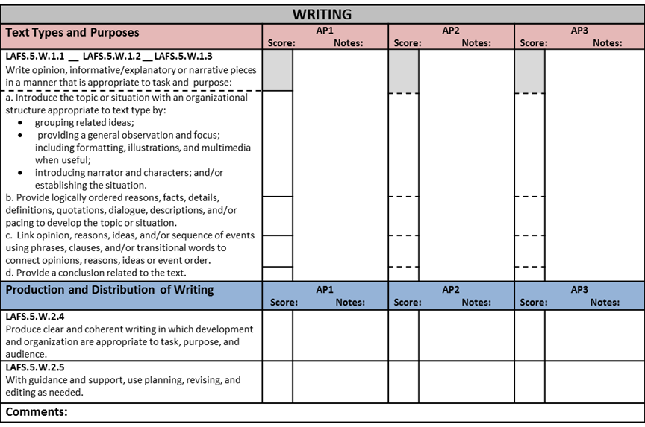
Scoring Features
Written Response
+ | Demonstrates correct use of skill most of the time
 | Demonstrates correct use of skill at least once
-- | Does not use the skill correctly
N/A | Writing does not include opportunity to demonstrate skill
Student: ________ AP1 DATE:______ Text Title: _____________
AP2 DATE:______ Text Title: _____________
Teacher:________ AP3 DATE:______ Text Title: _____________
A. Ability to mark if the student sometimes uses the skill as opposed to all or nothing
GRADE 5 – WRITING CHECKLIST
B. Alignment to standards noted
C. Column for each AP to note qualitative progress
Notes:
Presenter:
“This is a sample of a 5th grade writing checklist. Some of the features of the checklist include:
A. Ability to mark if the student sometimes uses the skill correctly or if the student does not demonstrate the skill
B. Column identifying which standard each indicator falls under
C. Column for each Assessment Period (AP), so that you can note any qualitative progress.”

Slide 51
Adaptive Tasks / Open-Response
Computer-adaptive
  Selected response (e.g., multiple choice)
  Scores are consistent (reliable) & accurate (valid) measure of student’s skill in the identified domain
Open-response
  Students’ responses can vary greatly
  Does NOT accurately quantify a student’s skill, but DOES guide instructional feedback for teachers
Notes:
Present slide.
Presenter:
“Although these tasks do not yield consistent or reliable scores, they do provide important information that the teacher can use to guide day-to-day instructional decision making.”

Slide 52
Section Summary
New features of FAIR-FS
System specifications
Task flow
  Screening tasks
  Diagnostic task
  [Optional] Open Response Tasks
Notes:
Presenter:
“In this section we discussed . . . “
Present slide

Slide 53
Reflection
Oral Reading Fluency
Discuss with your neighbor when and why the optional ORTs would be given.
Oral Response
Written Response
Notes:
Present slide.
If time permits, have participants share.

Slide 54
Session Topics
Administration of FAIR-FS 3-12
Example of Administration
Scoring and Reports
Notes:
Presenter:
“We have presented _____________. Are there any questions?”
Present slide.

Slide 55
Example of Administration

Slide 56
Ms. Dunphy’s 2nd Period Class
Ms. Dunphy (a grade 6 Language Arts teacher) takes her 2nd period class to the computer lab to take the FAIR-FS during AP1
They log in to the PMRN
And respond to 3 tasks:
  Word Recognition Task (~ 2 minutes)
  Vocabulary Knowledge Task (~ 3 minutes)
  Reading Comprehension (1-3 passages with questions)
Notes:
Present slide.

Slide 57

Ms. Dunphy’s 2nd Period Class
5 students identified as “at-risk” and take Syntactic Knowledge task
25 students took FAIR-FS screening
Ms. Dunphy administers Open Response tasks to 3 students
Notes:
Present slide:
Additional Information:
Five students in Ms. Dunphy’s class are identified as “at-risk” ( < .85 PLS) and are placed in the Syntactic Knowledge Task.
Ms. Dunphy planned to use the screening & diagnostic scores to help her determine which components of her curriculum needed more emphasis and more time. From her students’ test scores, the students’ files, and her observations of the students, Ms. Dunphy felt confident that all of the 2nd period students would be successful in the curriculum except for 3 students. Ms. Dunphy wanted to collect additional information about these 3 students and their approach to activities related to specific standards. She was interested in gaining this information to guide how she provided individual feedback to these students and seeing if she needed to make any modifications to future lessons on targeted standards.
While other students are working, Ms. Dunphy administers the Open Response tasks to each of these 3 students, one at a time.

Slide 58
Ms. D. Administers Open
Response Tasks
Oral Reading Fluency
  Reading Foundational Skills Strand
Oral Response
  Reading for Information Strand; Reading Literary Text Strand; Language Strand
Written Response
  Writing Strand; Language Strand
Take optional tasks?
YES
Oral Reading Fluency
Oral Response
Written Response
Notes:
Presenter:
“Ms. D. is now going to administer the Open Response Tasks to three of the students.”
Present slide.

Slide 59
Ms. D. Administers Open
Response Tasks
Oral Reading Fluency
Marks Miscues
Stanley reads story aloud while Ms. Dunphy scores for accuracy, rate, & expression
Marks end of 1 minute
Calculates accuracy and rate
Uses a rubric to rate expression
Notes:
Presenter:
“This is an example for the oral reading fluency and the teacher’s scoring.”
Present slide.

Slide 60
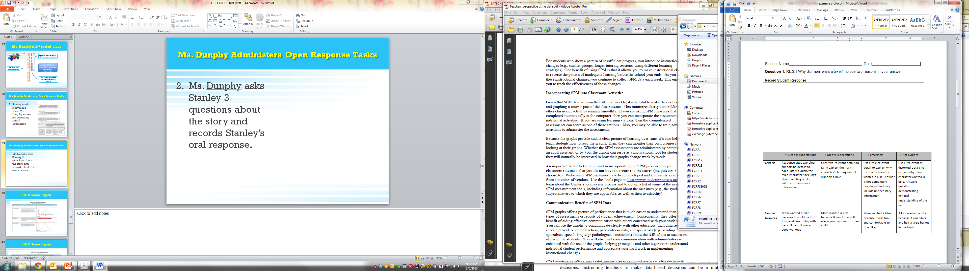
Ms. D. Administers Open
Response Tasks
Oral Response
Ms. Dunphy asks Stanley 3 questions about the story and records Stanley’s oral response. (Stanley also has a copy of the passage and questions).
Notes:
Presenter:
“This is an example of the teacher’s copy where the responses are recorded. A rubric and sample answers are included.”
Present slide.

Slide 61
Ms. D. Administers Open
Response Tasks
3. Ms. Dunphy makes sure Stanley has his packet, a pencil, & headphones and directs him to log in to the PMRN.
This task will take approximately 20 minutes.
Written Response
Notes:
Present slide.

Slide 62
Scoring Stanley’s Written Response
Obtain Stanley’s written response from the PMRN
  Writing at 5 minutes
  Completed writing (10 minutes)
Score the 5-minute sample using Appendix B of the administration manual
Score the 10-minute sample using Appendix D of the administration manual
Notes:
Presenter:
“After Stanley has completed the written response, the teacher will……”
Present slide.

Slide 63
5-minute sample
Total Words Written is provided
Use CIWS scoring rules to mark correct and incorrect sequences
5 minute written response | Word Count
^The ^Northern ^Mockingbird ^and XThe ^Hummingbird ^are ^two ^different ^birds ^that ^are ^alike ^and ^different ^in ^many ^ways^. ^They ^are ^alike XasX they ^are ^both ^omnivoresX, X and Xthey^ are ^different ^because ^the ^mockingbird ^communicates ^by ^singing ^and ^mocking ^other ^animalsX, Xand Xthe ^hummingbird ^uses ^visual ^displays^. ^The ^mockingbird^ can ^imitate ^dogs^, ^cats^, ^toads^, ^frogs^, XXeven ^humans^. ^The ^hummingbird ^is ^very ^colorfulX, XandX can ^use ^their ^heads^, ^feathers ^and ^flight ^patterns | 74
Notes:
Present slide.

Slide 64
10-minute (or final) sample
Use the grade appropriate LAFS checklist to score the 10 minute response.
Student | Question | Response | Time Completed
5C | Write about why you would or wouldn’t have a corn snake as a pet. Include three reasons that support your decision. | A corn snake is a good pet to have because it is not poisonus and are very easy to take care of. The first reason is that it is easy to feed them because it is only putting a mouse in the tank that it lives in, but when it is very little you have to feed it Pinkies-which are a smaller versions of a feeder mouse. Speaking of feeder mouse, it is another mouse you have to feed them when they are an a adult. the second reason is that you have to know when it sheds because when it sheds their eyes will turna blush white and will not eat for awhile. And the finale reason is that it is a very great pet for farmers because it will eat all their rats that are around the field, plus it will also feed themselfs and you don't have to wory about feeding them. So that was my three reasons why a corn snake could be a great pet for any snake lover or even a farmer. | 8.5 minutes
Notes:
Presenter: Here is a sample of a students written response after 10 minutes. Copies of the grades 3 - 9/10 checklists are provided in the administration manual. Notice that the number of minutes is posted on the screen.
Present slide:

Slide 65
Session Topics
Administration of FAIR-FS 3-12
Example of Administration
Scoring and Reports
Notes:
Presenter: “ Our goal is that by the end of the session, you will have increased knowledge of these areas: “
Present slide.

Slide 66
Scoring and Reports
Notes:
Presenter:
“This section will provide an overview of the Scoring and Reports.”

Slide 67
Accessing 3-12 Reports
PMRN v4 Reports available
  School Reports (School Level)
    School Report
    School Missing Score Report
    Assessment Calendar
    Edit School Registration function
  Teacher Report (School, Reading, Resource Level)
  Class Report (School, Reading, Resource Level)
  Student Report (School, Reading, Resource Level)
Notes:
Present slide.
Presenter:
At the beginning of the school year, PMRN reports are still being developed by the FLDOE. Listed below are reports that will be available towards the beginning of the school year:
School Reports (School Level)
School Report
School Missing Score Report
Assessment Calendar
Edit School Registration function
Teacher Report (School, Reading, Resource Level)
Class Report (School, Reading, Resource Level)
Student Report (School, Reading, Resource Level)
Access to the PMRN Reports is dependent on the Access Level of the User.

Slide 68
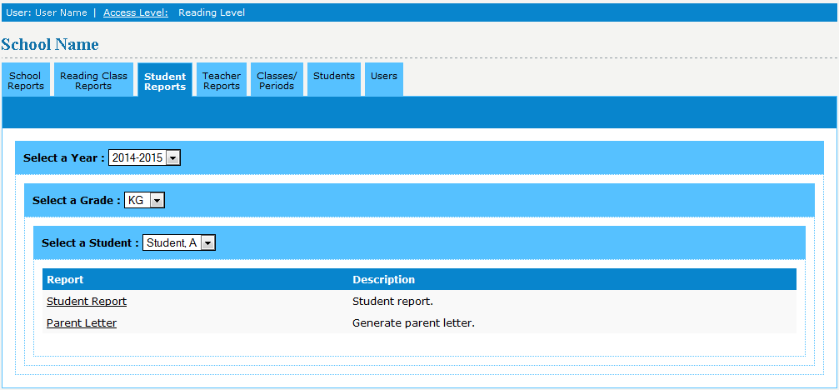
Accessing 3-12 Reports
School Level
School Level Users
  Sign In
  Click the tab of the Report Level you wish to view
    School Reports
    Reading Class Reports
    Teacher Reports
    Student Reports
  Click the linked name of the Report
Notes:
Present slide.
Presenter:
School Users are able to view Reports from all Reporting tabs in the PMRN via their Access Level, including:
School Level Reports
Reading Class Level Reports
Teacher Level Reports
Student Level Reports
To view reports in the PMRN, School Level Users should:
Sign In to the PMRN
Click the tab of the level of report they wish to view
Under the specified tab, click the linked name of the report

Slide 69
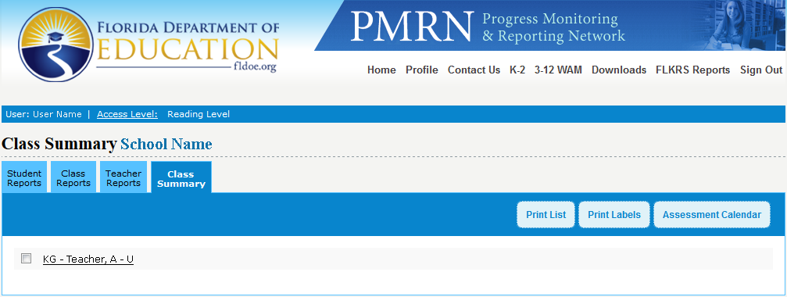
Accessing 3-12 Reports
Reading, Resource Level
Reading and Resource Level Users
  Sign In
  Click the tab of the Report Level you wish to view
    Student Reports
    Class Reports
    Teacher Reports
  Click the linked name of the Report
Notes:
Present slide.
Presenter:
Reading and Resource Level Users are able to view the following levels of Reports via the PMRN:
Student Level Reports
Class Level Reports
Teacher Level Reports
To view reports in the PMRN, Reading and Resource Level Users should:
Sign In to the PMRN
Click the tab of the level of report they wish to view
Under the specified tab, click the linked name of the report

Slide 70
Scoring and Reports
Important note:
Scores from FAIR-FS were designed to facilitate instructional decision making including problem-solving and data-based decision making.
  FAIR-FS scores are not intended to be the sole data point in determining retention or special education determination
Notes:
Present slide.

Slide 71
Score Reports
Detailed reports for teachers and parents
  Includes profile of student scores
Computer adaptive tasks provide:
  Ability scores
  Percentile ranks
  Probability of Literacy Success
Notes:
Presenter:
“Score reports will be available on the Progress Monitoring and Reporting Network.”
Present slide.
Additional Information:
The Progress Monitoring and Reporting Network (PMRN) is Florida’s web-based data management system for reporting of data related to student reading achievement and instructional practices. Schools will assign various user levels so that teachers, reading coaches, and administrators will be able to access FAIR-FS score reports for students.
Graphs show ability scores in relation to average scores for that grade level

Slide 72
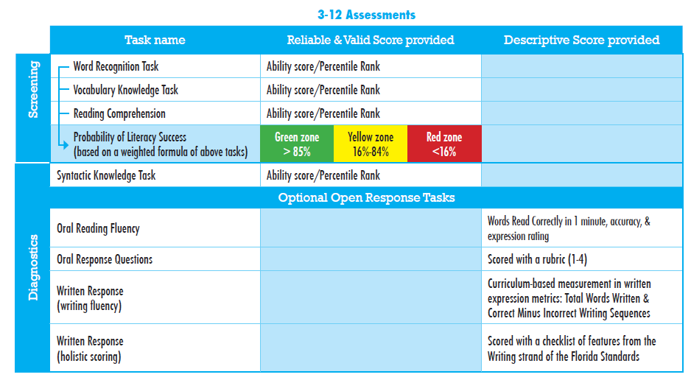
Notes:
Presenter: “This chart shows the screening and diagnostic tasks and the types of reports that are generated for each one. Remember that each score type has a specific purpose and audiences that have a greater investment in some score types than others.”
Highlight the differences between the 2nd column “Reliable and Valid Score” and the 3rd column “Descriptive Score”

Slide 73
Probability of Literacy Success (PLS)
Score represents the likelihood that a student will score at the 40th percentile on the end-of-year outcome measure (i.e., SAT-10)
Indicates WHO is at risk
PLS is based on aggregate of WRT, VKT, and RCT
  PLS of .50 predicts that student has 50/50 chance of achieving the passing score on the outcome measure
Notes:
Present slide.

Slide 74
Percentile Ranks
Score is used to rank one student’s performance in relation to a particular group of other students
  Ranges from 1 – 99 (25th through 75th percentile represents the average scoring range)
  Based on a representative sample of Florida students
3rd grade student with a percentile rank of 55 performed better than 55% of other 3rd graders in Florida
Notes:
Present slide.
Additional Information:
Note that percentile rank is NOT on an equal interval scale.
For example, the change from 10th to 15th percentile is a MUCH larger gain than the change from 50th to 55th percentile.

Slide 75
Ability Scores
Scores represent an estimate of ability in a specific skill and reflects true change over time as ability increases or decreases
  Covers a range of ability from 3rd grade to 10th grade
  Scores range from 150 – 1000
Indicates degree of growth for each student
A 3rd grade student with an ability score of 500 is performing exactly the same as a 7th grader with an ability score of 500
Notes:
Present slide.
Additional Information:
True change – based on individual student’s score NOT in relation to other students

Slide 76
Score Types for Computer-Adaptive Tasks
Score type | What it reflects | What it does NOT reflect
Ability score | Quantifies a student’s level of skill and reflects changes Scale ranges from a minimal amount of skill to expert | Performance compared to other students Grade-level performance
Percentile rank | Student’s ability compared to other students in the same grade | Percentage of correct responses Growth Level of expected performance
Probability of Literacy Success | Likelihood the student will receive a passing score on end-of-year test | Growth Previous year’s end-of-year test score Grade-level performance
Notes:
Present slide.
Additional Information:
Please note that none of these scores provides a score that serves as a “cut-point” or pass/fail or “meets grade-level expectations”. Each score is provided to answer a specific question.
An ability score provides an estimate of the level of a student’s ability in a particular skill and should change as a student’s ability with the skill increases or decreases. This is the score that indicates the degree of growth for each student and can track growth within a school year and across school years. The ability score is the student’s level of performance at the time of measurement. Growth is measured by comparing the previous ability score or scores to the current score OR by looking at the trend of ability scores on a graph. The other score types can NOT be used to look at a trend.
A percentile rank score is used to rank a student’s performance in relation to other students’ performance in a specific group. The specific group for FAIR-FS is a sample of students in the same grade level that are demographically representative of the state of Florida.
The PLS is interpreted similarly to the FSP (FCAT Success Probability) from the original FAIR. The name has changed because the calculation of this score no longer includes the prior year’s FCAT score. It includes only the scores on the FAIR-FS screening (WR, VK, RC). This score helps you to determine which students are at-risk and which students are at the most risk. This score indicates who needs intervention, but it does not help when specifying what the intervention needs to be. Use the “profile” of percentile rank scores to determine the targets for intervention.

Slide 77
Examples
Probability of Literacy Success: A PLS of .50 predicts that the student has a 50/50 chance of achieving the passing score or higher on the outcome test
Ability Score: If a student receives a score of 400 at AP1 and 520 at AP2, s/he demonstrated growth
Percentile Rank: A fifth grade student with a percentile rank of 55 performed better than 55% of other fifth grade students in Florida.
Notes:
Present slide.
Additional Informational:
Please note that true growth in a skill can only be determined by using the developmental ability score. It is the only score that can demonstrate a student’s true degree of ability in that skill. The other 2 quantifiers are derived from the developmental ability score in order to compare to other students (percentile rank) and to predict end of year performance (PLS).
A change in percentile rank from 55th to 50th does NOT mean that the student made backwards progress. In order to be at the 50th percentile, the student had to have made progress. 50th percentile means that the student is performing similarly to peers, so if the student’s peers are progressing, that student must be as well. It is impossible to determine the degree to which any student progressed using the percentile rank.
Think of ability scores as analogous to the measurement of height, or weight, or blood pressure. 55 inches is a pure representation of someone’s height just like the ability score is a representation of how much skill a student has with word recognition or vocabulary knowledge, or reading comprehension. When you know that someone is 55 inches tall, you can compare that number with her previous height and you can compare that number to the height of other people in any age group. The one piece of information you don’t know just by considering a person’s height is how typical that measurement is. So, you use other information (e.g., the person’s age) to derive a percentile rank to describe how typical that height is. For example, 55 inches is at the 84th percentile for 9 year-old girls but at the 3rd percentile for 13 year-old girls. Percentile ranks are derived from ability scores in the same way (compares that particular ability score to other students in the same grade level). Both pieces of information: height and the percentile rank associated with that height for a particular age group, are very important.

Slide 78
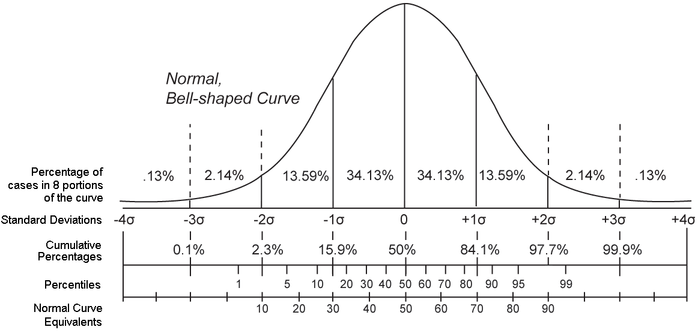
Considerations for Growth
Ability scores are on an equal interval scale whereas percentile rank is not.
Percentile rank is relative to other student’s performance & PLS is relative to another assessment.
Ability score does not involve a comparison.
Notes:
Present slide.
Presenter: “This graphic demonstrates that percentile ranks are not on an equal interval scale. For example, the distance between the 1st percentile and the 5th percentile is not the same as the distance between the 50th percentile and the 55th percentile.”
Additional Information:
Before there were ability scores, many educators used the Success Probability scores and percentile rank scores to determine growth. Both of these scores will reflect growth IF a very large amount of growth occurs. However, for students with very low or very high initial performance growth may not be reflected in the Success Probability or the percentile rank. Furthermore, students who are making some gains may not be reflected in the scores. The reasons we are providing the ability score as the best and only score that should be used for measuring growth are listed here.
This graphic demonstrates that percentile ranks are not on an equal interval scale. For example, the distance between the 1st percentile and the 5th percentile is not the same as the distance between the 50th percentile and the 55th percentile.

Slide 79
Student Score Profile
WR= Word Recognition
VK = Vocabulary Knowledge
RC = Reading Comprehension
SK = Syntactic Knowledge
Generally, a skill should be targeted for instruction when scoring below the 30th percentile
The lower bars represent skills that are relative weaknesses for a student and higher bars indicate relative strengths
Notes:
Presenter:
“This particular score profile shows that a student may be striving for reading comprehension due to difficulties with morphology (VKT). This student performed better than only 30% of her peers in her grade level on Syntactic Knowledge. So, she may need additional instruction with syntax as well.”

Slide 84
Communicating with Parents
Computer-generated parent resource letters will be available after each assessment period.
Letters will contain information on strength and weaknesses, progress over the school year, and skills targeted for instruction.
Letters will also include resources on strengthening reading skills assessed in FAIR-FS.
Notes:
Presenter: It is not permissible to email student’s scores unless parental permission is obtained.
Present slide.

Slide 85
Section Summary
Score Types
  Ability scores
  Percentile ranks
  Probability of literacy success
Student Score Reports
Parent Communication
Notes:
Present slide.
Presenter:
“Any questions?”

Slide 86
Session Topics
Administration of FAIR-FS 3-12
Example of Administration
Scoring and Reports
Notes:
Presenter: “ Our goal is that by the end of the session, you will have increased knowledge of these areas: “
Present slide.

Slide 87
Next Steps
With whom do I need to share this information?
  District staff
  School staff
How will I share this information?
  Printed material
  Face-to-face
What is the training schedule?
Notes:
Present slide.

Slide 88
Coming Soon
Train the trainer sessions held in the fall
  Score reports
  Instructional implications

Slide 89
Questions

Slide 90
For Assistance
Curriculum questions: Contact your district reading office
  Content and policy questions: Contact Just Read, Florida! at 850-245-0503 http://www.justreadflorida.com/
Technical questions: Call or email FLDOE Integrated Education Network Service Center IENHELP@fldoe.org or 855-814-2876

Slide 91
Instructional Implications

Slide 92
Informing Instruction
Use the student’s score profile and the classroom report to identify students and skills for supplemental instruction/intervention
  Identify lower performing students from the classroom report
  Target skills that are relative weaknesses for the individual student through:
    Supplemental curriculum
    Added time and emphasis on particular skills
    Targeted activities during center time*
Notes:
*Activities are available for each of the Language Arts Florida Standards through 5th grade, including those difficult-to-find activities to build oral language skills.
http://www.fcrr.org/for-educators/sca_cc.asp

Slide 93
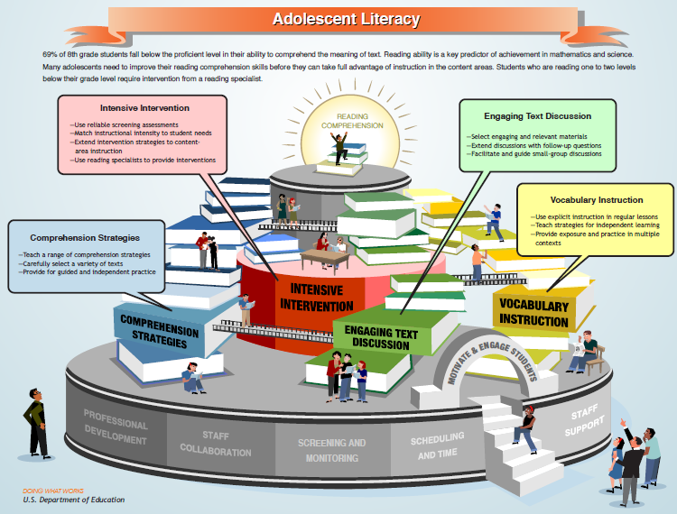
Notes:
The statistic at the top of this graphic (69%) is based on 2011 NAEP 8th grade reading results. The 2013 NAEP results for 8th grade reading is 68% of 8th graders fall below proficient. In Florida, the percentage is greater (70%).
Remember: the purpose of these assessments is to ultimately improve design of instruction in the classroom that targets reading comprehension.
The ultimate goal for LAFS is for students to have adequate reading comprehension in order to be college and career ready. In order to be college and career ready, all students need instruction that is tailored to their level of skill. In order to determine each student’s level of skill and tailor the instruction, we need valid and appropriate screening assessment.
Therefore, the scores on FAIR-FS, are the first step towards improved reading comprehension.
Now that we’ve talked about the scores that you will receive from FAIR-FS, let’s look at how you can use these scores to design instruction.

Slide 94

Effective Practices for
Literacy Instruction
1. | Provide explicit vocabulary instruction.
2. | Provide direct and explicit comprehension strategy instruction.
3. | Provide opportunities for extended discussion of text meaning and interpretation.
4. | Increase student motivation and engagement in literacy learning.
5. | Make available intensive and individualized interventions for struggling readers that can be provided by trained specialists.
Notes:
The What Works Clearinghouse uses a set of highly rigorous procedures (determined by experts in reading, reading research, and research design) for evaluating studies of instructional programs, instructional practices, and curricula. Groups within IES have then compiled these results into “What Works”.
These 5 recommendations for effective instructional practices to increase literacy skills have the strongest evidence.
The full text Practice Guide can be found at What Works Clearinghouse http://ies.ed.gov/ncee/wwc/
Additional resources that fit into each of these 5 categories and provide demonstrations and more concrete details can be found at:
http://centeroninstruction.org/informational-text-structure-module-2-grades-6-12-using-knowledge-of-text-structure-to-improve-comprehension-in-grades-6-12, Collaborative Strategic Reading http://iris.peabody.vanderbilt.edu/csr/chalcycle.htm,
Peer tutoring strategy for grades 2 – 6 http://iris.peabody.vanderbilt.edu/pals26/chalcycle.htm
(Kamil, Borman, Dole, Kral, Salinger, & Torgesen, 2008)

Slide 95
1. Explicit Vocabulary Instruction
Dedicated time for explicit vocabulary instruction
Teach new words:
  Multiple contexts
  Sufficient practice
  Opportunities to use the new vocabulary (writing, discussion, & extended reading)
Teach strategies for independent vocabulary learning
Notes:
Direct and explicit instruction involves a series of steps that include explaining and modeling the strategy, using the strategy for guided practice, and using the strategy for independent practice. (I do, we do, you do)
Teachers should provide students with explicit vocabulary instruction both as part of reading and language arts classes and as part of content-area classes such as science and social studies.
Children often learn new words incidentally from context. However, according to a meta-analysis of the literature, the probability that they will learn new words while reading is relatively low—about 15 percent
Find more demonstrations and materials, go to : http://dww.ed.gov/Adolescent-Literacy/topic/index.cfm?T_ID=23
Cited from Kamil et al., 2008, page 11-15

Slide 96
1. Vocabulary Strategies
Morphological Analysis – ex. audience, audible, auditory
Word Origin Tracing – ex. Greek/Latin roots
Semantic Mapping – visual displays of words
Synonyms & Antonyms
Context Clues
Notes:
Significant research (Henry, 1993, 1999; Moats, 2000; Treiman, 1993; & Venezky, 1999) demonstrates that word origin or etymology also can make the learning of words momentous.
Definition for morphological analysis: breaking words into derivational suffixes, prefixes, and base words.
About 60% of English words are derived from Latin and are found everywhere; they can be especially important for reading comprehension when found in content area textbooks. ‘‘Audi’’ (to hear) is one example; from it, many words are formed: auditory, audience, audit, auditorium, audible. Beck, McKeown, and Kucan (2001) and CCSS call these second-tier words because students generally encounter them after third grade.
Teachers might also use structural analysis to make words meaningful. For example, teachers might show students how knowing the meaning of common morphemic
roots can provide insight into word meanings: knowing the meaning of ‘‘rupt’’ (to break) can unlock the meaning of rupture, erupt, disrupt, corrupt, bankrupt, abrupt, interrupt, irrupt. Knowing the meaning of ‘‘tract’’ (a drawing out) can unlock the meaning of tractor, traction, contract, subtract, retract, protract.

Slide 97
2. Explicit Comprehension Instruction
Select text for each strategy
  Select appropriate reading level
Generalize strategies to different texts
Provide guided practice
Demonstrate your own use of comprehension strategies (think aloud)
Notes:
Comprehension strategies are routines and procedures that readers use to help them make sense of texts. Use of strategies has significant empirical support (Brown, Campione, & Day, 1981; Dole et al., 1991; Kame’enui et al., 1997; Pearson & Dole, 1987; Pressley, Snyder, & Cariglia-Bull, 1987)
Direct and explicit teaching involves a teacher modeling and providing explanations of the specific strategies students are learning, giving guided practice and feedback on the use of the strategies, and promoting independent practice to apply the strategies. In addition, explicit instruction involves providing a sufficient amount of support, or scaffolding, to students as they learn the strategies to ensure success.
Cited from Kamil et al., 2008, page 16-20

Slide 98
2. Comprehension Strategies
Summarizing
Finding the main idea
Self-questioning
Paraphrasing
Drawing inferences
Graphic Organizers
Notes:
The point here is that it may not be the particular strategies that make the difference in terms of student comprehension. Many researchers think that it is not the specific strategy taught, but rather the active participation of students in the comprehension process that makes the most difference on students’ comprehension. Instruction in reading strategies may help some students become active readers. Gersten et al. (2001); Pressley et al. (1987)
It appears that multiple-strategy training results in better comprehension than single-strategy training.
As the lesson begins, it is important for teachers to tell students specifically what strategies they are going to learn, tell them why it is important for them to learn the strategies, model how to use the strategies by thinking aloud with a text, provide guided practice with feedback so that students have opportunities to practice using the strategies, provide independent practice using the strategies, and discuss with students when and where they should apply the strategies when they read and the importance of having the will to use the strategies along with the skill. Even if students know how to use strategies as they read, research demonstrates that they have to make the effort to actually use them when they read on their own.

Slide 99
3. Extended Discussion of Text
Extended discussions of text enable the student to increase their ability to comprehend complex text.
Discussions could occur in small groups or whole class in various content areas.
Students are asked to defend their answers with textual evidence.
Teachers need to carefully prepare for these discussions with engaging selections and stimulating questions.
Notes:
Extended discussions of text enable the student to increase their ability to comprehend complex text. The goal is not to simply obtain the literal meaning, but to also make deeper interpretations, generalizations, and conclusions.
Cited from Kamil et al., 2008, page 21-25

Slide 100
4. Increase Student Motivation
& Engagement
When fostering motivation in students, research supports:
  Frequent feedback
  Supportive positive learning environment/personal connections
  Provide frequent choices
Teachers’ emphasis (e.g., encouragement) of mastery of skills (e.g., reading comprehension strategies) over performance on tests (e.g., FCAT level 4) leads to better performance on outcome tests.
Example: Simply telling a student that they scored at the 50th percentile will NOT be helpful for that student to improve performance.
Connecting specific instructional content with explicit feedback to test scores is critical.
Notes:
Correlational evidence suggests that motivation to read school-related texts declines as students progress from elementary to middle school. Gottfried (1985)
The strongest decline is observed among struggling students. Harter, Whitesell, and Kowalski (1992)
Cited from Kamil et al., 2008, page 26-30

Slide 101
5. Intensive and Individualized Interventions
Provide supplemental, intensive and individual interventions for struggling readers provided by trained specialists.
Intensive instruction by specialists will ONLY be effective if it is in addition to, not in place of, intensive content-area instruction.
The purpose of intensive interventions is to accelerate literacy development.
Two-step process:
  Initial screening to identify those students who need extra help
  Diagnostic tests to provide a profile of literacy strengths and weaknesses
Notes:
Cited from Kamil et al., 2008, page 31-36

Slide 102
5. Intensive and Individualized Interventions
Addressing Word Recognition skills
For students with scores indicating:
  Relative weakness on the WRT
  May also have lower performance on all tasks
Explicit instruction in decoding, including:
  Supplemental curricular programs for decoding identified by your school district
  Evidence-based supplemental activities

Slide 103
Increasing Syntactic Knowledge Strategies
Syntactic Knowledge is an awareness of the structure of text that provides the reader “keys” to “unlock” the meaning.
Teach connectives (conjunctions) – words or phrases that link clauses and sentences together to create more complex text.
Teach pronoun reference.
Teach subject/verb agreement.
Notes:
An important instructional target is syntactic knowledge, an awareness of the structure of texts. Instructional strategies that focus on connectives – words or phrases that link clauses and sentences together – can help students identify an author’s organizational pattern and, consequently, “unlock” the author’s message. This is a critical component of LAFS, and it is especially important in supporting student capacity to comprehend texts. Other aspects of syntactic instructional strategies include teaching:
Pronoun references
Subject/verb agreement
Examples:
Connectives: Cause and effect: consequently, thus, so, because, as, since, as a result. Sequence: initially, then, so far, finally, subsequently, eventually. Addition: and, more, and then, too, also. Contrast: but, however, instead, yet
Pronoun reference: Personal (I, you, he/she) Possessive (mine, yours, hers) Relative (who, what, that) Indefinite (anyone, everyone, something) Interrogative (who, which, why) Demonstrative (this, that, these)

Slide 104
Implications for Open Response Tasks

Slide 105
Open Response Tasks
Purpose: the information provided in these tasks is for:
  Further targeting instructional practices
  Providing more in-depth descriptive information (to other teachers, parents, students)
Results on these tasks are NOT validated for:
  High stakes decision-making
  Aggregating at the classroom or school level
Notes:
Future studies of the Oral Reading Fluency metric and the Writing Fluency metric may validate use for measuring growth in response to intervention. However, those metrics should not be used as such until those studies are conducted.

Slide 106
Oral Response
Analogous to a road map (Heritage, 2008; Popham, 2007):
  Each level of the rubric designates pivotal stops along the way to reach destination (standard)
  Specific feedback is necessary to move student from where s/he is to the next stop
For instruction, use reading
comprehension strategies
Notes:
In this particular task, the numerical score has no intrinsic meaning. Hearing the student’s responses to the 3 comprehension questions enables the teacher to “see” the student’s thinking process and therefore making it easier to diagnosis where to target instruction. The important information is to see where the student is in learning the particular skill and providing scaffolding, modeling, and feedback to move the student to the next step. For many students performing in the “emerging” or “not evident” categories, they may need to progress through multiple other steps first in order to reach expectations.

Slide 107
Written Response
Analyze at each level to target intervention (Puranik et al., 2008; Wagner et al., 2011)
  Word (TWW; CIWS spelling errors)
  Sentence (CIWS punctuation, syntax errors)
  Discourse (LAFS checklist)
  For instruction, use writing strategies.
Notes:
The writing task has multiple scoring components in order to draw attention to the multiple aspects that contribute to overall writing quality. Writing experts and researchers find that the source of a student’s difficulty with writing can occur at the word level (e.g., spelling, handwriting/typing, vocabulary choice), at the sentence level (e.g., fragments/run-ons, agreement, punctuation), and at the discourse level (e.g., creating a coherent argument).
In order to most efficiently target instruct to have the largest impact for struggling students, teachers need to know which level to target. For example, a student who is struggling to write complete sentences needs additional targeted instruction and feedback in forming and revising sentences.
TWW – total words written CIWS – Correct minus Incorrect Writing Sequences

Slide 108
Writing Instruction
Provide daily time for students to write
Teach students to use the writing process for a variety of purposes
Teach students to become fluent with handwriting, spelling, sentence construction, typing, and word processing.
Create an engaged community of writers
Notes:
This list of recommendations comes from the What Works Clearinghouse – provides the research evidence that is available for instructional practices in writing.
For elementary and early middle school writers -Teaching Elementary School Students to Be Effective Writers,
(Graham, Bollinger, Olsen, D’Aoust, MacArthur, McCutchen, & Olinghouse, 2012). http://ies.ed.gov/ncee/wwc/PracticeGuide.aspx?sid=17
For middle and high school writers: Self-regulated strategy instruction spans from elementary to high school and from students with learning disabilities to students struggling with writing to students progressing as expected.
Harris, K.R., Graham, S., Mason, L.H., & Friedlander, B. (2008). Powerful Writing Strategies for All Students. Brookes Publishing: Baltimore, MD.
Additional resources:
http://cehs.unl.edu/csi/writing.shtml
http://iris.peabody.vanderbilt.edu/srs/chalcycle.htm

