Slide 1
Florida Assessments for
Instruction in Reading aligned to the
Language Arts Florida Standards
FAIR-FS Purpose &
Getting Started with the PMRN
Notes:
Presenter:
Introduce presenters.
Provide purpose of training.
USB bracelets provided. Can use during presentation on personal laptops to follow, add notes, etc.
Survey audience for roles.
“As you can see from the footers this project is sponsored and funded by the Florida Department of Education who contracted with the Florida Center for Reading Research.”

Slide 2
Introduction
Materials to stakeholders
  PowerPoint sections for specific users
  Technical specifications: district/school IT staff
  Administration manuals
  Student orientation PowerPoints
  1-page administration guides
Agenda
Notes:
Presenter:
“Since this is a train-the-trainer session, you are being provided with a large amount of information that is targeted toward a variety of audiences. Knowing that you will be asked the most questions by a variety of educators, we will be providing more background information than is necessary for the most users. For the most part, the PowerPoint is broken into sections by user. You can decide which sections to distribute to and train each user in your school district (e.g., principals, reading coaches, district IT coordinators). And, you may choose to delete or add slides to certain sections. We have used the hidden slide function strategically throughout our materials so that you have the information available, but can choose whether or not to present them. The slides that we’ve hidden are because we think some people might be interested in having them, but they aren’t necessary for us to present to you at this time.”

Slide 3
Session Topics
Assessment and the FAIR-FS: An Overview
Development of the FAIR-FS
System Specifications
PMRN Overview
Single Sign-On
Principal’s Role
PMRN Manager’s Role
Coach’s Log
Notes:
Presenter: “Our goal is that by the end of the session, you will have increased knowledge of these areas:”
Present slide.

Slide 4

Assessment and the FAIR-FS: An Overview
Notes:
Presenter: “This section describes the context for assessment in general and the role that FAIR-FS plays in assessing Florida’s students.”

Slide 5
Teacher: Are my students making progress? How do I differentiate instruction?
Parent: Is my child making the necessary progress?
Student: Am I accomplishing what my teacher expects? How am I doing compared to other students?
Administrator: Are a majority of our students succeeding with our curriculum?
Notes:
Presenter:
“Schools have a variety of stakeholders with a variety of critical decisions to make in order to impact those life and career outcomes we all know can be impacted by education. Stakeholders increasingly want objective information in order to make their decisions.
One source of information (e.g., end of year test) cannot appropriately answer each of these questions.”

Slide 6
Functions of Assessment
Is Stanley responding to the curriculum?
How is Stanley doing in reading compared with other students his age?
Is Stanley gaining the skills necessary to be a good reader?
Report Cards
Progress monitoring
End of Year test
Screening
Formative Assessment
Is Stanley making appropriate progress to graduate from high school?
Is Stanley demonstrating skills that represent the Language Arts Florida Standards?
Did Stanley understand the concept presented in class yesterday?
Notes:
Presenter:
“These are just a few of the critical questions that need to be answered within education and some of the mechanisms by which those questions are answered.”
Additional information:
Is Stanley responding to the curriculum? (report card grades, curriculum embedded assessments)
How is Stanley doing in reading compared with other students his age? (screening)
Is Stanley gaining the skills necessary to be a good reader? (screening)
Is Stanley making appropriate progress to graduate from high school? (end of year test)
Is Stanley demonstrating skills that represent the standards? (formative assessment)
What is the likelihood that Stanley will pass the end of year test? (screening)
Did Stanley understand the concept presented in class yesterday? (formative assessment)
Does Stanley have a learning disability? (ongoing progress monitoring of intensive evidence based instruction/intervention)
Is my child making the necessary progress?(end of year test)
Each assessment tool is developed to answer specific questions and may or may not be used to answer other questions. They must be validated for each specific use.

Slide 7
Integrated Assessment
Evidence base for data-based decision making
  Screening Assessments (FAIR-FS)
  Diagnostic Assessments (FAIR-FS)
  Formative Assessments (classroom-based)
  Outcome Assessments (SAT-10, FSA)
Notes:
Presenter:
“Assessing students’ ability to read and understand requires a system’s approach that includes multiple components as part of a carefully planned comprehensive assessment plan.”
Present slide.
Additional information:
Hamilton, L., Halverson, R., Jackson, S., Mandinach, E., Supovitz, J., & Wayman, J. (2009). Using student achievement data to support instructional decision making (NCEE 2009-4067). Washington, DC: National Center for Education Evaluation and Regional Assistance, Institute of Education Sciences, U.S. Department of Education.
Retrieved from http://ies.ed.gov/ncee/wwc/publications/practiceguides/
For more information on systematically integrating assessments at a school, download and use the following reference from www.centeroninstruction.org
Torgesen, J. K. (2006) A comprehensive K-3 reading assessment plan: Guidance for school leaders. Portsmouth, NH. RMC Research Corporation, Center on Instruction
SAT - 10 Stanford Achievement Test, Tenth Edition is considered a gold standard nationally-normed outcome assessment of reading comprehension
FSA – Florida Standards Assessment

Slide 8
Questions Addressed by FAIR-FS
Which important reading skills are strengths and weaknesses for Stanley?
What skills should be targeted for instruction in order to improve Stanley’s reading comprehension?
What is the likelihood that Stanley will pass the end of year test?
Has Stanley made progress since the beginning of the school year?
Notes:
Presenter:
“Screening and diagnostic assessments like the FAIR-FS answer different questions than those asked by FCAT or the new LAFS outcome tests or other high stakes assessments.”
Present slide.

Slide 9
The FAIR-FS is a comprehensive system designed to:
Predict students’ literacy success
Diagnose weaknesses
  Research-based teachable skills
Set instructional objectives
Monitor literacy growth
Notes:
Presenter:
“As you can see, each of these design features relates to ongoing instruction and literacy growth. FAIR-FS is not about obtaining an outcome score.”

Slide 10
Reliability & Validity
First 2 questions asked about measurement:
  Does it actually measure what they say it measures?
  – validity –
  Does it measure the same thing every time?
  – reliability –
Computer-adaptive format of FAIR-FS increases reliability (and efficiency) by tailoring the task to the student
Average reliability on FAIR-FS is 0.9 (very high)
FAIR-FS demonstrates predictive validity
Notes:
Presenter:
“In order to make claims of validity, an assessment must first be determined to be reliable.
The answers to these 2 questions can be quantified through research studies. In our studies of the tasks within FAIR-FS, we first established reliability.
The reliability of an assessment is considered to be adequate at 0.7 and good at 0.8. The average reliability for FAIR-FS is exceptional (>0.9). Since the assessment is computer-adaptive we can also calculate the reliability for each individual student. In the field study, we found that FAIR-FS was reliable for 99% of students in grades K through 10.
Once we found that tasks were reliable, we then conducted a prospective study to determine validity. There are many different types of validity that can be reported, depending on the purpose of the assessment. Careful scrutiny of technical reports are needed to determine if validity has been established for the purpose the assessment is used.”

Slide 11
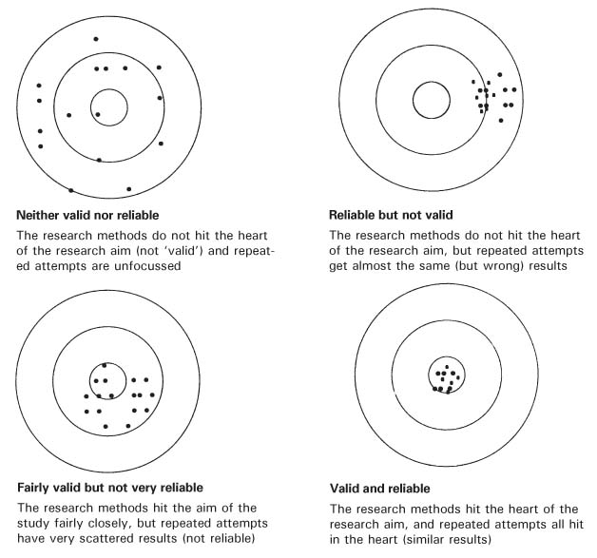
Reliability & Validity
Not Reliable
Reliable
Not Valid
Valid
Notes:
Presenter:
“ As an example, think of a target. The most valid shots are the ones that hit the bullseye, the center of the target. Reliable shots are the ones that cluster together. The upper left target shows that the shots are scattered, random, and haphazard. In other words, both reliability and validity are low.
The top right target shows that the shots all hit the same general area, so they were reliable. However, they didn’t land on the bulls eye so they aren’t valid.
In the bottom left target, the shots are closer to the bulls eye so they are more valid but not reliable because they aren’t clustered.
In the bottom right target the shots hit both the bulls eye (valid) and are clustered together (reliable).”

Slide 12
Section Summary
Different types of assessments are required to meet different purposes
FAIR-FS purposes
FAIR-FS is reliable and valid for use as a screening tool
Notes:
Presenter:
“We’ve come to the end of the first section. The bulleted items summarize what we discussed.”
Present slide.
Additional information:
Cited from Torgesen & Miller (2009)
For more information about integrating assessments, see “Assessments to Guide Adolescent Literacy Instruction” at http://centeroninstruction.org/adolescent-literacy-institute

Slide 13
Reflection
Discuss with your neighbor:
how your district may use the FAIR-FS
other assessments used in your district and the purposes they serve
what are the questions your teachers are asking about assessments and scores
Notes:
Present slide.
If time allows, provide about 5 minutes for discussion.

Slide 14
The FAIR-FS is a comprehensive assessment designed to:
Predict students’ literacy success
Diagnose weaknesses
  Research-based teachable skills
Set instructional objectives
Monitor literacy growth
Notes:
Presenter:
“Did you and your neighbor come up with these purposes?
Do the purposes for other tests in your district overlap with the purposes in the FAIR-FS?”

Slide 15
Session Topics
Assessment and the FAIR-FS: An Overview
Development of the FAIR-FS
System Specifications
PMRN Overview
Single Sign-On
Principal’s Role
PMRN Manager’s Role
Coach’s Log
Notes:
Presenter: “ We have completed the purpose and will now move to System Specifications.“

Slide 16
Development of the FAIR-FS
Notes:
Presenter:
“ This section will provide an overview of the development of the content of the FAIR-FS.”

Slide 17
Components of Reading Comprehension
Word Recognition
Language Comprehension (vocabulary knowledge; syntactic knowledge)
World Knowledge
Motivation
Cognitive Abilities (e.g., working memory, executive functions)
Notes:
Present slide.
Presenter:
“The individual subtests measure those component skills of reading comprehension (Word Recognition and Vocabulary Knowledge) that most heavily influence a student’s later performance in reading comprehension.”
Additional information:
The FAIR-FS is grounded in the latest research-based conceptualizations (Perfetti & Stafura, 2014) of reading comprehension as consisting of competencies in the following areas : word recognition, language comprehension (e.g., vocabulary and syntactic knowledge), world knowledge, motivation, and cognitive abilities (e.g., working memory; executive function). The 3-12 FAIR-FS includes tasks of word recognition, vocabulary, syntax, and reading comprehension. It handles world knowledge by ensuring that the reading comprehension items are based on Florida Standards and questions can be answered by reading the passage. Motivation is indirectly addressed by reporting the number of minutes students spend on each passage. Cognitive abilities are indirectly addressed by providing a computer-adaptive system that adapts to the students’ level of functioning.

Slide 18
Background and Research
Foundation for FAIR-FS
Development of the FAIR-FS occurred over the course of 2 grants with multiple studies
Findings included
  Additional support for the Simple View of Reading: alphabetic principle + meaning = comprehension
  Importance of oral language skills (Syntax and Vocabulary)
  Utility of Item Response Theory in assessment
Notes:
Present slide.
Additional information:
The FAIR-FS was developed with two federal grants to the Florida Center for Reading Research at Florida State University. The first was a measurement grant (2011-2014) focused on innovations in computer-adaptive testing that allow for tasks that take less time, are more reliable (above .90), and address more teachable skills than commercially available screening measures. The second grant (2010 – 2015) allowed FCRR to investigate the reading and language skills that best predict literacy outcomes and then to develop and empirically validate items that address these skills. Studies have been conducted to examine item difficulty and item information to produce a developmental ability scale and Florida representative norms for FAIR-FS tasks. The Florida Department of Education then funded an implementation study (2013-2014) to receive teacher input into a new diagnostic tool, administration manuals, and professional development materials.
Recent research has shown that explicit instruction in the alphabetic principle is necessary to learn to decode and to prevent reading difficulties.
Mastery of alphabetic principle must be coupled with construction of meaning--
at the word, sentence, and text level--if comprehension is to occur. (This is the Simple
View model of reading and has hundreds of studies lending empirical support)
Oral language skills (such as syntax and vocabulary) are crucial to the construction of meaning of written language and must be addressed in assessment and instruction.
In order to maximize the amount of valid information provided to educators, parents, and students, while minimizing time spent testing, FAIR FS was created as a computer-adaptive assessment, which utilizes Item Response Theory.
The primary focus of the FAIR-FS is to assess the skills that predict successful reading comprehension. Each assessment task also matches 1 or more standards.

Slide 19
Efficiency & Reliability
The FAIR-FS utilizes Computer Adaptive functionality to:
  Maximize the amount of information provided
  Maximize reliability
  Minimize testing time
Results in scores that can be used to
  Target instruction
  Monitor growth in specific skills
Notes:
Presenter:
“In the FAIR 2009 system, users really liked the small amount of time that it took to administer the assessment. However, many expressed frustration that the screening component only included 1 to 2 discrete skills and provided less information about important reading skills than other reading screening assessment tools.
The FAIR-FS has more tasks in the screening to provide quite a bit more information. Adding more tasks increases the amount of time required for assessment. The amount of time for each task has been greatly reduced by using more sophisticated statistics: Item Response Theory. Formulas are calculated by the computer in the background.”

Slide 20
Fixed Item vs. CAT
Fixed Item
Notes:
Presenter:
“On the fixed item test, all students receive the same questions or items regardless of whether they are low, average, or high ability.
This is an example of a typical assessment in which every student is administered the same items in the same order (not computer-adaptive). The K-2 FAIR 2009 was not a computer-adaptive assessment.
As you can see from this example showing the items administered to 3 different students, every student, no matter their abilities, was administered the same set of items. This is how many assessments operate. When test reliability is reported, the average reliability is reported and it’s assumed that the reliability of the assessment is the same for all students. However, it’s very likely that the reliability is not the same for all students taking the same set of items. For example, if a lower ability student knew some words, but read 0 words from this particular list, we could not get a reliable estimate of that student’s actual abilities. Similarly, the score for a student who got all 10 correct may not be reliably measuring their abilities. One way to improve reliability for ALL students and still maintain a relatively short assessment, is to deliver different items to students depending on their abilities. That type of assessment format is called computer adaptive testing (CAT).”

Slide 21
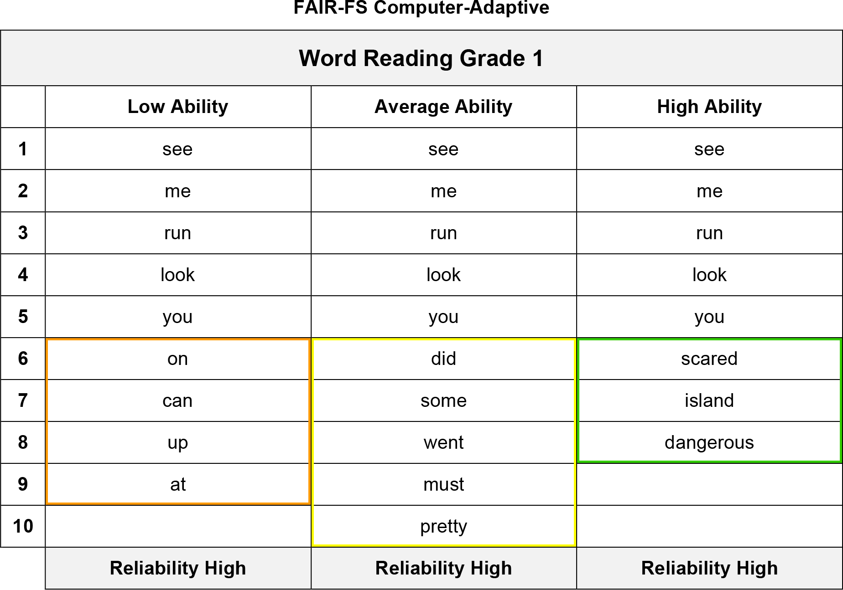
Fixed Item vs. CAT
Notes:
Presenter:
“Here is an example of the way the computer-adaptive assessment works. All ability levels start with the same 5 words. If the low ability reader misses all or most of the grade level words, the computer will provide easier words until a reliable estimate of ability is established. On the other end, the high level reader is given harder words to decode until a reliable estimate of ability is established. We want to know more information about the reader rather than just knowing how many grade level words he/she can decode. We want to know how high or how low their ability ranges. The computer-adaptive format tailors the tasks to each student which results in a highly reliable score for all levels in each task assessed.”

Slide 22
Section Summary
Components of reading comprehension
Background and research
Computer adaptive functionality
Notes:
Presenter:
“In this section we discussed the development of the FAIR-FS. The development was based on the components of the reading comprehension. The FAIR-FS consists of individual subtests which measure these component skills of reading comprehension (Word Recognition and Vocabulary Knowledge) that most heavily influence a student’s later performance in reading comprehension.
Based on research and advances in computer adaptive functionality the FAIR-FS was created as a more valid, reliable, and efficient assessment.”

Slide 23
Session Topics
Assessment and the FAIR-FS: An Overview
Development of the FAIR-FS
System Specifications
PMRN Overview
Single Sign-On
Principal’s Role
PMRN Manager’s Role
Coach’s Log
Notes:
Presenter:
“We have discussed Development of the FAIR-FS. Are there any questions?”

Slide 24
System Specifications
Notes:
Presenter:
“This section of slides provides the minimum specifications for use of the FAIR-FS across all grades K-12 and administration of the PMRN. For schools that are not using all of the applications (K-2 FAIR-FS, 3-12 FAIR-FS, and PMRN), we are listing the system specifications separately for each application.
This information needs to go to your district and school level IT person/department.”

Slide 25
System Specifications
Recommended Bandwidth Specifications
  External Connection to Internet
    100 kbps per student or faster
    Example: at 9:30am, when 10,000 students in a district’s high schools, middle schools, and elementary schools are testing at the same time, the district’s bandwidth would need to be 1 gbps or faster
  Internal School Network
    1000 kbps per student or faster
Notes:
Presenter:
“To successfully administer the FAIR-FS across all grades (K-12) on the same day, these are the minimum bandwidth requirements.”
Present slide.

Slide 26
System Specifications
Desktop, Laptop, Netbook & Thin Client / Virtual Desktop Infrastructure
  Operating System
    Windows – XP, 7, or newer
    Mac OS 10.7 or higher
    Linux – Linux: Ubuntu 11.10, Fedora 16 or newer
    Memory – 1gb RAM or greater
    Connectivity - Computers must be able to connect to the Internet via wired or wireless networks.
    Screen Size – 9.5 inch screen or larger
    Screen Resolution - 1024 x 768 resolution or higher
Notes:
Present slide.

Slide 27
System Specifications
Desktop, Laptop, Netbook & Thin Client / Virtual Desktop Infrastructure
  Input Device Requirements
    Keyboard, Mouse
  Headphone/Earphone Requirements
    K-2 requires a “Y” jack splitter
    3-12 requires one set of headphones per computer
Notes:
Present slide.
Additional information:
The input device must allow students to select/deselect, drag, and highlight objects and areas. Based on our field testing, we recommend using an external mouse and not a touchpad for the K-2 FAIR-FS AIR. The input device must allow students to enter letters, numbers, and symbols and shift, tab, return, delete, and backspace. To meet security guidelines, each Bluetooth/wireless keyboard and/or mouse must be configured to pair with only a single computer during assessment administration.
Other assistive technologies may be needed for students requiring accommodations.
Headphones are required for both the K-2 and 3-12 FAIR-FS. It is recommended that for the K-2 that the audio output have a splitter (“Y”) and both the teacher and the student have headphones. In the field testing of the K-2 application, assessors found the Y splitter to be necessary since testing in a quiet room with just the speakers playing the audio was a highly unlikely scenario.
For the 3-12, the student is required to have headphones.
There is no requirement for microphones.

Slide 28
System Specifications
Browser Specifications
  Internet Explorer (IE)
    Version 9, 10
  Chrome
    Version 32
  Firefox
    Version 26
  Safari
    Version 5.1.7
  Flash Player
    Version 10.3
Notes:
Present slide.

Slide 29
Progress Monitoring and
Reporting Network (PMRN)
Overview

Slide 30
Section Topics
What is the PMRN?
New URL
PMRN Technology Requirements
Security
PMRN v3 and v4 Differences
Notes:
Present slide.
Presenter: The topics that we will cover in this section include:
What is the PMRN?
New PMRN URL Address
PMRN Technology Requirements
PMRN Security
PMRN v3 and v4 Differences

Slide 31
What is the PMRN?
Tool (web-based data management system) for facilitating the use of reading/language arts data to inform instructional decisions
The PMRN facilitates this process through:
  Setting the calendar for administering screening assessment
  Rostering students in grade levels at schools with assigned teachers
  Summarizing and reporting specific data points for use in instructional decisions
  Authorizing educators to access student data
Notes:
Presenter:
“ In order to facilitate instructional decision-making in the area of reading, teachers, reading coaches, and support staff need a tool to organize data and make that data readily AND securely available to those making instructional decisions for individual students, groups of students, and schools of students. The first version of the Progress Monitoring and Reporting Network (PMRN) was created to organize and report the data from the DIBELS assessments and subsequent versions were enhanced to facilitate use of the FAIR 2009.
The PMRN version 4 serves several vital functions that facilitate the administration of and data organization for the FAIR-FS. This is a very basic view of the complex methods the PMRN v4 uses.”

Slide 32
3-12 FAIR-FS WAM
K-2 FAIR-FS AIR
WSS
Coach’s Log
Progress Monitoring and Reporting Network
calendaring rostering reporting authorizing
3-12 FAIR-FS Reports
K-2 FAIR-FS Reports
FLKRS Reports
Coach’s Log Reports
Notes:
Presenter:
“Version 4 of the Progress Monitoring and Reporting Network (PMRN) performs the calendaring, rostering, authorizing, and reporting functions that enable the use of the FAIR-FS assessments. It provides access to the ‘input’ applications (shown along the top of this graphic). These are the applications that administer the grades 3-12 assessments and the grades K-2 assessments. In grades K-2, an Adobe application must be downloaded onto a computer and can be administered with or without access to the internet.
The PMRN is also the system used for reporting the Florida Kindergarten Readiness Screener (FLKRS), which is a statutory requirement for screening Kindergarten students who previously attended a Florida VPK program.
The PMRN houses the Professional Development Log for Reading/Literacy Coaches, which is required by State Board Rule 6A-6.053a and is a tool that is used to identify the critical roles of a reading coach that will impact the reading program at a school and to guide the performance of the Reading/Literacy Coach.”

Slide 33

New Address
https://pmrn.fldoe.org
Notes:
Present slide.
Presenter:
Notice that the PMRN is now completely hosted on FLDOE’s web servers and not FCRR.
It is important to note that PMRN Users that utilize the SSO can access the PMRN through both the FLDOE SSO Portal and the PMRN Sign In page.

Slide 34
PMRN Technology Requirements
Browser Minimum Requirements
  Internet Explorer (IE)
    Version 9, 10
  Google Chrome
    Version 32
  Mozilla Firefox
    Version 26
  Apple Safari
    Version 5.1.7
Monitor Resolution
  1024 x 768
Notes:
Presenter:
These are the technology requirement specific to the PMRN
Browser minimum requirements:
Internet Explorer (IE) versions, 9, 10
Google Chrome version 32
Mozilla Firefox version 26
Apple Safari version 5.1.7
For computers utilizing Windows or Apple/Macintosh operating systems, the enabling of JavaScript and Cookies are required.
It is recommended that your monitor resolution be set to 1024 by 768.

Slide 35

PMRN Security
Secure Socket Layer (SSL)
Saving Passwords
Signing Out
Protect Your Identity
Notes:
Presenter:
“The PMRN was designed to protect student and teacher data.
Secure Socket Layer (SSL): The PMRN is a secure socket layer (SSL) encrypted site, using the same 128-bit encryption that a bank website uses.
Saving Passwords: Some computers and Internet browsers allow you to Save Passwords. It is recommended that you do not have your computer remember your PMRN Password. Ask your site technology specialist about disabling the option to Save Passwords.
Signing Out: When you complete a PMRN session, please Sign Out. The PMRN will automatically end your session if you are idle for twenty minutes. If you must leave the computer, please Sign Out so that another person who might use your computer cannot have access to information within the PMRN.
Note: To prevent being “timed out”, click Save, refresh the page, or load a new report within twenty minutes. Typing is not considered an action that prevents being “timed out”, as the database is not refreshed.
Protect Your Identity: You should keep your SSO User Name and Password in a secure location, and you should not share it with anyone. Details about privacy and security issues can be found on the PMRN site through the Copyright, Privacy Statement, and Disclaimer links found at the bottom of the Sign In page.”

Slide 36

Enhancements to the PMRN
URL/Web Address
No Exclusions
Assessment Calendar
Score Invalidation
Copied Scores
PMRN v4 User’s Guide
WAM Transfer Function
WAM Automatic Updates
Notes:
Present slide.
Additional information:
Since no students can be excluded from testing they should not be rostered in the PMRN. If they are rostered, withdraw them from the PMRN.
Support Specialists cannot invalidate scores.
Students can be withdrawn from a school in the middle of a task.
Scores will automatically copy to a new school when a student transfers.

Slide 37
Enhancements to the PMRN
New URL/Web Address
  https://pmrn.fldoe.org
No student exclusions through PMRN
  Students not assessed
    Should not be rostered into PMRN
    If previously rostered, must be withdrawn from school
Notes:
Present slide.
Additional information:
Students may not be excluded from testing through the PMRN.
Students who will not be assessed using the FAIR-FS are not to be rostered in the PMRN and, if they are rostered, they are to be withdrawn from the school (NOT only removed from the class).

Slide 38

Enhancements to the PMRN
Assessment Calendar
  Three equal Assessment Periods (AP)
    AP1 = Instructional Days 1 – 60
    AP2 = Instructional Days 61 – 120
    AP3 = Instructional Days 121 - 180
  No Norming Periods
  No Lockdown Periods
  NOTE: FLKRS must still be administered during the first 30 instructional days
Notes:
Presenter:
“The year will be divided into three equal Assessment Periods of 60 days each (AP1 = Instructional Days 1-60; AP2 = 61-120; AP3 = 121-180).
There will no longer be an identified “Norming” period or “Lockdown” period.
NOTE: FLKRS must still be administered during the first 30 instructional days.”

Slide 39
Enhancements to the PMRN
Invalidation and Withdrawal
  Score invalidation is no longer available
  Support Specialists unable to invalidate scores
  Students not completed with task may be withdrawn
  Student may continue with task when enrolled in new school that they left off of in previous school
Notes:
Presenter:
“The Support Specialists at the Help Desk at the Florida Center for Reading Research or the FLDOE will not be able to invalidate scores.
Students who have not completed a task can be withdrawn without completing the task.
The next school that enrolls the student during the same AP will pick up the student where the student left off in the task.”

Slide 40
Enhancements to the PMRN
Copied Scores
  Scores from previous school will transfer automatically when student is enrolled
  School Level Users and teachers do not have the option to copy or not copy scores
Notes:
Presenter:
“The process of copying scores is being modified.
If a student already has scores from a previous school, the scores will automatically be transferred.
Teachers and school level Users will not have the option to copy or not copy the scores.”

Slide 41
Enhancements to the PMRN
PMRN v4 User’s Guide
  v4 User’s Guide currently in development by FLDOE
  v3 User’s Guide
    It is recommended that Users use the v3 User’s Guide until the v4 User’s Guide is available
  Major functions of the two applications are similar
Notes:
Presenter:
“The User’s Guide for PMRN v4 is currently under development.
Until one is developed, it is recommended that Users use the 2013-2014 v3 User’s Guide.
Although the look and feel of PMRN v3 and PMRN v4 are different, the major functions of the two applications are similar.”

Slide 42
Enhancements to the PMRN
3-12 Web-based Assessment Module (WAM) Transfer Function
  Data from the PMRN can ‘sync’ to the WAM
  User can now add students to a class in the PMRN and instantly assess them via the WAM
Notes:
Presenter:
“The 3-12 Web-based Assessment Module (WAM) for FAIR-FS now has an option to automatically ‘sync’ data from the PMRN to the WAM.
This function allows a User to instantly add any students in the WAM that have been recently been added to the school in the PMRN.”

Slide 43

Service Center Information
Florida Department of Education (FLDOE) Integrated Education Network Service Center
  Provide support via the PMRN v4, K-2 AIR, 3-12 WAM, and FAIR-FS
Operational Hours
  Monday – Friday
  7:00 AM – 7:30 PM ET
Contact via Phone or E-mail
  855-814-2876
  ienhelp@fldoe.org
Notes:
Presenter:
“Questions and requests for assistance should be directed to the Florida Department of Education (FLDOE) Integrated Education Network Service Center. The Service Center will provide Users with assistance on questions and issues regarding the PMRN, K-2 AIR, 3-12 WAM, and FAIR-FS.
Service Center operational hours are Monday through Friday, 7:00 AM – 7:30PM ET.”

Slide 44
Section Topics
What is the PMRN?
New URL
PMRN Technology Requirements
Security
PMRN v3 and v4 Differences
Notes:
Presenter:
“Section check – do I know how to do each of these steps? Which staff members need to perform these functions and how will I ensure they have this information?
What is the PMRN?
New PMRN URL Address
PMRN Technology Requirements (Give to IT department/person)
PMRN Security
PMRN v3 and v4 Differences

Slide 45
Session Topics
Assessment and the FAIR-FS: An Overview
Development of the FAIR-FS
System Specifications
PMRN Overview
Single Sign-On
Principal’s Role
PMRN Manager’s Role
Coach’s Log
Notes:
Presenter:
“ We’ve gone over the system specifications and introduced the PMRN. Next we will go through another critical new component to the PMRN for the 2014-2015 school year, the Single Sign-On.”

Slide 46
Single Sign-On
Notes:
Presenter:
“How many of you are currently using the Department of Education’s Single Sign-On portal?”

Slide 47
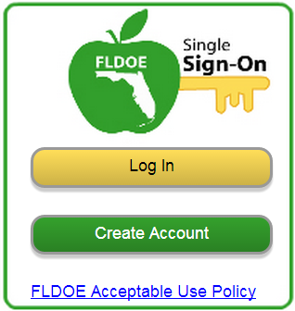
What is Single Sign-On?
The Florida Department of Education (FLDOE) Single Sign-On (SSO) provides a simpler way for educators to access several state resources with one username and one password.
Website: www.fldoe.org/sso
Notes:
Present slide.

Slide 48
Who can use Single Sign-On?
Essentially, everyone can use FLDOE SSO, however, the resources you can access depend on your role and the permissions you have been assigned.
Notes:
Present slide.

Slide 49
Teacher Resources on SSO
CPALMS - Collaborate, Plan, Align, Learn, Motivate, Share
eIPEP - Electronic Institutional Program Evaluation Plans
ELFAS - English Language Arts Formative Assessment System
IBTP - Items Bank and Test Platform
FSL - Florida School Leaders
PMRN - Progress Monitoring and Reporting Network
Notes:
Presenter:
These resources will be available through the SSO during the upcoming school year and training will be provided for each separately

Slide 50
Getting Started
Two authentication options for organizations:
  A “federated” solution (Locally-issued credentials)
  A “hosted” solution (FLDOE-issued credentials)
Notes:
Present Slide.

Slide 51
How to Login to SSO
Your path to logging into FLDOE SSO depends on whether your organization selected Federated or Hosted.
Federated
Hosted
Your login credentials are the same as your local network logon.
Your login credentials are provided to you via email.
Notes:
Present slide.

Slide 52
Federated Districts (44)
Hosted Districts (29)
ALACHUA
BAKER
BRADFORD
BREVARD
BROWARD
CHARLOTTE
CITRUS
CLAY
COLLIER
DADE
DEAF/BLIND
DESOTO
DUVAL
ESCAMBIA
FLVS FULL TIME
HAMILTON
HARDEE
HILLSBOROUGH
INDIAN RIVER
JACKSON
LAKE
LEE
LEON
LEVY
MANATEE
MARION
OKALOOSA
OKEECHOBEE
ORANGE
OSCEOLA
P.K. YONGE
PALM BEACH
PINELLAS
POLK
PUTNAM
SANTA ROSA
SARASOTA
SEMINOLE
ST. JOHNS
ST. LUCIE
UNION
VOLUSIA
WAKULLA
WALTON
BAY
CALHOUN
COLUMBIA
DIXIE
FAMU LAB SCH
FAU LAB SCH
FLAGLER
FRANKLIN
FSU LAB SCH
GADSDEN
GILCHRIST
GLADES
GULF
HENDRY
HERNANDO
HIGHLANDS
HOLMES
JEFFERSON
LAFAYETTE
LIBERTY
MADISON
MARTIN
MONROE
NASSAU
PASCO
SUMTER
SUWANNEE
TAYLOR
WASHINGTON
*Working toward Federation
*Updated July 7, 2014
Notes:
Present Slide.
Presenter:
“This slide is subject to change, this information is correct as of 7/7/14.”
Additional Information:
Hosted
33 Districts
29,849 Users (9%)
Federated
40 Districts
294,952 Users (91%)

Slide 53
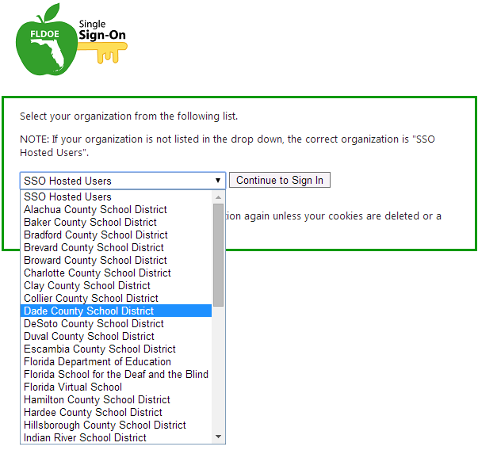
Federated
Go to www.fldoe.org/sso.
Click the yellow Log In button on the right side.
Use the drop down list to select your organization, and then click Continue to Sign In.
Enter the username and password used to sign into the network and proceed to log in.
Then, the secure FLDOE SSO page is displayed with your name and authorized resources.
Notes:
Present Slide.

Slide 54
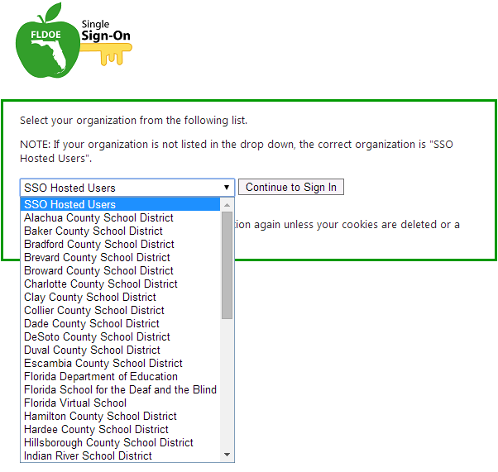
Hosted
Go to www.fldoe.org/sso.
Click on the yellow Log In button on the right side.
Use the drop down list to select FLDOE SSO Hosted Users, and then click Continue to Sign In.
Type the assigned username and computer-generated password from the emails, and then click Sign In.
Then, the secure FLDOE SSO page is displayed with your name and authorized resources.
Notes:
Present Slide.

Slide 55
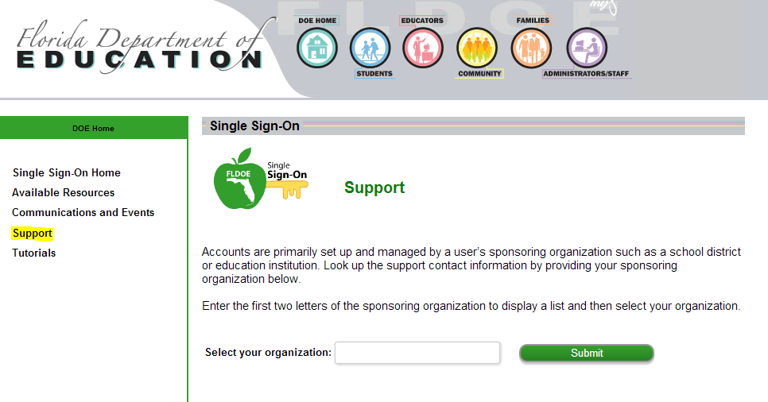
Need Assistance?
For additional assistance managing your Single Sign-On account refer to the SSO Support Page on how to contact your district/organization’s help desk.
Notes:
Present Slide.
Fly-in 1
“Select your organization.”

Slide 56
Single Sign-On & PMRN
Key Terms
  Authentication is the process of identifying an individual
  Authorization is the process of granting or denying access to a network resource
As it relates to the PMRN
  Single Sign-On credentials authenticate users who need to access the PMRN.
  Users will need authorization granted from within the PMRN by their Principal (SL1), or Reading Coach (SL2) to access PMRN resources.
Once a User has been authorized
  The User’s authorization in the PMRN must be linked to the SSO account.
  The two are linked within the PMRN.
Notes:
Presenter
“We’ve introduced the SSO, now we’re going to discuss the interaction of the SSO with the PMRN.”

Slide 57
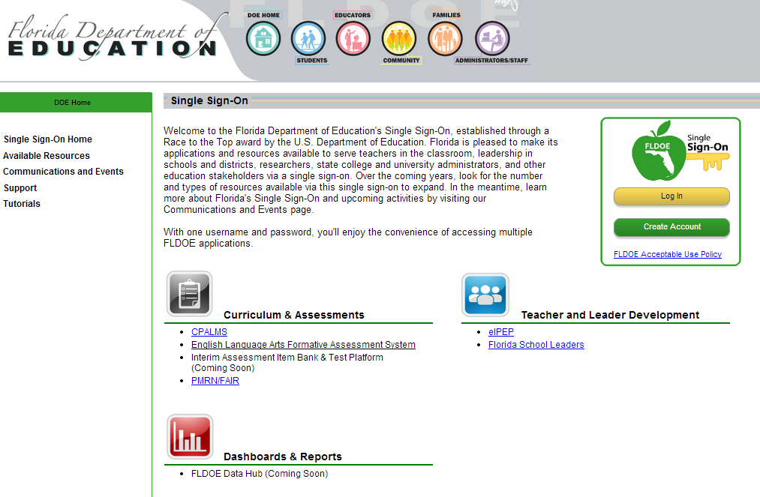
Single Sign-On & PMRN
To access the PMRN through the Single Sign-On Portal use your SSO credentials at http://www.fldoe.org/sso

Slide 58
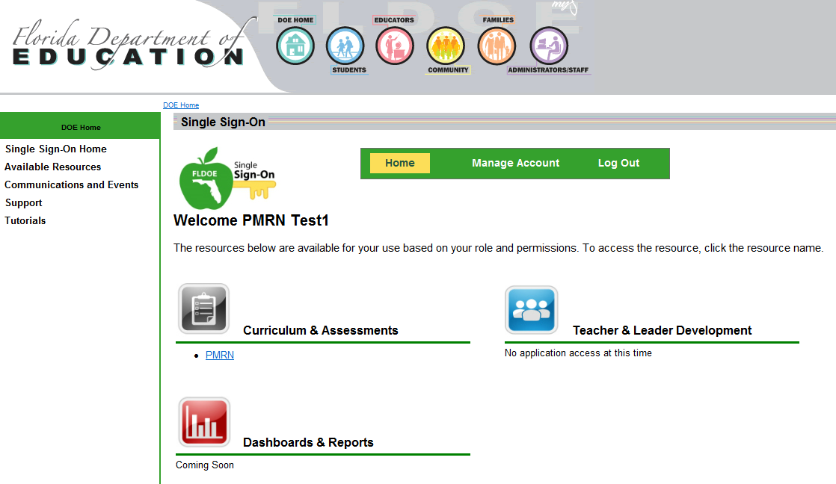
Single Sign-On & PMRN
Once you have signed into the Single Sign-On Portal you should see the PMRN link under the Curriculum & Assessments header.
  If the link is not available you will need to contact your district’s Help Desk for additional authorization.

Slide 59
Single Sign-On & PMRN
You can also Log In to the PMRN using your SSO credentials at https://pmrn.fldoe.org
Notes:
The Username and Password fields above the SSO icon is for non-public school access.

Slide 60
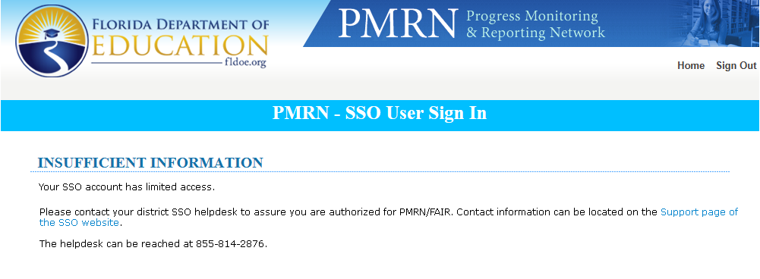
Single Sign-On & PMRN
If you attempt to access the PMRN website and you receive the following error page you will need to contact your Local Education Agency (LEA) for additional assistance in obtaining your SSO authentication for accessing the PMRN
Notes:
Before Jaime talks about the Principal’s Role in registering users for the PMRN, are there any questions regarding the SSO?

Slide 61
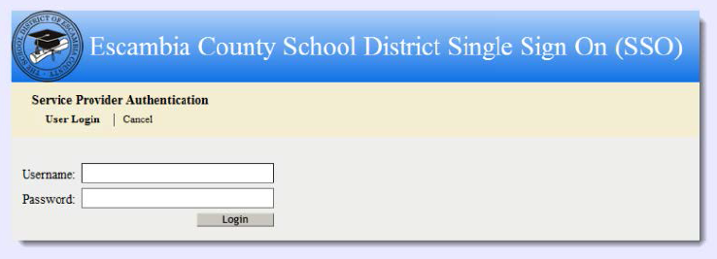
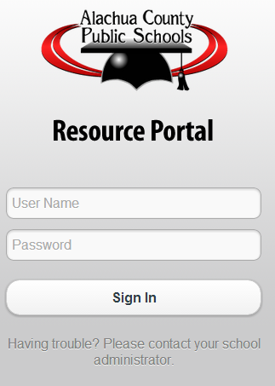
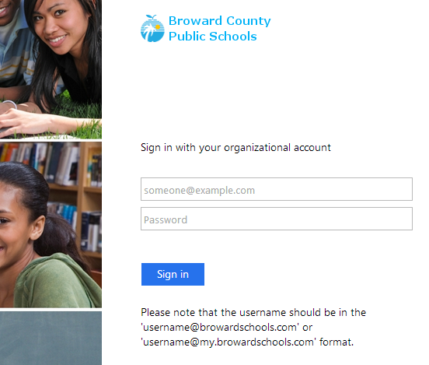
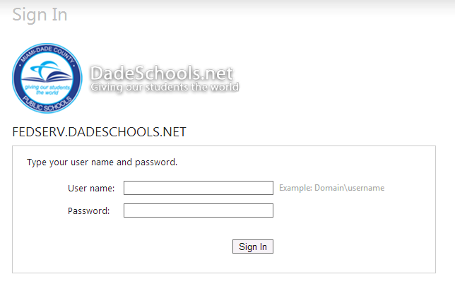
For Federated Users Only
Logging In
Notes:
Present Slide.
Presenter: These are just a few examples of the Sign In page for Federated users.

Slide 62
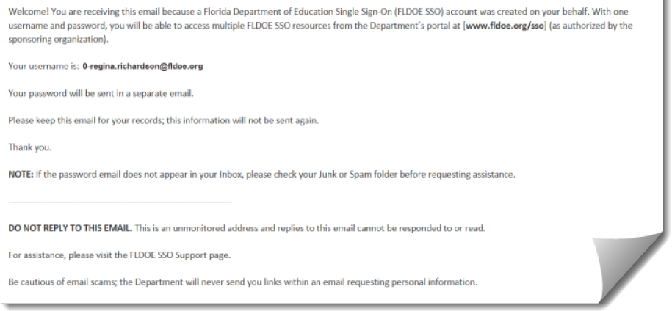
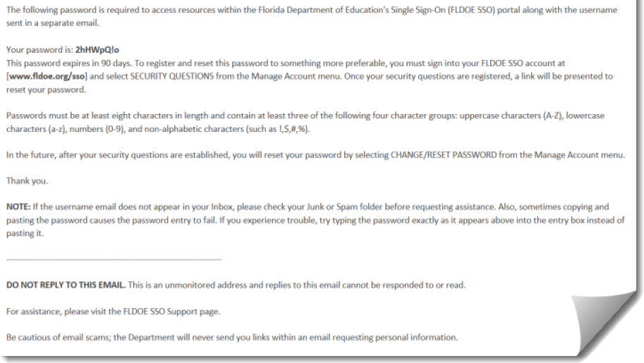
For Hosted Users Only
Login Credentials
As a hosted user, your login credentials are managed through the FLDOE. You will receive a pair of emails from the sender @fldoe.org.
The FLDOE-Hosted account name is a sequence of “SSOId-email address.”
Notes:
Present Slide.
Presenter: The first e-mail will contain your username, which consists of your Local Education Agencies (LEAs) SSO ID number hyphenated with your email address. The second e-mail will contain a temporary password with instructions on how to login, complete the password registration, and change the temporary password to one of your own.

Slide 63
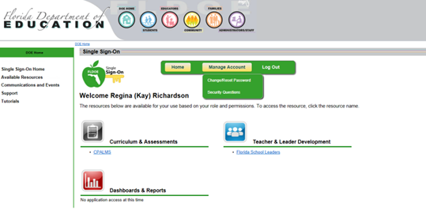
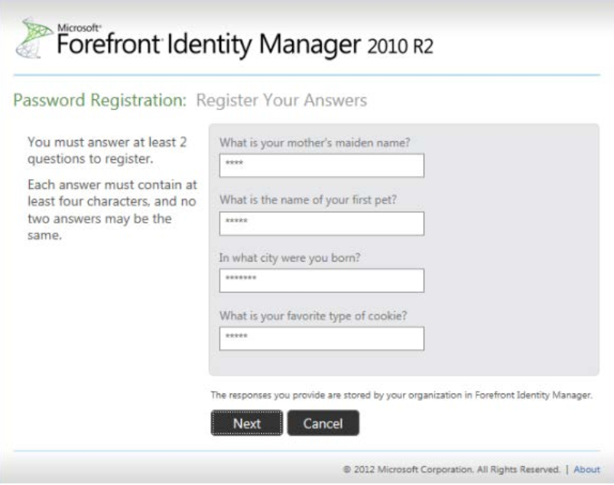
For Hosted Users Only
Registering Your Password
To change your computer-generated password or reset your password in the future, you must first register your password.
You must need to answer at least two (2) security questions.
Notes:
Present Slide.
Presenter:
Click the yellow “Manage Account” button
Select “Security Questions” from the drop down menu
Follow the steps in Microsoft Forefront Identity Manager to register your password

Slide 64
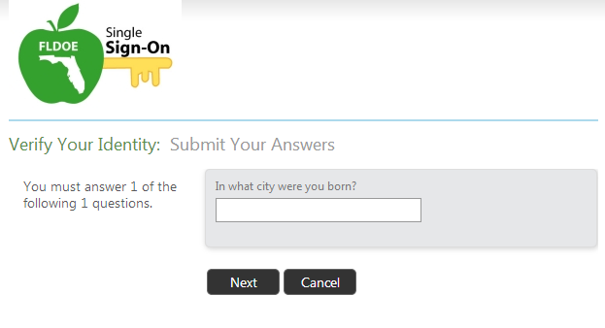
For Hosted Users Only
Resetting your Password
Federated staff members must contact their local technical support for assistance with their password.
Notes:
Presenter:
“FLDOE will notify hosted users via e-mail when their expiration date is approaching to reset their Password. It is very important for Hosted staff members to register passwords after they login for the first time. Passwords expire every 90 days and must be reset to something new. Users can reset their password by providing the answer to one of their security questions.”
Present slide.

Slide 65
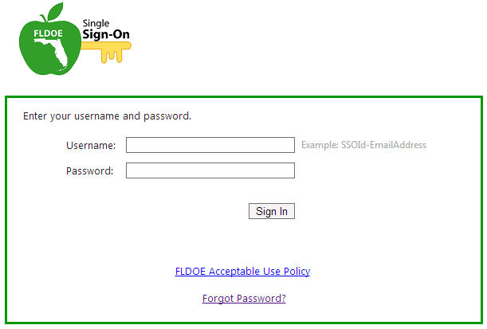
For Hosted Users Only
Forgot your Password
FLDOE Single Sign-On allows hosted users to reset their password by answering one of the security questions they completed during registration.
Notes:
Present Slide.
Presenter:
On the SSO Sign In page click the “Forgot Password?” link
You will need to enter your SSO Username, then verify you identity by answering one of your registered security questions

Slide 66
Principal’s Role

Slide 67
Topics
Survey 8
Principal Sign In (SSO)
PMRN Registration
School Configuration
Adding PMRN Users
Removing Users
Notes:
Present slide.

Slide 68
Survey 8
Districts compile a list of students with associated teachers’ names and submits to FLDOE EIAS office
  This list populates the PMRN
  Districts should only send students in Survey 8 that will be tested in the PMRN
  New students may be added individually by PMRN managers
  FLDOE EIAS produces a Survey 8 import schedule
Notes:
Present slide.
Additional information:
Survey 8 Imports- July 24th-the last Thursday in September.
Education Information and Accountability Services (EIAS)

Slide 69
Survey 8
Populating student rosters from Survey 8 data is critical because:
  It facilitates a more reliable match of students to teachers.
  It allows the PMRN to attach student historical scores and assist future matching processes.
Notes:
Present slide.

Slide 70
Survey 8
The PMRN imports two files provided by the EIAS office at each iteration of Survey 8 – a staff file and a student file.
In the student file, the important fields are the student’s Identifier AND the student’s responsible instructor(s).
In the staff file, the important field is the teacher’s Florida employee identification number.
The students in the student file are matched to teachers in the staff file through the responsible instructor record (where it matches). Aggregated reports for teachers are created from this information.
Notes:
Present slide.

Slide 71
Survey 8
Student file fields updated/used:
  Identifier
  Identifier Alias
  District
  School
  Last Name
  First Name
  Middle Name
  Date of Birth
  Responsible Instructor
Staff file fields updated/used:
  District
  School
  Florida employee identification number
  Last Name
  First Name
Notes:
Presenter:
“For use in the PMRN, only the fields shown here are used from Survey 8. Any other information (such as race/ethnicity, SES, etc.), if it is included, is ignored.”
Present slide.

Slide 72
Principal First Sign In
Beginning of School Year
  Principal (SL1 User) is the only User at a school
Principal will add PMRN Manager as User
  PMRN Manager is the School Level 2 (SL2) User
Notes:
Presenter:
“At the beginning of the school year, the principal, or SL1 User, is the only User of the PMRN at a school. This User is created by the FCRR and must Sign In to create School Level Users and Coach’s Log Users.
The SL1 User will typically add the PMRN Manager (School Level 2; SL2) User, and any Coach’s Log Users.”

Slide 73
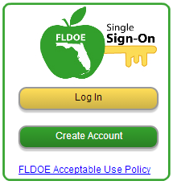
Principal First Sign In
To access the PMRN via SSO
  SSO Portal Home Page http://www.fldoe.org/SSO
  Click Log In button
Notes:
Presenter:
“A principal must access the PMRN via the Single Sign On (SSO) by following these directions:
Access the SSO Home Page (http://www.fldoe.org/SSO)
Via the SSO Access Icon, click the “Log In” button
You will then be taken to the Organization Selection page”

Slide 74
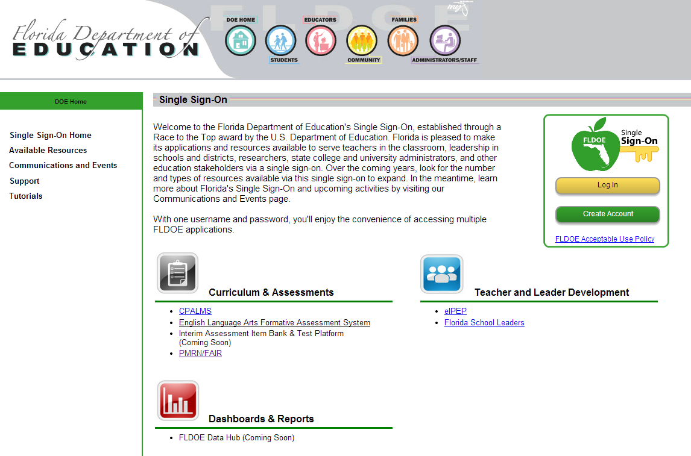
Principal First Sign In
Notes:
Present slide.
Additional information:
Florida Department of Education (FLDOE) Single Sign On (SSO) Home Page

Slide 75
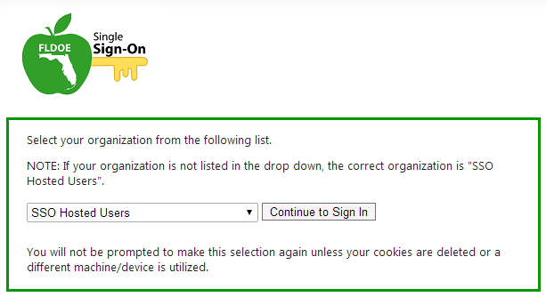
Principal First Sign In
  Organization Selection page
Hosted Users
  From drop-down menu, Select “SSO Hosted Users”
Federated Users
  From drop-down menu, select User District
Click Continue to Sign In button
Notes:
Presenter:
“On the Organization Selection page, the principal will be asked to select his or her organization.
Hosted Users will select ‘SSO Hosted Users’ via the drop-down menu.
Federated Users will select their District (i.e. ‘Alachua County School District’) via the drop-down menu.
Note: If a User’s organization is not listed in the drop-down menu, the principal should select ‘SSO Hosted Users’.
The principal will then click the ‘Continue to Sign In’ button.
If the principal is a Hosted User, the principal will be asked to enter his or her User Name and Password via the DOE page.
If the principal is a Federated User, the principal will be taken to his or her District’s SSO Sign In Portal page.”

Slide 76
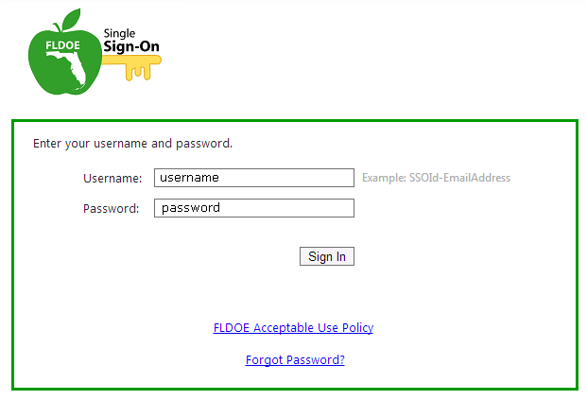
Principal First Sign In
Hosted User
Via the FLDOE SSO Sign In Page
  Enter User Name
  Enter Password
  Click Sign In
Forgot Password?
Notes:
Presenter:
“On the FLDOE SSO Sign In page, the principal will:
Enter his or her User Name
Enter his or her Password
Click the ‘Sign In’ button
Note: If the principal has forgotten his or her Password, he or she may click on the ‘Forgot Password?’ link to retrieve his or her Password.
Upon Signing In successfully, the principal will be taken to his or her SSO Portal.”

Slide 77
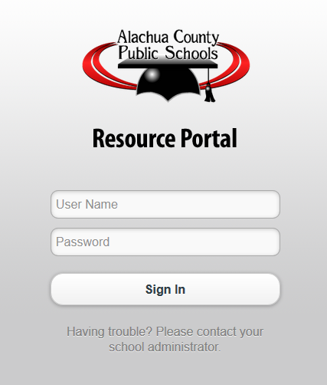
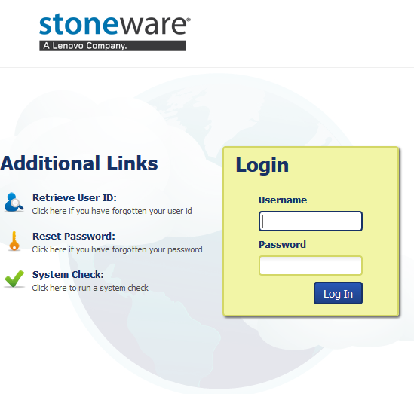
Principal First Sign In
Federated User
Via the District SSO Sign In Page
  Enter User Name
  Enter Password
  Click Sign In or Login
Notes:
Presenter:
“On the principal’s District hosted SSO Sign In page, the principal will:
Enter his or her User Name
Enter his or her Password
Click the ‘Sign In’ or ‘Log In’ button
Note: If the principal has forgotten his or her Password, the District hosted Sign In page may contain a link to assist Users in retrieving their Passwords. If available, he or she may click on the page link that will direct the principal to retrieve his or her Password.
Upon Signing In successfully, the principal will be taken to his or her SSO Portal.”

Slide 78
PMRN Registration
Access to the PMRN administration begins with school registration
PMRN Registration is completed by the school’s principal
Notes:
Presenter:
“Access to the PMRN administration begins with the school being registered.
PMRN Registration is to be completed by the school’s principal.
Note: A principal at a school accessing the PMRN via the SSO may only register his or her school for the PMRN via the Registration located via their SSO access. The principal can no longer register his or her school via the non-SSO PMRN Registration page.”

Slide 79
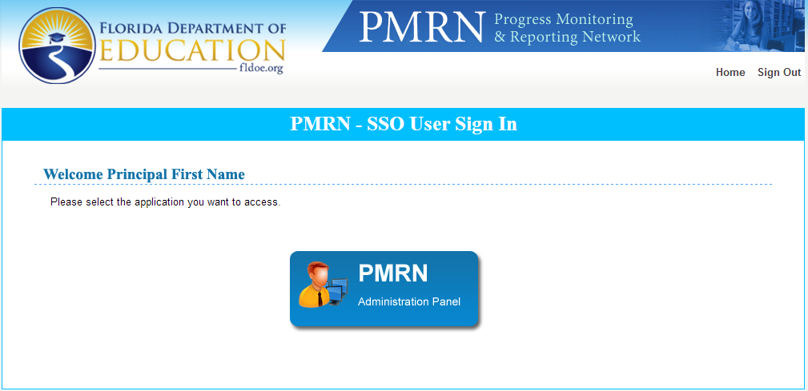
PMRN Registration
After acquiring SSO credentials
  access the PMRN through the PMRN SSO portal
  Click the PMRN Admin Panel button
Notes:
Presenter:
“Upon first Sign In, the principal will access the PMRN through the PMRN SSO portal.
Via the PMRN SSO Portal page, the principal will click the PMRN Administration Panel button to access the PMRN.
The principal will be taken to the PMRN Registration page for his or her school.”

Slide 80
PMRN Registration
On the PMRN Registration Page
  Confirm School Information
    School Name, School Number, District
    School Address, Phone Number, Fax Number
  Confirm Principal Information
    First Name, Last Name
    E-mail Address, Phone Number
  Enter and Confirm First Instructional Day
    First day of school for students
Notes:
Present slide.
Additional information:
If any of the information is incorrect, the principal should contact the Florida Department of Education (FLDOE) Integrated Education Service Center via phone or E-mail.
855-814-2876
ienhelp@fldoe.org

Slide 81
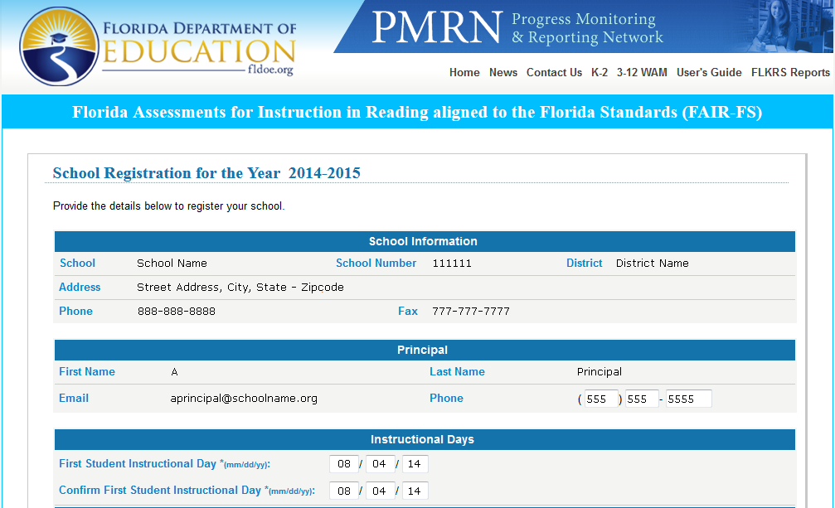
PMRN Registration
Notes:
Present slide.

Slide 82
PMRN Registration
For each assessment system (K-2 and 3-12)
  Identify which grade levels will be using the K-2 AIR
  Identify which grades level will be using the 3-12 WAM
  Identify if students will be added through FLDOE Surveys 2 and 3
Notes:
Presenter:
For each assessment system, the principal identifies
which grades are to take the FAIR-FS,
if students will be added through FLDOE surveys 2 and 3,
In Florida, student counts are made the early part of October and again in February. In November and April, the FCRR gets the results of these surveys. If the principal selects “Yes, add students,” students who were enrolled during the survey week are added to the list of students in the grade.
Students are not assigned to classes or periods.
Students are not removed.
The advantage is that newly enrolled students are added to the school population with the correct Identifier and need not be entered for subsequent FAIR-FS assessment.
All students have their demographics updated.”

Slide 83
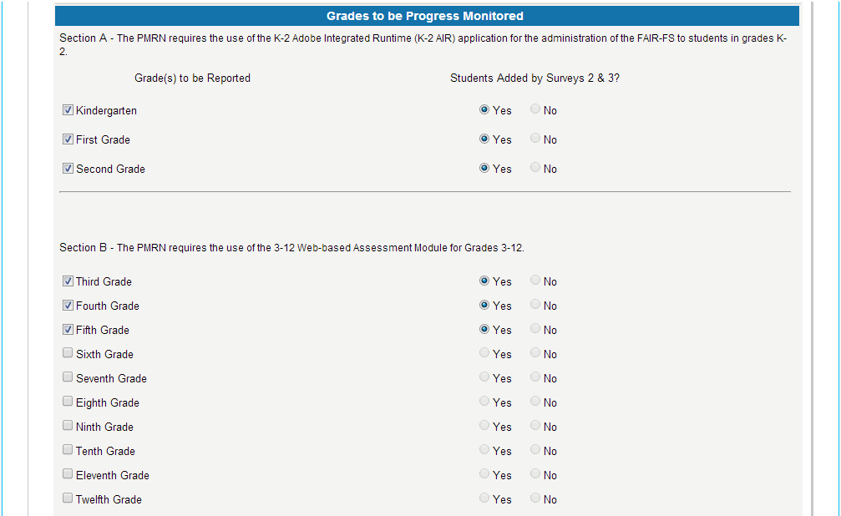
PMRN Registration
Notes:
Presenter:
“Please note – initial PMRN data comes from Survey 8 which includes student file as well as staff files. Please be aware that the updates from Surveys 2 and 3 will be student files of your entire school population. You have the option to select ‘yes’ or ‘no’ to receive these updates. There are advantages and disadvantages to these options depending on your school’s needs. For example, most elementary schools assess all students. The demographics would be updated so new students would be automatically added, but you need to assign them to a teacher. In a secondary school with low mobility rates and only Level 1 and 2 students are being assessed, updates would import ALL students including Levels 3, 4, and 5.”
Present slide.

Slide 84
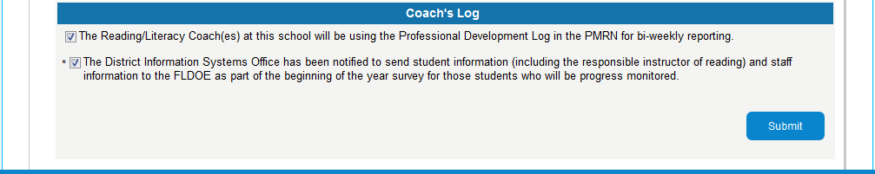
PMRN Registration
  Confirm whether or not the school will utilize the Coach’s Log function.
Notes:
Present slide.

Slide 85
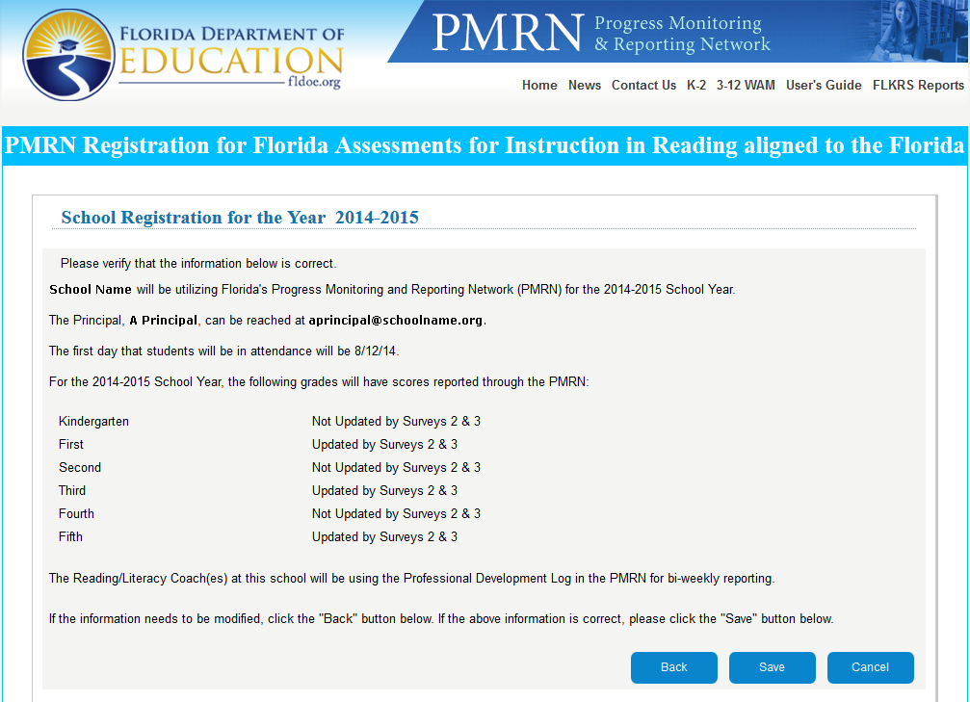
PMRN Registration Confirmation
Notes:
Presenter:
“The principal confirms that the district’s information management office has been notified to transmit to the Florida Department of Education’s Bureau of Information and Accountability Services the school’s Student Demographic, Staff Demographic, and Responsible Instructor: Reading files with survey 8. These files are used for the initial rostering of students in classes.
Once saved and submitted, this completes the registration form.
A school’s registration will be confirmed and accepted by Support Specialists. A confirmation message is sent to the principal at the E-mail address entered into the registration form.
Acceptance will generate the school’s calendar in the PMRN.
Note: PMRN administration may not occur at a school until the school’s first instructional day.”

Slide 86
Topics
Survey 8
Principal Sign In (SSO)
PMRN Registration
School Configuration
Adding PMRN Managers
Removing Users
Notes:
Presenter:
“Now that the school is registered, the next step for the principal is the school configuration, which can be completed in 1 short session.
The purpose of the School Configuration step is to set the school’s calendar or time frames for when FAIR-FS administration may begin at each school.”

Slide 87
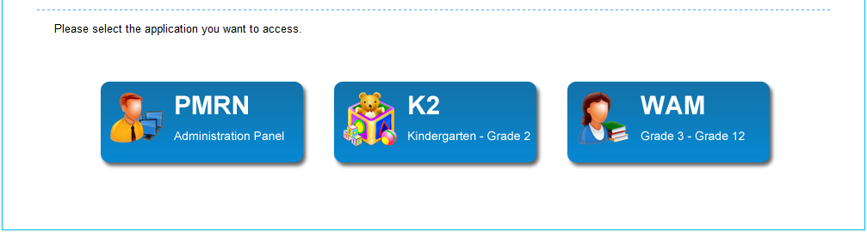
School Configuration – Sign In
  The principal must have the school’s calendar start date ready before Signing In to the PMRN for the first time at the beginning of the school year
  Sign In via the SSO Portal
    Click the PMRN Administration Panel button
Notes:
Present slide.
The principal must have the school’s calendar start date ready before Signing In to the PMRN for the first time at the beginning of the school year.
The principal will Sign In to the PMRN via the SSO.

Slide 88
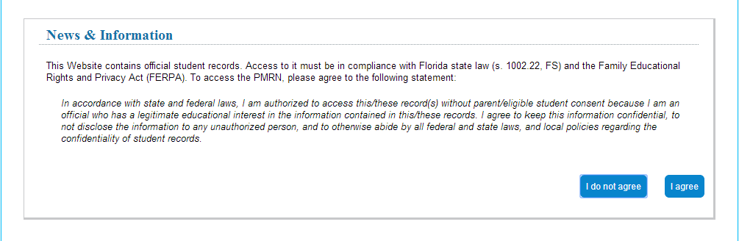
School Configuration - FERPA
  Users must agree to abide by the Family Education Rights and Privacy Act (FERPA)
  Click I Agree to continue to the next page
Notes:
Presenter:
“On the Family Education Rights and Privacy Act (FERPA) page, you must click I Agree to continue to the next page.
The PMRN contains official student records. The provisions of FERPA and Florida laws cover access to and disclosure of these records.
Only those persons with a defined educational need may access the PMRN or view printed reports, Passwords may not be shared or given to others, computers with the PMRN open may not be left unattended, and printed copies of reports must be locked in a secure area when not being supervised.”
Note: Please do not email student’s names or attach student’s score for any purpose.

Slide 89
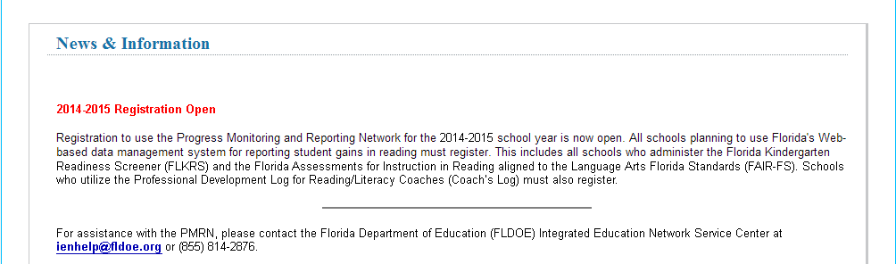
School Configuration - News
  News Page
  Click the Next button
Notes:
Presenter:
“A News page is displayed, containing the most recent and relevant information regarding the PMRN. This often displays information regarding when the system is offline for scheduled maintenance, issues, and other pertinent access information.
Click the Next button to proceed.”

Slide 90
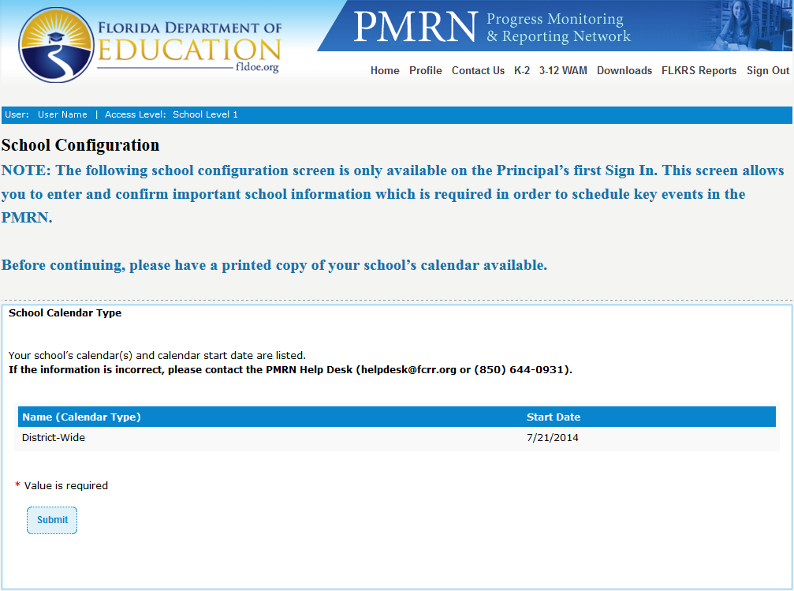
School Configuration Page
  School Configuration Page
    Confirm school calendar (e.g., district-wide) and school start date
    Click Submit
Notes:
Presenter:
“District-wide is typical for most public schools”
“The principal clicks the Submit button to complete the School Configuration.”

Slide 91
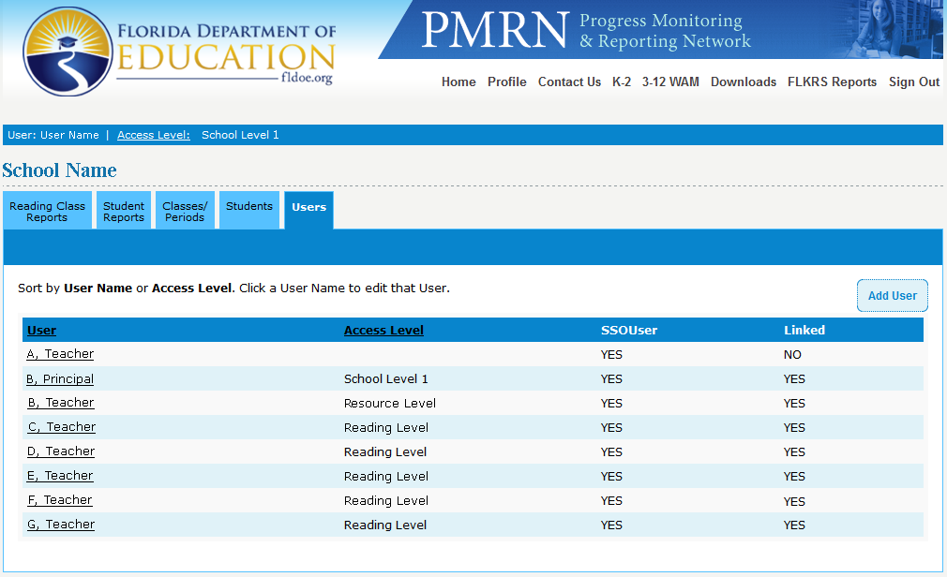
Principal Home Page
Congratulations! You have completed the School Configuration process and have reached your Home Page.
Notes:
Present slide.

Slide 92
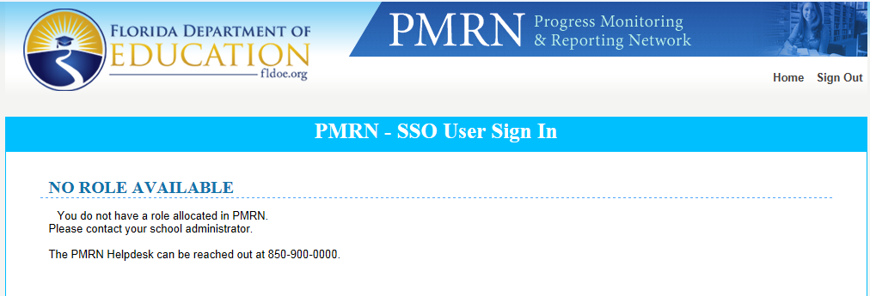
PMRN Role Access
The Single Sign-On accounts provide authentication to PMRN not access.
Users that attempt to enter the PMRN that have not been granted access will receive the following error page.
You will need to contact a School Level User (SL1, SL2, SL3) to be given access to the PMRN.
  If you are the principal, and you are receiving this message, you are not properly identified in your district’s SSO files as the school’s administrator
Notes:
Presenter:
“The principal may choose to designate a PMRN manager at this time.”
Present slide.

Slide 93
Adding PMRN Managers
Notes:
Presenter:
“The beginning of the year is the best time to add the Reading Coach or other designee as the school’s SL2 User to manage the PMRN
SL1 Users are the only Users that may add SL2 and Coach’s Log Users. To add new Users, sign in as the SL1 user and click the Users tab. The click the Add User button.”

Slide 94
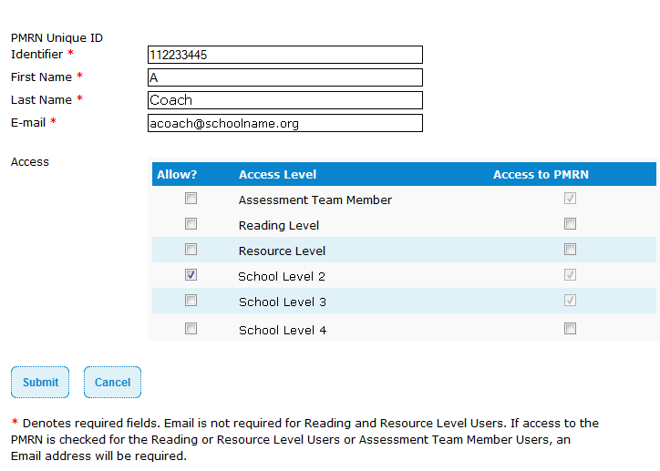
Assigning PMRN Manager
Fill in the information boxes on the screen.
Please verify the E-mail address with the reading coach (or other designee).
Check the box next to “School Level 2”.
Click Submit.
Note: The School Level 2 staff member will be able to Sign In via their SSO credentials after the linking process has authenticated the User.
Notes:
Present Slide.
Presenter: Although a user may have been granted access in SSO, they cannot enter PMRN with their SSO credentials until the role has been assigned and the user has been linked.

Slide 95
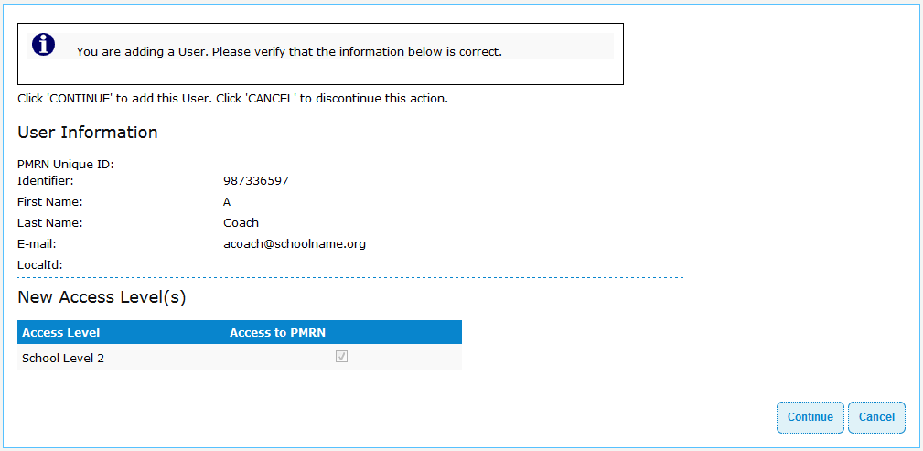
Assigning PMRN Manager
The new User’s name, E-mail Address, and Access Level will be displayed. (If there is an error, click Cancel, which will return you to the list of Users at the school.)
Click Continue.

Slide 96
Linking Single Sign-On Account
User’s PMRN and SSO accounts should be linked automatically when the SSO data import updates.
Once you have successfully added a User to the PMRN their name will now appear under the User column.
If there is a “NO” for the User under the Linked column after the SSO data import updates, you will need to manually link their PMRN Access to their Single Sign-On Account.
Notes:
Presenter:
The principal or PMRN manager will need to update the access of the users in the school when staff arrive, change roles, or leave. I will now describe the process of linking.
User’s PMRN and SSO accounts should be linked automatically when the SSO data import updates.
Once you have successfully added a User to the PMRN their name will now appear under the User column.
Click Fly-in 1
If there is a “NO” for the User under the Linked column after the SSO data import updates, you will need to manually link their PMRN Access to their Single Sign-On Account.
Click Fly-in 2

Slide 97
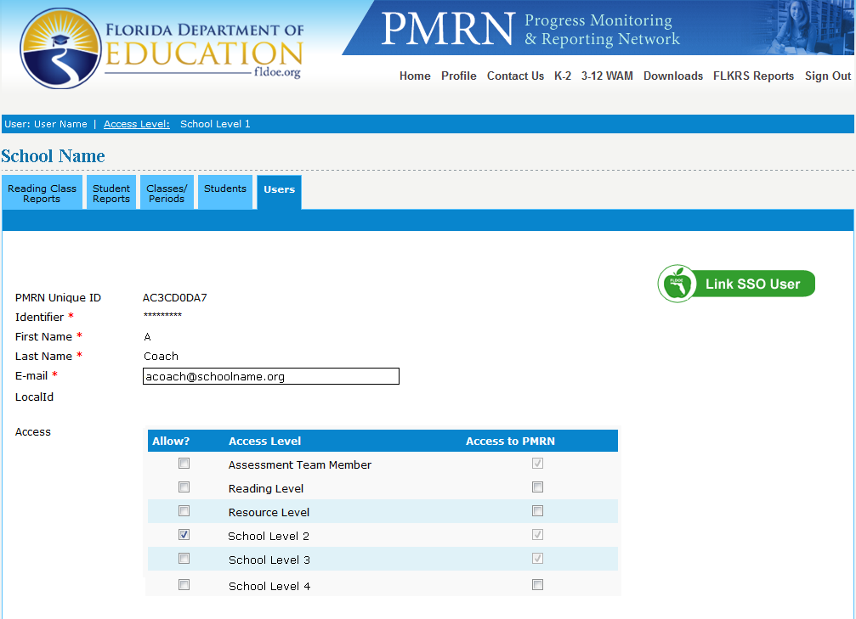
Linking Single Sign-On Account
All Users must be linked to a SSO account in order to access the PMRN using their Single Sign-On credentials.
Notes:
Present Slide.
Presenter:
Click the Users tab (to return to the list of users)
Click the Name of the User you would like to link

Slide 98
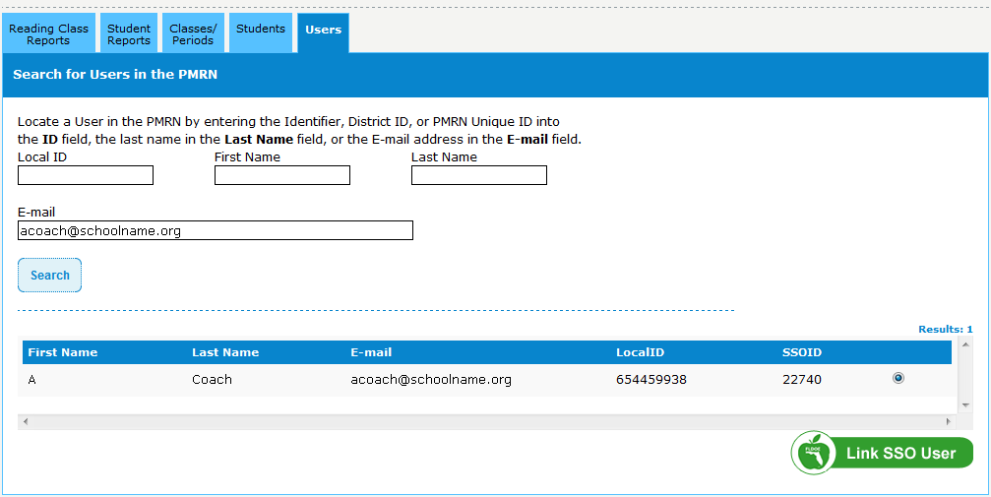
Linking Single Sign-On Account
Use the Search fields to locate the User’s SSO account.

Slide 99
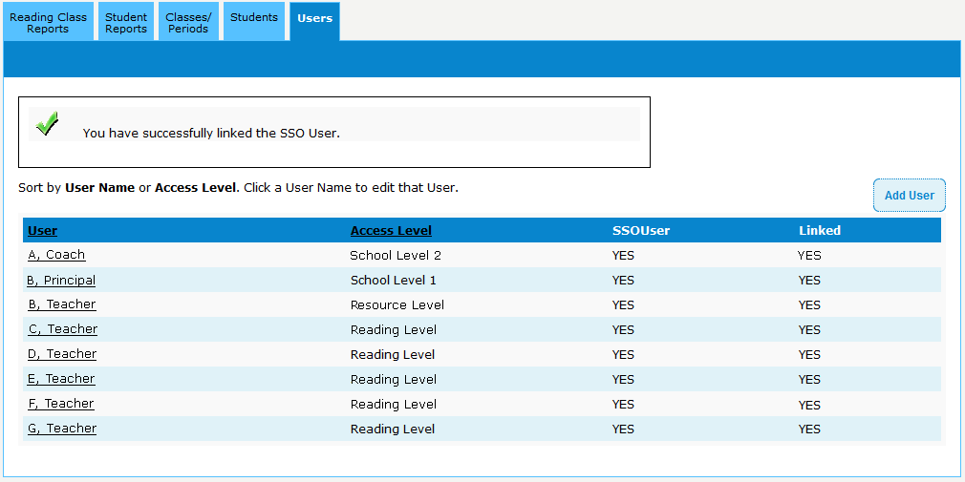
Linking Single Sign-On Account
Once a PMRN User has been successfully linked to an SSO Account there will be a “YES” in the “SSOUser” and “Linked” columns.

Slide 100
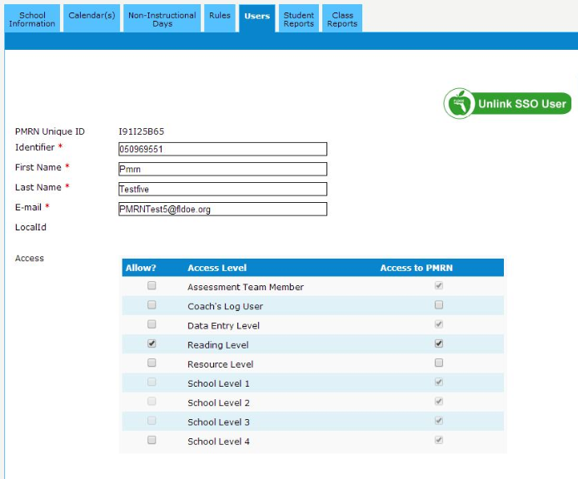
Unlinking Single Sign-On Account
If you link a PMRN User to the wrong SSO account the “Unlink SSO User” button allows you to disassociate the two accounts.
The unlinking feature should only be used when the incorrect SSO account has been linked to a User’s PMRN account.

Slide 101
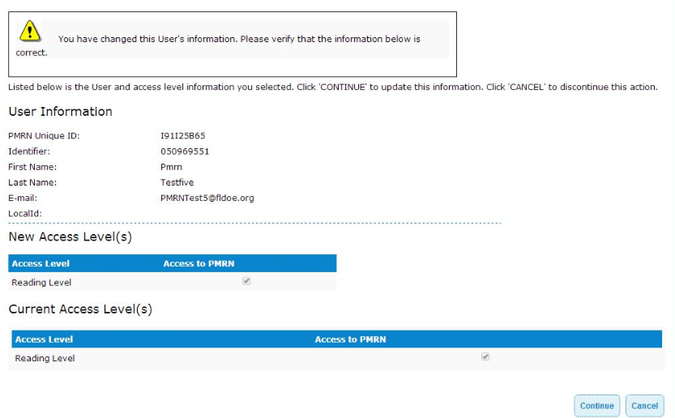
Unlinking Single Sign-On Account
The changes will be displayed. (If there is an error, click Cancel, which will return you to the list of Users at the school.)
Click Continue.

Slide 102
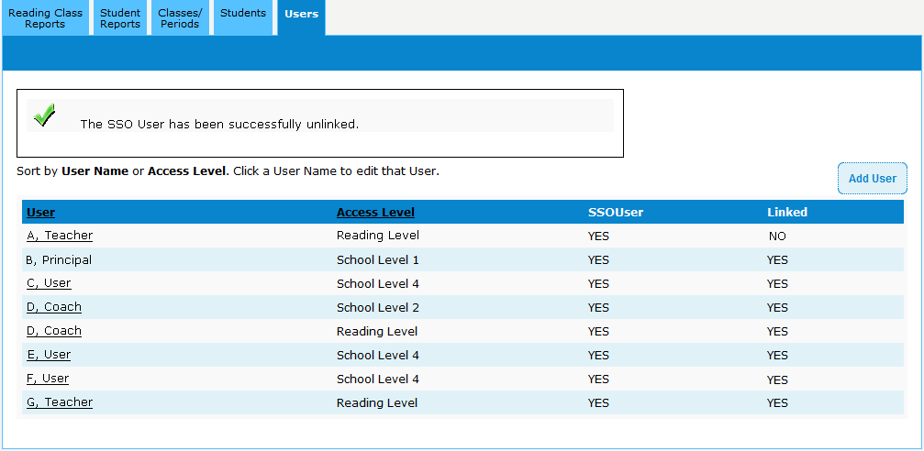
Unlinking Single Sign-On Account
Once a PMRN User has been successfully unlinked to an SSO Account there will be a “NO” in the “Linked” column.

Slide 103


Unlinking Single Sign-On Account
The unlinking feature should only be used when the incorrect SSO account has been linked to a User’s PMRN account.
      DO NOT Unlink a user’s SSO Account when removing their access from your school.

Slide 104
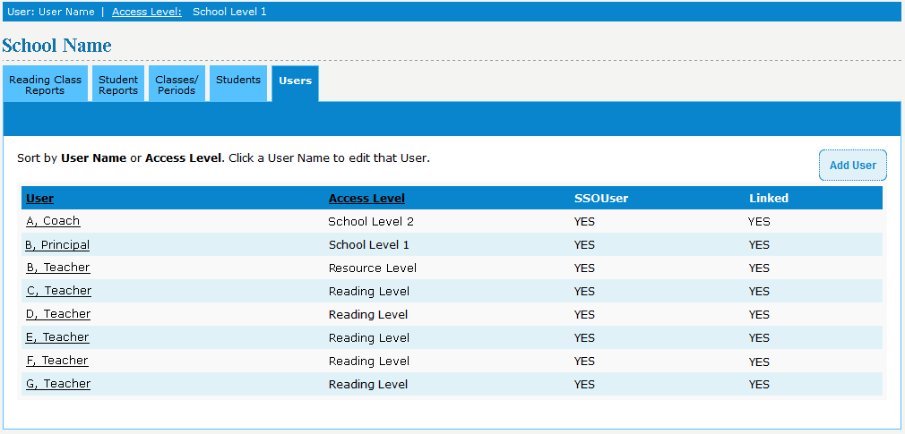
Removing Users
To remove a User, begin at your Home Page, click the Users tab.
Click the name of the User you want to delete.
Notes:
Instead of unlinking from the SSO, the user needs to be removed from the school’s access page.

Slide 105
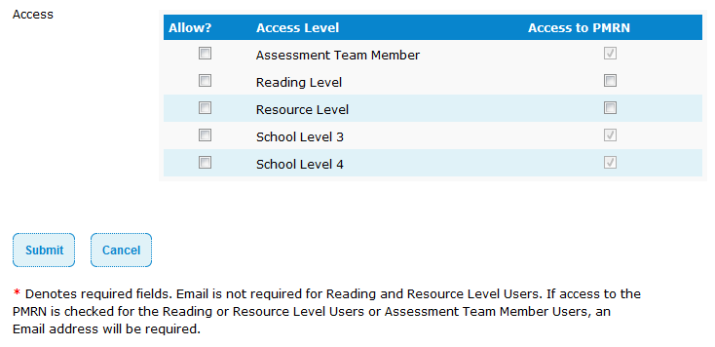
Removing Users
Uncheck the box(es) under the Allow? column and Access to PMRN column, corresponding to their current Access Level(s) .
Note: A teacher who has Progress Monitoring scores associated with him or her cannot be deleted from the list of this year’s teachers. Access to the reports should be removed, by unchecking the box under the Access to PMRN column but the teacher’s name will still appear on the list of Users at the school.

Slide 106
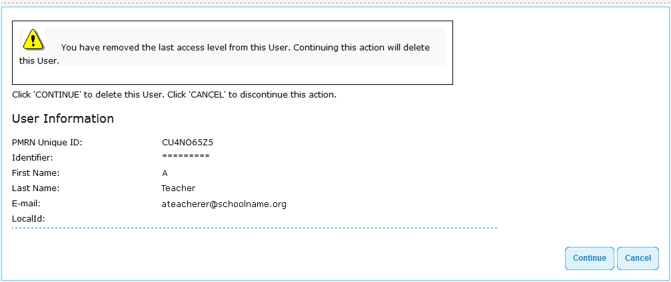
Removing Users
To confirm the removal, click Continue.
Note: A teacher who has Progress Monitoring scores associated with him or her cannot be deleted from the list of this year’s teachers. Access to the reports should be removed, by unchecking the box under the Access to PMRN column but the teacher’s name will still appear on the list of Users at the school.

Slide 107
Topics Covered
Survey 8
Principal Sign In (SSO)
PMRN Registration
School Configuration
Adding PMRN Users
Removing Users
Notes:
Presenter:
“Section check – do I know how to do each of these steps? Which staff members need to perform these functions and how will I ensure they have this information?”

Slide 108
PMRN Manager’s Role

Slide 109
Topics
PMRN Manager Sign In
PMRN Access Levels
Adding Users
  Removing Users
Adding Teachers
  Removing Teachers
Creating Classes
  Adding, Deleting, Assigning
Enrolling Students
  Enrolling, Adding, Removing, Withdrawing
Notes:
Present slide.
Presenter:
The topics we will cover in this section are:
PMRN Manager Sign In
PMRN Access Levels
Adding Users
Removing Users
Adding Teachers
Removing Teachers
Creating Classes
Adding, Deleting, Assigning
Enrolling Students
Enrolling, Adding, Removing, Withdrawing

Slide 110
PMRN Manager Sign In
Beginning of School Year
  Principal (SL1 User) is the only User at a school
SL1 User will add PMRN Manager as User
  PMRN Manager is the School Level 2 (SL2) User
Notes:
Present slide.
Presenter:
At the beginning of the school year, the principal, or SL1 User, is the only User of the PMRN at a school. This User is created by the FCRR and must Sign In to create School Level Users and Coach’s Log Users.
The SL1 User will typically add the PMRN Manager, or School Level 2 (SL2) User, and any Coach’s Log Users.

Slide 111
PMRN Manager Sign In
To access the PMRN via SSO
  SSO Portal Home Page http://www.fldoe.org/SSO
  Click Log In button
Notes:
Present slide.
Presenter:
A User must access the PMRN via the Single Sign On (SSO) by following these directions:
Access the SSO Home Page (http://www.fldoe.org/SSO)
Via the SSO Access Icon, click the “Log In” button

Slide 112
PMRN Manager Sign In
Notes:
Present slide.
Florida Department of Education (FLDOE) Single Sign On (SSO) Home Page

Slide 113
PMRN Manager Sign In
  Organization Selection page
Hosted Users
  From drop-down menu, Select “SSO Hosted Users”
Federated Users
  From drop-down menu, select User District
Click Continue to Sign In button
Notes:
Present slide.
Presenter:
On the Organization Selection page, the PMRN Manager will be asked to select his or her organization.
Hosted Users will select “SSO Hosted Users” via the drop-down menu.
Federated Users will select their District (i.e. “Alachua County School District”) via the drop-down menu.
Note: If a User’s organization is not listed in the drop-down menu, the User should select “SSO Hosted Users”.
The User will then click the “Continue to Sign In” button.
If the User is a Hosted User, the User will be asked to enter his or her User Name and Password via the DOE page.
If the User is a Federated User, the User will be taken to his or her District’s SSO Sign In Portal page.

Slide 114
PMRN Manager Sign In
Hosted User
Via the FLDOE SSO Sign In Page
  Enter User Name
  Enter Password
  Click Sign In
Forgot Password?
Notes:
Present slide.
Presenter:
On the FLDOE SSO Sign In page, the User will:
Enter his or her User Name
Enter his or her Password
Click the “Sign In” button
Note: If the User has forgotten his or her Password, he or she may click on the “Forgot Password?” link to retrieve his or her Password.
Upon Signing In successfully, the User will be taken to his or her SSO Portal.

Slide 115
PMRN Manager Sign In
Federated User
Via the District SSO Sign In Page
  Enter User Name
  Enter Password
  Click Sign In or Login
Notes:
Present slide.
Presenter:
On the User’s District hosted SSO Sign In page, the User will:
Enter his or her User Name
Enter his or her Password
Click the “Sign In” or “Log In” button
Note: If the User has forgotten his or her Password, the District hosted Sign In page may contain a link to assist Users in retrieving their Passwords. If available, he or she may click on the page link that will direct the User to retrieve his or her Password.
Upon Signing In successfully, the User will be taken to his or her SSO Portal.

Slide 116
Access Levels
Types of Access Levels
  Administrative Users
  Non-Administrative Users
List of PMRN Access Levels
Notes:
Present slide.
Presenter:
Within the PMRN, there are a number of different Access Levels
Levels Range from Assessment Team Members (ATM) who assess students on the K-2 AIR or 3-12 WAM, but do not have administrative privileges or access to reports,
to:
District Level Users who can review all reports at all levels (Student to District).
There are two (2) types of Access Levels in the PMRN: Administrative Users and Non-Administrative Users.

Slide 117
Administrative Users
Administrative User Abilities
  Enter or remove Users
  Enroll, remove, or withdraw students
  Create classes
  Receive official communications from PMRN
Administrative User Access Levels
  District Level 1 User – Superintendent
  District Level 2 User – District Reading Contact
  School Level 1 User - Principal
  School Level 2 User – Reading coach or principal’s designee (PMRN manager)
  School Level 3 User – Administration individual to assist SL2 user)
Notes:
Present slide.
Presenter:
Administrative Users have the capability to either enter or remove other Users in the PMRN, enroll or withdraw students in the PMRN, create classes, and receive official communications from the PMRN.
The three (3) Administrative User Access Levels are:
District Level 1 User (Superintendent)
District Level 2 User (District Reading Contact)
School Level 1 User (Principal)
School Level 2 User (PMRN Manager)
School Level 3 User (Administration Individual to assist SL2 User)

Slide 118
District Level 1 (DL1) User
District Level 2 (DL2) User
A superintendent is the only DL1 User at a district
District Reading Contacts are DL2 Users at a district
DL1 User Abilities
  Have access to all reports for district in the PMRN
  Add and Remove Users
    District Level 2 Users
    District Level 3 Users
DL2 User Abilities
  Have access to all reports for district in the PMRN
  Add and Remove Users
    District Level 3 Users
Notes:
Present slide.
Presenter:
A superintendent is the only District Level 1 (DL1) User at a district in the PMRN.
The DL1 User is added by Support Specialists in the PMRN.
DL1 Users have access to all information and reports within a district’s PMRN site.
This includes schools’ information in that district.
DL1 Users are the only Users who have the ability to create and remove District Level 2 Users.
District Reading Contacts are District Level 2 Users at a district in the PMRN.
There can be two (2) DL2 Users (one elementary, one secondary).
DL2 Users have access to all information and reports within a district’s PMRN site.
This includes schools’ information in that district.
DL2 Users have the ability to create and remove District Level 3 Users.

Slide 119
School Level 1 (SL1) User
A principal is the only SL1 User at a school
SL1 User Abilities
  Have access to all information for school in PMRN
  Add and Remove Users
    School Level 2 User
    Coach’s Log Users
Beginning of School Year
  School Configuration page
Notes:
Present slide.
Presenter:
A principal is the only School Level 1 (SL1) User at a school in the PMRN.
SL1 Users have access to all information within a school’s PMRN site.
SL1 Users are the only Users who have the ability to create and remove School Level 2 and Coach’s Log Users.
At the beginning of the school year, the SL1 User must Sign In to the PMRN and complete the School Configuration page.

Slide 120
School Level 2 (SL2) User
Each school may only have one SL2 User
  Added by principal (SL1 User)
Responsible for day-to-day PMRN administration
SL2 User Abilities
  Add and Remove Users
  Enroll, Remove, or Withdraw students
  Create classes
  Receive official communications from PMRN
Notes:
Present slide.
Presenter:
Each school may only have one (1) School Level 2 (SL2) User.
The SL2 User is added by the SL1 User at the beginning of the school year.
The SL2 User is the User who is responsible for the day-to-day administration of the PMRN. This is usually the Reading/Literacy Coach.
SL2 Users can:
Add and Remove Users
Enroll, Remove, or Withdraw students
Create classes
Receive official communications from the PMRN
The SL2 User is also known as the PMRN Manager. Sometimes, the SL2 User is the:
Assistant principal in charge of Curriculum
Curriculum Resource teacher
Standards Coach
SL2 Users have the same PMRN access and administrative abilities given to principals (SL1 Users), except SL1 Users have:
Access to the School Configuration pages
The ability to create and remove Coach’s Log Users

Slide 121
School Level 3 (SL3) User
One SL3 User per school is allowed
Assist SL2 Users with PMRN administration
SL3 User Abilities
  Add Teachers
  Enroll, remove, or withdraw students
  Create classes
SL3 Users may only add new Users if creating a Reading or Resource class
Notes:
Present slide.
Presenter:
Each school may only have one (1) School Level 3 (SL3) User.
SL3 Users assist SL2 Users with administration of the PMRN.
SL3 Users can:
Add Teachers
Enroll, Remove, or Withdraw students
Create classes
SL3 Users may only add new Users if creating a Reading or Resource class

Slide 122
Non-Administrative Users
Non-Administrative User Abilities
  View PMRN Reports
    School, Teacher, Class, and Student levels
Non-Administrative User Access Levels
  District Level 3 User
  School Level 4 User
  Reading User
  Resource User
  Coach’s Log User
  Assessment Team Member
  NGCAR-PD and content area teachers
Notes:
Present slide.
Presenter:
Non-Administrative Users can view reports within the PMRN at the School, Teacher, Class, and Student levels. Appropriate staff would include an assistant principal, guidance counselor, or any other individual who works with all students at the school.
The five (5) Non-administrative User Access Levels are:
School Level 4 User
Reading User
Resource User
Coach’s Log User
Assessment Team Member

Slide 123
District Level 3 (DL3) User
There may be six (6) DL3 Users per district
DL3 User Abilities
  View PMRN Reports
    District, School, Teacher, Class, and Student levels
      Within their assigned district
  No PMRN administrative functions
Notes:
Present slide.
Presenter:
Each district may have up to six (6) District Level 3 (DL3) Users in the PMRN.
DL3 Users can:
View PMRN Reports at the District, School, Teacher, Class, and Student level (within their district)
DL3 Users do not have any administrative abilities in the PMRN.

Slide 124
School Level 4 (SL4) User
There may be eight (8) SL4 Users per school
SL4 User Abilities
  View PMRN Reports
    School, Teacher, Class, and Student levels
  No PMRN administrative functions
Notes:
Present slide.
Presenter:
Each school may have up to eight (8) School Level 4 (SL4) Users in the PMRN.
Users under the SL4 Access Level could include an assistant principal, school psychologist, guidance counselor, or any other individual who works with all students at the school.
SL4 Users can:
View PMRN Reports at the School, Teacher, Class, and Student level
SL4 Users do not have any administrative abilities in the PMRN.

Slide 125
Reading Level User
Reading Teachers
Provide primary reading instruction to a class
Reading User Abilities
  Assess their students via the FAIR-FS assessment applications
  View PMRN Reports
    Teacher, Class, and Student levels
Notes:
Present slide.
Presenter:
Reading Level Users (or Reading Teachers) provide primary reading instruction to a class.
Reading Level Users are able to assess their assigned students via the FAIR-FS assessment applications.
Reading Level Users can view reports for their class(es) and the students in their class(es).
An unlimited amount of Reading Level Users may be added to a school.

Slide 126
Resource Level User
Resource Teachers
Provide additional reading instruction to a class
Resource User Abilities
  Assess their students via the FAIR-FS assessment applications
  View PMRN Reports
    Teacher, Class, and Student levels
Notes:
Present slide.
Presenter:
Reading Level Users (or Resource Teachers) provide additional instruction beyond the primary reading class.
Resource Level Users are able to assess their assigned students via the FAIR-FS assessment applications.
Students must first be assigned to a Reading Class before they can be assigned to a Resource class.
Reading Level Users can view reports for their class(es) and the students in their class(es).
Reading Teachers who deliver the primary reading instruction to these students will also be able to view reports for them.
An unlimited amount of Resource Level Users may be added to a school.

Slide 127
Coach’s Log (CL) User
CL Users submit coaching hours every two (2) weeks to the PMRN
Only SL1 Users can add a Coach’s Log User
Notes:
Present slide.
Presenter:
Coach’s Log (CL) Users are responsible for Submitting coaching hours to the PMRN every two (2) weeks.
Only SL1 Users (principals) can add a CL User.
A school may add up to eight (8) CL Users.

Slide 128
Assessment Team Member (ATM)
ATM Users administer FAIR-FS via:
  K-2 AIR
  3-12 WAM
ATM Users have no access to reports in PMRN
Notes:
Present slide.
Presenter:
Assessment Team Members (ATM Users) administer the FAIR-FS using the K-2 AIR or the 3-12 WAM.
ATM Users have no access to reports in the PMRN.

Slide 129
Public vs. Non-Public
Public schools have ability to add all Users
Non-Public Schools may only have the following Users:
  School Level 1 User
  School Level 2 User
  Reading Users
Notes:
Present slide.
Presenter:
Public schools have the ability to add all Users described in presentation
School Level 1 User
School Level 2 User
School Level 3 User
School Level 4 User
Reading User
Resource User
Coach’s Log User
Assessment Team Member
Non-Public schools may only add the following Users to a school:
School Level 1 User
School Level 2 User
Reading User

Slide 130
Users and Access Levels
Access Level | Number Allowed | Who | Responsibilities / Privileges | Can Access K-2 AIR | Can Generate Key for 3-12 WAM
School Level 1 (SL1) | 1 | Principal | Registers and Configures School, Assigns Users, Manages Classes/Periods, Views School Reports, | ✓ | ✓
School Level 2 (SL2) | 1 | Reading Coach | Assigns Users, Manages Classes/Periods, Views School Reports | ✓ | ✓
School Level 3 (SL3) | 1 | 2nd Reading Coach or an individual assisting with PMRN administration | Manages Classes/Periods, Views School Reports | ✓ | ✓
School Level 4 (SL4) | 8 | School Administrator or an individual who needs access to school-wide reports | Views School Reports | ✓ | ✓
Coach’s Log (CL) | 8 | Reading Coach | Enters Coach’s Log Hours and Narratives
Reading Teachers (RT) | Unlimited | Teacher that delivers primary Reading instruction | Views Class/Student Reports, Assesses students | ✓ | ✓
Resource Teachers (RT) | Unlimited | Teacher that provides intervention or extra support | Views Class/Student Reports, Assesses students | ✓ | ✓
Assessment Team Members (ATM) | Unlimited | Any individual who needs to test students on the K-2 AIR or 3-12 WAM | Administers the FAIR-FS using the K-2 AIR or 3-12 WAM | ✓ | ✓
Notes:
Present slide.

Slide 131
Activating Users
Click Users tab.
Click on teacher’s name.
Enter teacher’s email.
In left column: Click boxes to allow access levels.
In right column: Click boxes to allow access to the PMRN.
Click Submit.
Notes:
Present slide.
Presenter:
Additional Information
SL1 and SL2 access levels may add new users by opening the Users Tab.
At the beginning of the year, the principal should add his or her Reading Coach as the SL2 User for the school. In the PMRN, the principal is the SL1 User and the Reading/Literacy Coach or other designee is the SL2 User. An SL1 or SL2 User may add a new User. SL3 Users can add Reading and Resource Users.
Please verify the E-mail address with the User. The Identifier is the person’s Employee ID number or Social Security number. Access Level refers to the User level you assign this person. A teacher’s Employee ID number is usually 6 or 7 digits in length. The School Level User would need to enter their 2-digit District Number in front of the Employee ID number (plus a possible zero) to meet the 9-digit requirement for an Identifier.

Slide 132
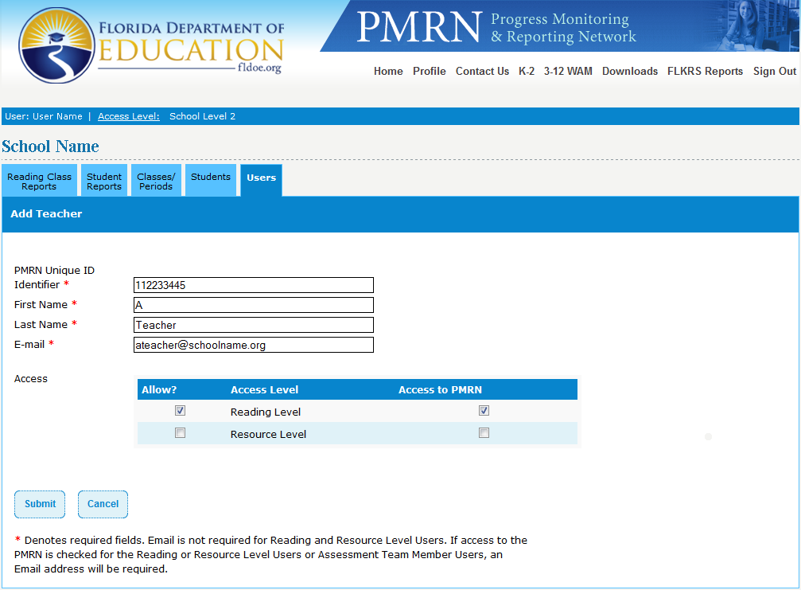
Activating Users
Notes:
Present slide.
Presenter: “Click Users tab.
Click on teacher’s name.
Enter teacher’s email.
In left column: Click boxes to allow access levels.
In right column: Click boxes to allow access to the PMRN.
Click Submit.”
Other Information
Allow Column: All users must have “Allow?” box(es) checked according to their designated level.
This allows teacher’s name to be associated with students.
Access to PMRN Column: Users who have “Access to PMRN” box checked can access reports.
Users who don’t have boxes checked cannot gain access to reports.

Slide 133

Adding Users
Click Add User
Notes:
Present slide.
Presenter: “Click Users tab and review list of users and access levels. If a user needs to be added, click Add User.”

Slide 134
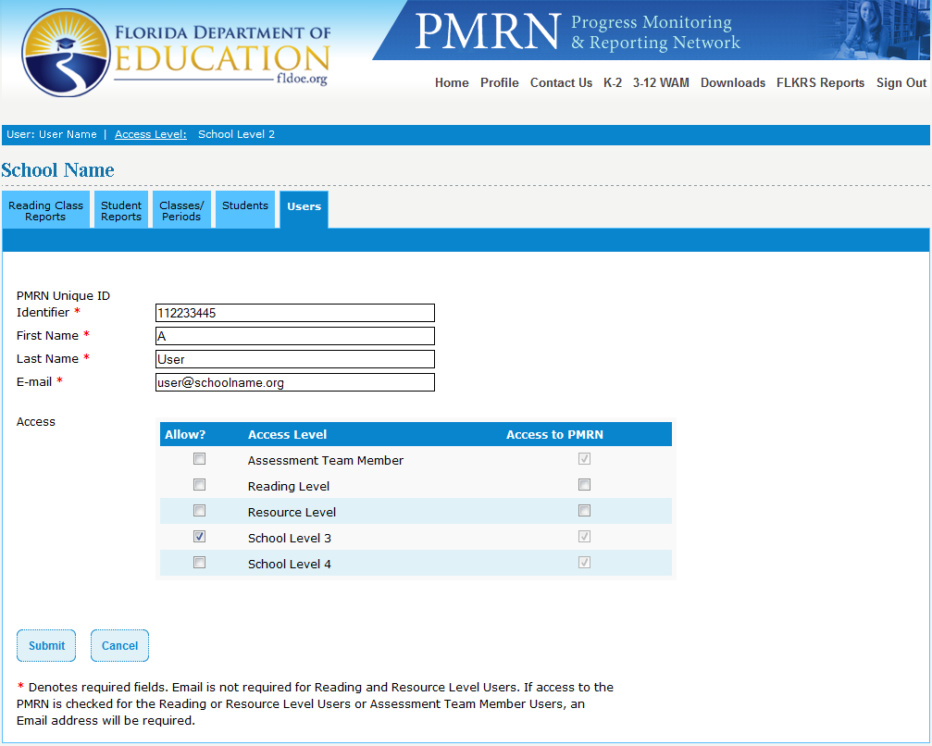
Adding Users
Complete the required information
Click Submit
Confirm information
Click
Continue
to complete
Notes:
Present slide.
Click for fly-in:
Presenter: “Complete the required information.”
Click for fly-in:
Presenter: “Click Submit. The next screen will ask you to confirm the information. After you have done that click continue to complete.”

Slide 135
Linking SSO User
Click Users tab
Verify that all users are SSO Users and are linked
If not linked, click teacher’s name
Notes:
Present slide.
Presenter: “After confirming a new user, look at the “SSO” and “Linked” columns. Both should say “yes”. If “NO” is in the Users “Linked” column, click on user’s name.

Slide 136
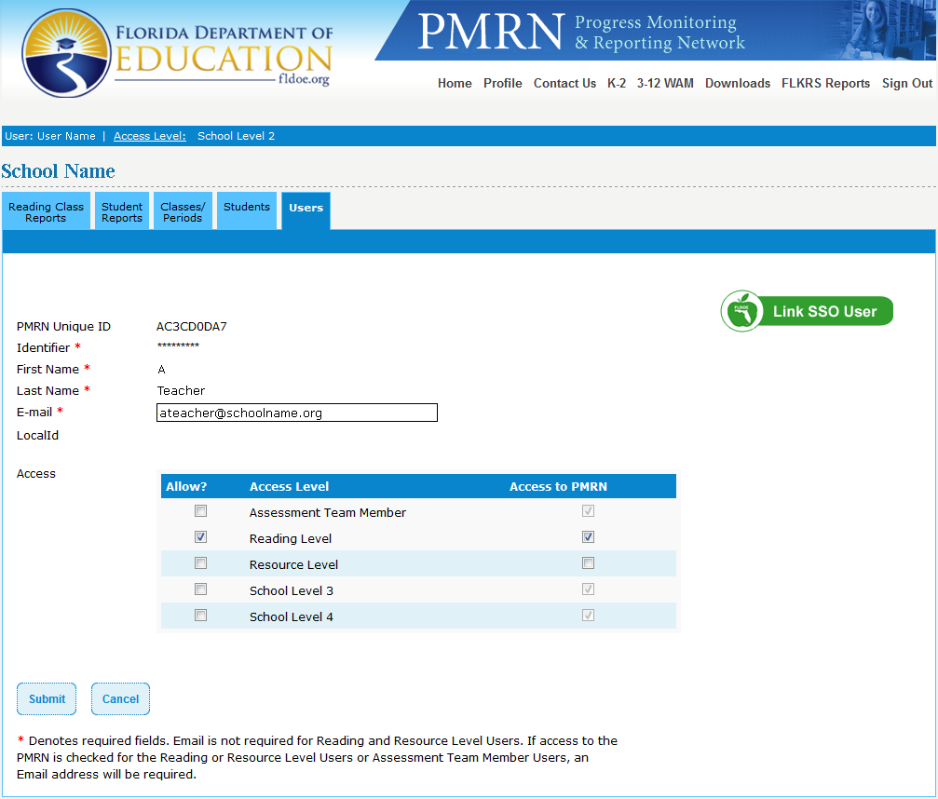
Linking SSO User
Click “Link SSO User”
Notes:
Present slide.

Slide 137

Linking SSO User
PMRN searches SSO file
If person not found, search via email address
When found,
click Link SSO
User
Notes:
Present slide.
Note: District Level 1 (DL1) and District Level 2 (DL2) Users will follow the same process to add and link DL2 and DL3 Users.

Slide 138

Removing Users
Uncheck the box(es)
in both columns
Click Submit
Notes:
Present slide.
Presenter: “Before a user can be removed, students must be reassigned to a new teacher.
Click Users tab.
Click the name of the User you want to remove.”
Present slide.

Slide 139

Removing Users
Confirm that this is the teacher to be removed and click Continue
Notes:
Present slide.
Additional Information
A teacher who has Progress Monitoring scores associated with him or her cannot be deleted from the list of this year’s teachers. Access to the reports should be removed, but the teacher’s name will still appear on the list of Users at the school.
Note: District Level 1 (DL1) and District Level 2 (DL2) Users will follow the same process to remove DL2 and DL3 Users.

Slide 140

Adding Classes
Click Classes/Periods tab
Click Add Class/Period button
Notes:
Present slide.
Additional Information
Periods can be used in a variety of ways. Periods can be used to group students by the time that they see the teacher, by students taught by a set of team teachers, or by ability levels. This is a great feature that allows you to group students in meaningful ways for instruction.

Slide 141

Adding Classes
Use drop-down menus to complete information.
Click Submit
Notes:
Present slide.
Presenter:
- Once the class has been added, students may be added or enrolled into the class.

Slide 142

Adding Students
Click: Classes/Periods tab
Click the name of
the class/period
in which you want
to add a student
Click Add
Student button
Notes:
Present slide.

Slide 143

Adding Students
Search for the student in the PMRN
- Type student’s Last Name OR
- Click Show All
button OR
- Click on the
First Letter of
the student’s
Last Name
Notes:
Presenter: “Begin at your Home Page and click the Classes/Periods tab.
Click the name of the class and period in which you want to add a student.”
Additional Information:
Within the PMRN, you must first search for a student before you put them in a class.
Beside each student’s name is an indicator of his or her current status at your school:
Shows this student is assigned to another class
Shows this student is already assigned to the class selected.
Shows the student can be added to this class.
To add one or more students to this class, click the box(es) in front of their name(s). Click Submit.
If this completes your additions, click Return To Class Roster. You will return to the Edit Class page. is enrolled at a grade level other than the one you selected

Slide 144

Adding Students
Click the box(es) in front of their name(s) of the student(s) to be added. Click Submit.
if you did not find your student, you may enroll your student
Notes:
Present slide.

Slide 145
Enrolling Students
Students may be enrolled in two different methods
  Enroll student directly into assigned class
  Enroll students into school (class not assigned)
Enroll student into assigned class
  Click Classes/Periods tab
  Click name of class
Notes:
Present slide.
Presenter:
Students that have not been added via the Survey 8 import may be enrolled into a school in the PMRN.
There a two (2) methods in which a student may be enrolled:
Students may be enrolled into the school
Students may be enrolled directly into their assigned class
A student may be enrolled directly into their assigned class by:
Clicking the Classes/Periods tab
Click the name of the class in which the student should be enrolled
Directions continued on next slide

Slide 146
Enrolling Students
  Click Enroll Student
Notes:
Present slide.
Presenter:
Click the Enroll Student button

Slide 147

Enrolling Students
  Search for the student
  If you are sure your student is not in the PMRN, click the radio button to the left of I want to enroll a new student
  Click Next
Notes:
Present slide.
Presenter:
Search for the student via his or her:
Identifier
OR
First Name, Last Name, and Birthdate
If you do not locate the student and are sure your student is not in the PMRN, click the radio button to the left of I want to enroll a new student.
Click the Next button
Directions continued on next slide

Slide 148

Enrolling Students
Enter student information
  Identifier
  First, Last Name
  Birthdate
  Gender
  Class Period
Click Add
Notes:
Present slide.
Presenter:
Enter the student’s information
Student Identifier
First Name
Middle Name (Not Required)
Last Name
Birthdate
Gender
Class Period
Click the Add button
The student will now be enrolled and added into his or her assigned class.

Slide 149

Enrolling Students
Click Students tab
Click Enroll a Student button
Search for student
Notes:
Present slide.
Presenter:
To Enroll a student via the Students tab
Click the Enroll a Student button
Directions continued on next slide

Slide 150
Enrolling Students
If you are sure your student is not in the PMRN, click the radio button to the left of I want to enroll a new student
Click Next
Note:
Student must
still be assigned
to a class
Notes:
Present slide.
Presenter: “On the next screen you will be asked to complete the student information. Click Add.”

Slide 151

Enrolling Students
Enter student information
  Identifier
  First, Last Name
  Birthdate
  Grade Level
  Gender
Click Add
Notes:
Present slide.
Presenter:
Enter the student’s information
Student Identifier
First Name
Middle Name (Not Required)
Last Name
Birthdate
Grade Level
Gender
Click the Add button
Note: Remember, this process will enroll a student into the school but will not add him or her to a class. The PMRN Manager must now add the student to his or her assigned class.

Slide 152

Assigning Classes
Notes:
Present slide.
Presenter:
A class may be re-assigned to a different teacher if the current teacher is re-assigned or is no longer in the school.
Note: A class may only be assigned to a teacher who does not already have a class at the same grade level assigned to them.
Click for fly-in:
Presenter: Click the Classes/Periods tab.”
Click for fly-in:
Presenter: “Click name of class for which you wish to assign teacher.”
Click for fly-in:
Presenter: “In the Period drop-down menu, select ALL.”
Click for fly-in:
Presenter: “Select new teacher from the “Change the teacher for this period” drop-down menu.”
Click for fly-in:
Presenter: “Click Submit.”
The class will now be assigned to the new teacher.

Slide 153
Removing Students
Notes:
Present slide.
Presenter:
A student may be removed from a class within the school in the PMRN.
Click for fly-in:
Presenter: “Click the Classes/Periods tab.”
Click for fly-in:
Presenter: “Click Remove Student.”

Slide 154

Removing Students
Notes:
Presenter: “Uncheck the student’s “In Class” box.
Click: Submit”
Additional Information:
Students can be removed from a class, but their information is still available within the school so they can be transferred to another class. Students can also be withdrawn from a school. Only School Level 1, 2, or 3 Users can remove students from a class or withdraw students from a school.

Slide 155

Deleting Classes
  Click Delete Class/Period next to the teacher’s name and period (option available only if no students are enrolled in class)
Notes:
Presenter: “Students must be reassigned to another class in the PMRN prior to deleting that class.
Click the Classes/Periods tab.”
Present slide.

Slide 156

Withdrawing Students
Notes:
Presenter: “Click Students tab.
From the drop-down menu, select either All Grades, or the student’s specific grade.
Click either the letter that is the first letter of the student’s Last Name OR type the student’s Last Name in the box.
Click Search.
Presenter: “Click on the box(es) next to the names of the students(s) you want to withdraw.
Click the Withdraw Selected Students button.
Click Continue.”
Additional Information:
Only a School Level 1, 2 , or 3 User can withdraw a student from school in the PMRN.
Note: If a student needs to be withdrawn and is “In Progress” with a task in the 3-12 WAM, a User will now be able to withdraw the student, even though the student has not completed testing. Please contact the Support Specialists of the PMRN Help Desk for assistance.
- When a list of students is retrieved, click the check box(es) that belong(s) to the students(s) you want to withdraw so that the check is not selected.
Click the Withdraw Selected Students button.

Slide 157
Topics Covered
PMRN Manager Sign In
PMRN Access Levels
Adding Users
  Removing Users
Adding Teachers
  Removing Teachers
Creating Classes
  Adding, Deleting, Assigning
Enrolling Students
  Enrolling, Adding, Removing, Withdrawing
Notes:
Present slide.
Presenter:
We have covered the following topics in this section:
PMRN Manager Sign In
PMRN Access Levels
Adding Users
Removing Users
Adding Teachers
Removing Teachers
Creating Classes
Adding, Deleting, Assigning
Enrolling Students
Enrolling, Adding, Removing, Withdrawing

Slide 158
Coach’s Log

Slide 159
What is the Coach’s Log?
Tool to improve reading program by guiding performance of Reading and Literacy Coaches
State Board Rule 6A-6.053 requires all Reading and Literacy Coaches to complete the Coach’s Log
Bi-weekly reporting on coaching activity occurs through the PMRN
Notes:
Presenter:
“As we transition from version 3 to version 4 of the PMRN all features of the coach’s log remain the same. The only difference is that is now hosted on the FLDOE website and can be accessed through the SSO portal.
What is the Coach’s Log?
The Professional Development Log for Reading/Literacy Coaches was designed to provide a guide of the most effective roles a coach can serve and guide their professional development in using their skills that most affect literacy instruction in a school. Reading and Literacy Coaches across the state are required to report on Coaching Activity on a bi-weekly basis.
When the principal registers a school at the beginning of the year, they will indicate if the school will utilize the bi-weekly Coach’s Log.
The State Board Rule can be accessed at http://www.justreadflorida.com/docs/6A-6-053.pdf
It states that:
(c) All reading/literacy coaches must report their time to the Progress Monitoring and Reporting Network (PMRN) on a biweekly basis. Principals will be required to log onto the PMRN prior to the start of each school year to enroll their reading/literacy coach(es). Principals must provide the funding source(s) for each coach at the beginning of the school year. Any reading/literacy coach who is funded through the Research-Based Reading Instruction Allocation in the Florida Education Finance Program (FEFP) as part of the K-12 Comprehensive Reading Plan must be a full-time coach. Reading/literacy coaches who split their time between two schools are considered full-time coaches.

Slide 160

Creating Coach’s Log User
Only a principal (SL1) User can create a Coach’s Log User
From the SL1 Home Page, click the Users tab
Click Add User
Fill in the information boxes
Click the Allow boxes for the Coach’s Log Access Level
Notes:
Present slide.

Slide 161

Creating Coach’s Log User
The principal must enter information specific to the Coach’s Log Access Level:
  Type the date of when the User became a Reading Coach. If the User was a Coach in a previous year, enter the 1st instructional day of the school year.
  Click the Full-Time or Part-Time radio button. If Part-Time is chosen, enter the percent of time the Reading Coach serves the school.
  Click the check boxes for the Coach’s “Funding Type” and enter the “Percent of Funding” in the boxes to the right
  Click Submit
Notes:
Present slide.

Slide 162

Creating Coach’s Log User
Linking the Coach’s Log User
From the SL1 Home Page, click the Users tab
Click the User’s name
Click the Link SSO User button
Notes:
Presenter:
“The SSO Component of Adding User (if new User) requires the following. . .”
Present slide.

Slide 163

Creating Coach’s Log User
Search via Identifier, Last Name, or E-mail address
Click the radio button
Click the Link SSO User button
Notes:
Presenter:
“The next steps in the SSO Component of Adding User (if new User) are. . .”
Present slide.

Slide 164
Accessing the Coach’s Log Form
Upon Signing In for the first time each year, the Coach will be required to fill out his/her Professional Information and Submit the form before he/she can continue to the Log
  View and Edit Professional Information button at the top of the Coach’s Log Form allows for subsequent edits
Coaches who serve multiple schools will need to be added as a User and complete a Coach’s Log at each school
Notes:
Presenter:
“Once the Coach’s Log User has been added, he/she may Sign In to the PMRN, select Coach’s Log access level, and enter hours into the Coach’s Log form.
Upon Signing In for the first time each year, the Coach will be required to fill out his/her Professional Information and Submit the form before he/she can continue to the Log.
The Professional Information can be edited in subsequent sessions by clicking the “View and Edit Professional Information” button that appears at the top of the Coach’s Log Form.
Coaches who serve multiple schools will need to be added as a User and fill out a Coach’s Log at each school.”

Slide 165

Coach’s Log Professional Information Page
Notes:
Present slide.

Slide 166
Coach’s Log Form
16 task areas for categorizing time
  4 task areas involve teacher selection:
  12 task areas cover a wide variety of data collection and discussion
The Teacher Selection Table is populated by the upload of Survey 8
Selections are only visible on the Coach’s Log Form- they are not displayed on the report
  The teachers displayed can be edited by clicking the “Edit Teachers” button within any of the task areas above
Notes:
Presenter:
“There are 16 task areas to assist Coaches in categorizing time and in making decisions on how to best use time to improve student performance in reading. Select task areas provide for even more detailed recording by allowing the selection of a teacher (or teachers).
The following 4 task areas allow for teacher selection: Small Group Professional Development, Modeling Lessons, Coaching, Coach-Teacher Conferences and Conversations
The Teacher Selection Table is populated by the upload of Survey 8
Selections are only visible on the Coach’s Log Form- they are not displayed on the report
The teachers displayed can be edited by clicking the “Edit Teachers” button within any of the task areas above
The remaining 12 task areas do not incorporate teacher selection: Whole Faculty Professional Development, Planning, Student Assessment, Data Reporting, Data Analysis, Meetings, Knowledge Building, Managing Reading Materials, Other, Successes, Concerns, and Hours Outside the Contracted Day.”

Slide 167

Coach’s Log Form
Notes:
Present slide.

Slide 168
Coach’s Log Form
Narratives
  Narratives for task areas 13-16
    Reports = biweekly reporting period
    Can be viewed by principal’s only
Coaches may report up to 9 hours a day, 45 hours a week, and 90 hours for the bi-weekly reporting period.
Saving vs. submitting
  a saved log can be edited
  A Submitted Log has been officially submitted to the PMRN and must be unlocked by a Support Specialist for editing
Notes:
Presenter:
“Narratives
Coaches can enter narratives in task areas 13-16 (Other, Successes, Concerns, Hours Outside the Contracted Day).
These narratives are viewable within the Coach’s Log form or on the Coach’s Log Report
The Coach’s Log Report shows the hours submitted for each submitted reporting period
The principal (School Level 1 User) can also view a Coach’s Log Report and toggle between each Coach at the school
Coaches may report up to 9 hours a day, 45 hours a week, and 90 hours for the bi-weekly reporting period. These hours can be distributed across all task areas of the Coach’s Log.
The hours in the Coach’s Log can be Saved or Submitted
The Coach can edit a Saved Log
A Submitted Log has been officially submitted to the PMRN and must be unlocked by a Support Specialist in order for editing to occur.”

Slide 169

Coach’s Log Form
Notes:
Present slide.

Slide 170
Automated E-mails
If a Log has not yet been Submitted
  “Coach’s Log Submission Reminder”
  “Coach’s Log Submission- Final Reminder”
  “School Level 1 Coach’s Log E-mail”
Notes:
Presenter:
“E-mails associated with the Coach’s Log
- If a Log has not yet been Submitted
The “Coach’s Log Submission Reminder” is sent to the Coach’s Log User on the Thursday before the end of the Reporting Period.
The “Coach’s Log Submission- Final Reminder” is sent to the Coach’s Log User the Monday before the end of the Reporting Period.
The “School Level 1 Coach’s Log E-mail” is sent to the principal. This E-mail reports to the principal who and who has not submitted the log for the most recent reporting period and the number of hours reported.”

Slide 171
Session Topics
Assessment and the FAIR-FS: An Overview
Development of the FAIR-FS
System Specifications
PMRN Overview
Single Sign-On
Principal’s Role
PMRN Manager’s Role
Coach’s Log
Notes:
Present slide.

Slide 172
Questions

Slide 173
For More Information
Curriculum questions: Contact your district reading office
  Content and policy questions: Contact Just Read, Florida! at 850-245-0503 http://www.justreadflorida.com/
Technical questions: Call Florida Department of Education (FLDOE) Integrated Education Network Service Center 855-814-2876 ienhelp@fldoe.org
Notes:
Present slide.

